Slide 1
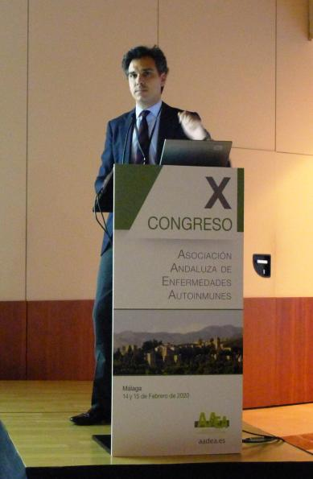
FÁRMACOS BIOLÓGICOS
ORIGINALES VS BIOSIMILARES.
Dr. Alejandro Muñoz Jiménez.
Reumatología | H. U. Virgen del Rocío| Sevilla
Prof. Asoc. de la Facultad de Medicina | Universidad de Sevilla

Slide 2
¿Qué es un medicamento biológico?
Característica | Fármacos tradicionales | Fármacos biológicos
Tamaño, estructura | Generalmente se trata de moléculas PEQUEÑAS, con una estructura simple | Moléculas de GRAN TAMAÑO con múltiples estructuras y modificaciones postraduccionales
Formas | Una forma, homogénea | HETEROGÉNEA, múltiples isoformas
Inmunogenicidad | Por lo general, no generan inmunogenicidad | Pueden generar INMUNOGENICIDAD
Estabilidad | Por lo general, son estables y predecibles | Pueden ser sensibles a las CONDICIONES FÍSICAS (p. ej., pH, temperatura)
HETEROGENEIDAD
Notes:
References:
1. Kozlowski S, et al. N Engl J Med 2011;365:385-8;
2. Abraham J. Semin Oncol 2013;40(Suppi1):S5-S24;
3. European Generics Medicines Association (EGA) Biosimilar Medicines Handbook. 2016 [online]. Available at: http://www.medicinesforeurope.com/wp-content/uploads/2016/04/BIOSIMILAR-MEDICINES-HANDBOOK_INT_web_links2.pdf
[Accessed March 2018]

Slide 3



Retos que plantean los medicamentos biológicos
Hasta un 45 % de los médicos alemanes consideran que el precio de los fármacos biológicos es un obstáculo importante o muy importante a la hora de recetarlos para tratar la psoriasis de moderada a grave¹
Investigadores del Reino Unido notificaron que, entre el año 2000 y el año 2014, el precio promedio de un ciclo de tratamiento con un nuevo fármaco anticanceroso aumentó casi un 450 %²
La capacidad de acceder a nuevos medicamentos contra el cáncer en Europa depende del país en el que vivan los pacientes³
References:
1. Nast A, et al. Arch Dermatol Res 2013;305:899 907;
2. Savage P, Mahmoud S. Br J Cancer 2015;17;112:1037-41;
3. Swedish lnstitute for Health Economics (IHE). Access to high-quality oncology care across Europe. Report 2014:2. Available at: http://portal.research.lu.se/portal/files/29186857/IHE_Report_2014_2.pdf
Notes:
References:
1. Nast A, et al. Arch Dermatol Res 2013;305:899 907;
2. Savage P, Mahmoud S. Br J Cancer 2015;17;112:1037-41;
3. Swedish lnstitute for Health Economics (IHE). Access to high-quality oncology care across Europe. Report 2014:2. Available at: http://portal.research.lu.se/portal/files/29186857/IHE_Report_2014_2.pdf
[Accessed March 2018];
4. Putrik P, et al. Ann Rheum Dis 2014;73:2010-21;
5. Putrik P, et al. Ann Rheum Dis 20114;73:198-206;
6. Ecker OM, et al., mAbs 2015; 7:9-14

Slide 4


Retos que plantean los medicamentos biológicos
El 22 % de los países europeos NO FACILITA EL ACCESO a medicamentos biológicos para el tratamiento de la ARTRITIS REUMATOIDE.
10 países de la UE NO SUBVENCIONAN ningún tipo de medicamento biológico para el tratamiento de la ARTRITIS REUMAATOIDE^{4.}
El PRECIO DE UN AÑO DE TRATAMIENTO de la artritis reumatoide (AR) con un fármaco biológico es superior al producto interior bruto per cápita (PIB) de 26 países europeos⁵
References:
4. Putrik P, et al. Ann Rheum Dis 2014;73:2010-21;
5. Putrik P, et al. Ann Rheum Dis 20114;73:198-206;
6. Ecker OM, et al., mAbs 2015; 7:9-14
Notes:
References:
1. Nast A, et al. Arch Dermatol Res 2013;305:899 907;
2. Savage P, Mahmoud S. Br J Cancer 2015;17;112:1037-41;
3. Swedish lnstitute for Health Economics (IHE). Access to high-quality oncology care across Europe. Report 2014:2. Available at: http://portal.research.lu.se/portal/files/29186857/IHE_Report_2014_2.pdf
[Accessed March 2018];
4. Putrik P, et al. Ann Rheum Dis 2014;73:2010-21;
5. Putrik P, et al. Ann Rheum Dis 20114;73:198-206;
6. Ecker OM, et al., mAbs 2015; 7:9-14

Slide 5

Retos que plantean los medicamentos biológicos
No obstante, el uso de esta clase de productos biofarmacéuticos ha experimentado un aumento significativo.
Se aprueban 4 productos nuevos cada año.
El volumen total de ventas a nivel mundial asciende a 125 000 millones de dólares⁶
References:
4. Putrik P, et al. Ann Rheum Dis 2014;73:2010-21;
5. Putrik P, et al. Ann Rheum Dis 20114;73:198-206;
6. Ecker OM, et al., mAbs 2015; 7:9-14
Notes:
References:
1. Nast A, et al. Arch Dermatol Res 2013;305:899 907;
2. Savage P, Mahmoud S. Br J Cancer 2015;17;112:1037-41;
3. Swedish lnstitute for Health Economics (IHE). Access to high-quality oncology care across Europe. Report 2014:2. Available at: http://portal.research.lu.se/portal/files/29186857/IHE_Report_2014_2.pdf
[Accessed March 2018];
4. Putrik P, et al. Ann Rheum Dis 2014;73:2010-21;
5. Putrik P, et al. Ann Rheum Dis 20114;73:198-206;
6. Ecker OM, et al., mAbs 2015; 7:9-14

Slide 6



¿Qué es un biosimilar?
EMA¹
FDA^{2,3}
References:
1. European Medicines Agency (EMA). Guideline on similar biological medicinal products (CHMP/437/04 Rev 1). 2014 [online]. Available at: http:/ /www.ema.europa.eu/docs/en GB/document library/Scientific_guideline/2014/10/WC500176768.pdf [Accessed March 2018];
2. US Food and Drug Administration (FDA). Scientific Considerations. 28 Apr 2015. Available at: https://www.fda.gov/downloads/Drugs
3. FDA. Quality Considerations. 28 Apr 2015. Available at https:/www.fda.gov/downloads/Drugs/GuidaneceComplianceRegulatorylnformation/Guidances/UCM291134.pdf [Accessed March 2018].
.
Notes:
References:
1. European Medicines Agency (EMA). Guideline on similar biological medicinal products (CHMP/437/04 Rev 1). 2014 [online]. Available at: http:/ /www.ema.europa.eu/docs/en GB/document library/Scientific_guideline/2014/10/WC500176768.pdf [Accessed March 2018];
2. US Food and Drug Administration (FDA). Scientific Considerations. 28 Apr 2015. Available at: https://www.fda.gov/downloads/Drugs/
GuidanceComplianceRegulatorylnformation/Guidances/UCM291128.pdf [Accessed March 2018];
3. FDA. Quality Considerations. 28 Apr 2015. Available at https:/www.fda.gov/downloads/Drugs/GuidaneceComplianceRegulatorylnformation/Guidances/UCM291134.pdf [Accessed March 2018].

Slide 7
¿Qué es un biosimilar?
EMA¹
Un biosimilar es un medicamento biológico que contiene una versión del principio activo del primer producto biológico original autorizado (medicamento de referencia/especialidad farmacéutica original)
Es necesario establecer la similitud con el medicamento de referencia en términos de calidad, actividad biológica, seguridad y eficacia mediante un exhaustivo proceso de comparación
Un biosimilar debe ser muy similar al medicamento de referencia, tanto en sus características fisicoquímicas como biológicas
FDA^{2,3}
References:
1. European Medicines Agency (EMA). Guideline on similar biological medicinal products (CHMP/437/04 Rev 1). 2014 [online]. Available at: http:/ /www.ema.europa.eu/docs/en GB/document library/Scientific_guideline/2014/10/WC500176768.pdf [Accessed March 2018];
2. US Food and Drug Administration (FDA). Scientific Considerations. 28 Apr 2015. Available at: https://www.fda.gov/downloads/Drugs
3. FDA. Quality Considerations. 28 Apr 2015. Available at https:/www.fda.gov/downloads/Drugs/GuidaneceComplianceRegulatorylnformation/Guidances/UCM291134.pdf [Accessed March 2018].
.
Notes:
References:
1. European Medicines Agency (EMA). Guideline on similar biological medicinal products (CHMP/437/04 Rev 1). 2014 [online]. Available at: http:/ /www.ema.europa.eu/docs/en GB/document library/Scientific_guideline/2014/10/WC500176768.pdf [Accessed March 2018];
2. US Food and Drug Administration (FDA). Scientific Considerations. 28 Apr 2015. Available at: https://www.fda.gov/downloads/Drugs/
GuidanceComplianceRegulatorylnformation/Guidances/UCM291128.pdf [Accessed March 2018];
3. FDA. Quality Considerations. 28 Apr 2015. Available at https:/www.fda.gov/downloads/Drugs/GuidaneceComplianceRegulatorylnformation/Guidances/UCM291134.pdf [Accessed March 2018].

Slide 8
¿Qué es un biosimilar?
EMA¹
Un biosimilar es un medicamento biológico que contiene una versión del principio activo del primer producto biológico original autorizado (medicamento de referencia/especialidad farmacéutica original)
Es necesario establecer la similitud con el medicamento de referencia en términos de calidad, actividad biológica, seguridad y eficacia mediante un exhaustivo proceso de comparación
Un biosimilar debe ser muy similar al medicamento de referencia, tanto en sus características fisicoquímicas como biológicas
FDA^{2,3}
References:
1. European Medicines Agency (EMA). Guideline on similar biological medicinal products (CHMP/437/04 Rev 1). 2014 [online]. Available at: http:/ /www.ema.europa.eu/docs/en GB/document library/Scientific_guideline/2014/10/WC500176768.pdf [Accessed March 2018];
2. US Food and Drug Administration (FDA). Scientific Considerations. 28 Apr 2015. Available at: https://www.fda.gov/downloads/Drugs
3. FDA. Quality Considerations. 28 Apr 2015. Available at https:/www.fda.gov/downloads/Drugs/GuidaneceComplianceRegulatorylnformation/Guidances/UCM291134.pdf [Accessed March 2018].
.
Notes:
References:
1. European Medicines Agency (EMA). Guideline on similar biological medicinal products (CHMP/437/04 Rev 1). 2014 [online]. Available at: http:/ /www.ema.europa.eu/docs/en GB/document library/Scientific_guideline/2014/10/WC500176768.pdf [Accessed March 2018];
2. US Food and Drug Administration (FDA). Scientific Considerations. 28 Apr 2015. Available at: https://www.fda.gov/downloads/Drugs/
GuidanceComplianceRegulatorylnformation/Guidances/UCM291128.pdf [Accessed March 2018];
3. FDA. Quality Considerations. 28 Apr 2015. Available at https:/www.fda.gov/downloads/Drugs/GuidaneceComplianceRegulatorylnformation/Guidances/UCM291134.pdf [Accessed March 2018].

Slide 9
¿Qué es un biosimilar?
FDA^{2,3}
Los biosimilares son un tipo de producto biológico muy similar a un producto biológico de referencia ya aprobado
No deben existir diferencias clínicamente significativas entre el biosimilar y el medicamento de referencia en cuanto a su seguridad, pureza y potencia
Se tolera la existencia de pequeñas diferencias en los componentes clínicamente inactivos
EMA¹
References:
1. European Medicines Agency (EMA). Guideline on similar biological medicinal products (CHMP/437/04 Rev 1). 2014 [online]. Available at: http:/ /www.ema.europa.eu/docs/en GB/document library/Scientific_guideline/2014/10/WC500176768.pdf [Accessed March 2018];
2. US Food and Drug Administration (FDA). Scientific Considerations. 28 Apr 2015. Available at: https://www.fda.gov/downloads/Drugs
3. FDA. Quality Considerations. 28 Apr 2015. Available at https:/www.fda.gov/downloads/Drugs/GuidaneceComplianceRegulatorylnformation/Guidances/UCM291134.pdf [Accessed March 2018].
.
Notes:
References:
1. European Medicines Agency (EMA). Guideline on similar biological medicinal products (CHMP/437/04 Rev 1). 2014 [online]. Available at: http:/ /www.ema.europa.eu/docs/en GB/document library/Scientific_guideline/2014/10/WC500176768.pdf [Accessed March 2018];
2. US Food and Drug Administration (FDA). Scientific Considerations. 28 Apr 2015. Available at: https://www.fda.gov/downloads/Drugs/
GuidanceComplianceRegulatorylnformation/Guidances/UCM291128.pdf [Accessed March 2018];
3. FDA. Quality Considerations. 28 Apr 2015. Available at https:/www.fda.gov/downloads/Drugs/GuidaneceComplianceRegulatorylnformation/Guidances/UCM291134.pdf [Accessed March 2018].

Slide 10
¿Qué es un biosimilar?
FDA^{2,3}
Los biosimilares son un tipo de producto biológico muy similar a un producto biológico de referencia ya aprobado
No deben existir diferencias clínicamente significativas entre el biosimilar y el medicamento de referencia en cuanto a su seguridad, pureza y potencia
Se tolera la existencia de pequeñas diferencias en los componentes clínicamente inactivos
EMA¹
References:
1. European Medicines Agency (EMA). Guideline on similar biological medicinal products (CHMP/437/04 Rev 1). 2014 [online]. Available at: http:/ /www.ema.europa.eu/docs/en GB/document library/Scientific_guideline/2014/10/WC500176768.pdf [Accessed March 2018];
2. US Food and Drug Administration (FDA). Scientific Considerations. 28 Apr 2015. Available at: https://www.fda.gov/downloads/Drugs
3. FDA. Quality Considerations. 28 Apr 2015. Available at https:/www.fda.gov/downloads/Drugs/GuidaneceComplianceRegulatorylnformation/Guidances/UCM291134.pdf [Accessed March 2018].
.
Notes:
References:
1. European Medicines Agency (EMA). Guideline on similar biological medicinal products (CHMP/437/04 Rev 1). 2014 [online]. Available at: http:/ /www.ema.europa.eu/docs/en GB/document library/Scientific_guideline/2014/10/WC500176768.pdf [Accessed March 2018];
2. US Food and Drug Administration (FDA). Scientific Considerations. 28 Apr 2015. Available at: https://www.fda.gov/downloads/Drugs/
GuidanceComplianceRegulatorylnformation/Guidances/UCM291128.pdf [Accessed March 2018];
3. FDA. Quality Considerations. 28 Apr 2015. Available at https:/www.fda.gov/downloads/Drugs/GuidaneceComplianceRegulatorylnformation/Guidances/UCM291134.pdf [Accessed March 2018].

Slide 11

Directrices europeas sobre los biosimilares
Directiva general 9CHMP/437/04)
Directrices sobre Medicamentos Biológicos Similares
Revisadas
2014
Revisadas
2015
Directrices clínicas/no clínicas
Revisadas
2014
Directrices en materia de calidad
Biosimilares en la UE: Guía para profesionales sanitarios
2017
2006
2006
2006
2006
2009
2010
2012
2013
2013
Insulina
Revisado en 2015
Somatropina
G-CSF
Revisión en curso
Epoetina
Revisado en 2010
Interferón-⍺
Revisión en curso
LMWH
Revisado en 2016
mAbs
Interferón-Β
Folitropina
References:
EMA. CHMP/437/04. 30 Oct 2005. Available at: http://www.ema.europa.eu/docs/en_GB/document_library/Scientific_guideline/2014/10/WC500176768.pdf [Accessed March 2018]
EMA. Biosimilars in the EU. 2017. Available at: http://www.ema.europa.eu/docs/en_GB/document library/Leaflet/2017/05/WC500226648.pdf
[Accessed May 2018].
Notes:
References:
EMA. CHMP/437/04. 30 Oct 2005. Available at: http://www.ema.europa.eu/docs/en_GB/document_library/Scientific_guideline/2014/10/WC500176768.pdf [Accessed March 2018]
EMA. Biosimilars in the EU. 2017. Available at: http://www.ema.europa.eu/docs/en_GB/document library/Leaflet/2017/05/WC500226648.pdf
[Accessed May 2018]

Slide 12
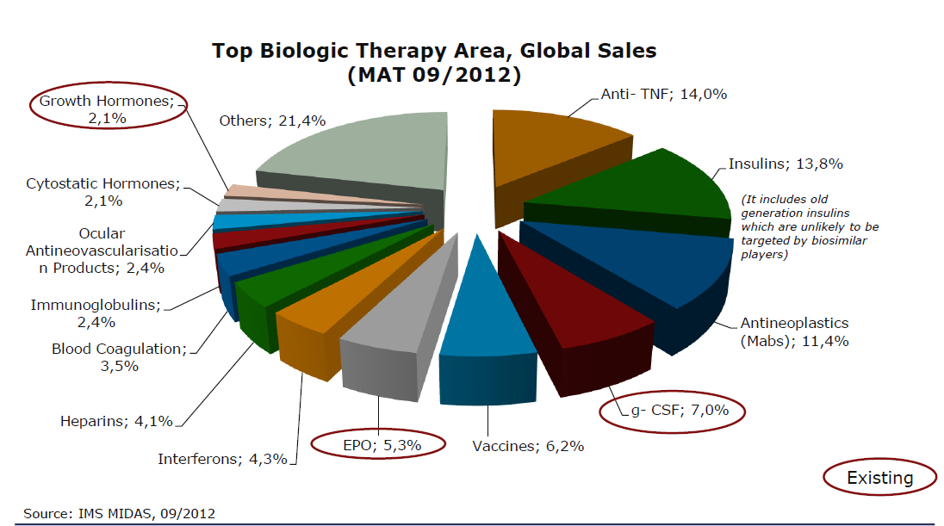


Slide 13
Desarrollo y aprobación de biosimilares en Europa
2004
2005
2006
2007
2008
2009
2010-12
2013
2014
2015
2016
2017/18
Se establece la BASE JURÍDICA PARA LA REGULACIÓN DE LOS BIOSIMILARES en la Directiva 2001/83/CE de la UE, en su versión modificada (2004/27/CE)
References:
1. EMA. CHMP/437/04. 30 Oct 2005. Available at: http://www.ema.europa.eu/docs/en_GB/document_library/Scientific_guideline/2009/09/WC500003517.pdf [Accessed March 2018];
2. The Center for Biosimilars. A new IOVIA report predicts key role of biosimilars in developed markets in the coming years. Mar 2018. Available at: https://www.cindyci.com/download_news_pdf.php?_id=3754; [Accessed March 2018];
3. EMA. Find medicine. Available at: http://www.ema.europa.eu/ema/index.jsp?curl=pages/includes/medicines/medicines_landing_page.jsp.
Notes:
References:
1. EMA. CHMP/437/04. 30 Oct 2005. Available at: http://www.ema.europa.eu/docs/en_GB/document_library/Scientific_guideline/2009/09/WC500003517.pdf [Accessed March 2018];
2. The Center for Biosimilars. A new IOVIA report predicts key role of biosimilars in developed markets in the coming years. Mar 2018. Available at: https://www.cindyci.com/download_news_pdf.php?_id=3754; [Accessed March 2018];
3. EMA. Find medicine. Available at: http://www.ema.europa.eu/ema/index.jsp?curl=pages/includes/medicines/medicines_landing_page.jsp.

Slide 14
Desarrollo y aprobación de biosimilares en Europa
2004
2005
2006
2007
2008
2009
2010-12
2013
2014
2015
2016
2017/18
Publicación de la primera
Directiva sobre similares
CHMP/437/041
References:
1. EMA. CHMP/437/04. 30 Oct 2005. Available at: http://www.ema.europa.eu/docs/en_GB/document_library/Scientific_guideline/2009/09/WC500003517.pdf [Accessed March 2018];
2. The Center for Biosimilars. A new IOVIA report predicts key role of biosimilars in developed markets in the coming years. Mar 2018. Available at: https://www.cindyci.com/download_news_pdf.php?_id=3754; [Accessed March 2018];
3. EMA. Find medicine. Available at: http://www.ema.europa.eu/ema/index.jsp?curl=pages/includes/medicines/medicines_landing_page.jsp.
Notes:
References:
1. EMA. CHMP/437/04. 30 Oct 2005. Available at: http://www.ema.europa.eu/docs/en_GB/document_library/Scientific_guideline/2009/09/WC500003517.pdf [Accessed March 2018];
2. The Center for Biosimilars. A new IOVIA report predicts key role of biosimilars in developed markets in the coming years. Mar 2018. Available at: https://www.cindyci.com/download_news_pdf.php?_id=3754; [Accessed March 2018];
3. EMA. Find medicine. Available at: http://www.ema.europa.eu/ema/index.jsp?curl=pages/includes/medicines/medicines_landing_page.jsp.

Slide 15
Desarrollo y aprobación de biosimilares en Europa
2004
2005
2006
2007
2008
2009
2010-12
2013
2014
2015
2016
2017/18
Somatropina
References:
1. EMA. CHMP/437/04. 30 Oct 2005. Available at: http://www.ema.europa.eu/docs/en_GB/document_library/Scientific_guideline/2009/09/WC500003517.pdf [Accessed March 2018];
2. The Center for Biosimilars. A new IOVIA report predicts key role of biosimilars in developed markets in the coming years. Mar 2018. Available at: https://www.cindyci.com/download_news_pdf.php?_id=3754; [Accessed March 2018];
3. EMA. Find medicine. Available at: http://www.ema.europa.eu/ema/index.jsp?curl=pages/includes/medicines/medicines_landing_page.jsp.
Notes:
References:
1. EMA. CHMP/437/04. 30 Oct 2005. Available at: http://www.ema.europa.eu/docs/en_GB/document_library/Scientific_guideline/2009/09/WC500003517.pdf [Accessed March 2018];
2. The Center for Biosimilars. A new IOVIA report predicts key role of biosimilars in developed markets in the coming years. Mar 2018. Available at: https://www.cindyci.com/download_news_pdf.php?_id=3754; [Accessed March 2018];
3. EMA. Find medicine. Available at: http://www.ema.europa.eu/ema/index.jsp?curl=pages/includes/medicines/medicines_landing_page.jsp.

Slide 16
Desarrollo y aprobación de biosimilares en Europa
2004
2005
2006
2007
2008
2009
2010-12
2013
2014
2015
2016
2017/18
Epoetina
References:
1. EMA. CHMP/437/04. 30 Oct 2005. Available at: http://www.ema.europa.eu/docs/en_GB/document_library/Scientific_guideline/2009/09/WC500003517.pdf [Accessed March 2018];
2. The Center for Biosimilars. A new IOVIA report predicts key role of biosimilars in developed markets in the coming years. Mar 2018. Available at: https://www.cindyci.com/download_news_pdf.php?_id=3754; [Accessed March 2018];
3. EMA. Find medicine. Available at: http://www.ema.europa.eu/ema/index.jsp?curl=pages/includes/medicines/medicines_landing_page.jsp.
Notes:
References:
1. EMA. CHMP/437/04. 30 Oct 2005. Available at: http://www.ema.europa.eu/docs/en_GB/document_library/Scientific_guideline/2009/09/WC500003517.pdf [Accessed March 2018];
2. The Center for Biosimilars. A new IOVIA report predicts key role of biosimilars in developed markets in the coming years. Mar 2018. Available at: https://www.cindyci.com/download_news_pdf.php?_id=3754; [Accessed March 2018];
3. EMA. Find medicine. Available at: http://www.ema.europa.eu/ema/index.jsp?curl=pages/includes/medicines/medicines_landing_page.jsp.

Slide 17
Desarrollo y aprobación de biosimilares en Europa
2004
2005
2006
2007
2008
2009
2010-12
2013
2014
2015
2016
2017/18
Filgrastim
References:
1. EMA. CHMP/437/04. 30 Oct 2005. Available at: http://www.ema.europa.eu/docs/en_GB/document_library/Scientific_guideline/2009/09/WC500003517.pdf [Accessed March 2018];
2. The Center for Biosimilars. A new IOVIA report predicts key role of biosimilars in developed markets in the coming years. Mar 2018. Available at: https://www.cindyci.com/download_news_pdf.php?_id=3754; [Accessed March 2018];
3. EMA. Find medicine. Available at: http://www.ema.europa.eu/ema/index.jsp?curl=pages/includes/medicines/medicines_landing_page.jsp.
Notes:
References:
1. EMA. CHMP/437/04. 30 Oct 2005. Available at: http://www.ema.europa.eu/docs/en_GB/document_library/Scientific_guideline/2009/09/WC500003517.pdf [Accessed March 2018];
2. The Center for Biosimilars. A new IOVIA report predicts key role of biosimilars in developed markets in the coming years. Mar 2018. Available at: https://www.cindyci.com/download_news_pdf.php?_id=3754; [Accessed March 2018];
3. EMA. Find medicine. Available at: http://www.ema.europa.eu/ema/index.jsp?curl=pages/includes/medicines/medicines_landing_page.jsp.

Slide 18
Desarrollo y aprobación de biosimilares en Europa
2004
2005
2006
2007
2008
2009
2010-12
2013
2014
2015
2016
2017/18
Infliximab
Folitropina-⍺
References:
1. EMA. CHMP/437/04. 30 Oct 2005. Available at: http://www.ema.europa.eu/docs/en_GB/document_library/Scientific_guideline/2009/09/WC500003517.pdf [Accessed March 2018];
2. The Center for Biosimilars. A new IOVIA report predicts key role of biosimilars in developed markets in the coming years. Mar 2018. Available at: https://www.cindyci.com/download_news_pdf.php?_id=3754; [Accessed March 2018];
3. EMA. Find medicine. Available at: http://www.ema.europa.eu/ema/index.jsp?curl=pages/includes/medicines/medicines_landing_page.jsp.
Notes:
References:
1. EMA. CHMP/437/04. 30 Oct 2005. Available at: http://www.ema.europa.eu/docs/en_GB/document_library/Scientific_guideline/2009/09/WC500003517.pdf [Accessed March 2018];
2. The Center for Biosimilars. A new IOVIA report predicts key role of biosimilars in developed markets in the coming years. Mar 2018. Available at: https://www.cindyci.com/download_news_pdf.php?_id=3754; [Accessed March 2018];
3. EMA. Find medicine. Available at: http://www.ema.europa.eu/ema/index.jsp?curl=pages/includes/medicines/medicines_landing_page.jsp.

Slide 19
Desarrollo y aprobación de biosimilares en Europa
2004
2005
2006
2007
2008
2009
2010-12
2013
2014
2015
2016
2017/18
Insulina
References:
1. EMA. CHMP/437/04. 30 Oct 2005. Available at: http://www.ema.europa.eu/docs/en_GB/document_library/Scientific_guideline/2009/09/WC500003517.pdf [Accessed March 2018];
2. The Center for Biosimilars. A new IOVIA report predicts key role of biosimilars in developed markets in the coming years. Mar 2018. Available at: https://www.cindyci.com/download_news_pdf.php?_id=3754; [Accessed March 2018];
3. EMA. Find medicine. Available at: http://www.ema.europa.eu/ema/index.jsp?curl=pages/includes/medicines/medicines_landing_page.jsp.
Notes:
References:
1. EMA. CHMP/437/04. 30 Oct 2005. Available at: http://www.ema.europa.eu/docs/en_GB/document_library/Scientific_guideline/2009/09/WC500003517.pdf [Accessed March 2018];
2. The Center for Biosimilars. A new IOVIA report predicts key role of biosimilars in developed markets in the coming years. Mar 2018. Available at: https://www.cindyci.com/download_news_pdf.php?_id=3754; [Accessed March 2018];
3. EMA. Find medicine. Available at: http://www.ema.europa.eu/ema/index.jsp?curl=pages/includes/medicines/medicines_landing_page.jsp.

Slide 20
Desarrollo y aprobación de biosimilares en Europa
2004
2005
2006
2007
2008
2009
2010-12
2013
2014
2015
2016
2017/18
Etanercept
References:
1. EMA. CHMP/437/04. 30 Oct 2005. Available at: http://www.ema.europa.eu/docs/en_GB/document_library/Scientific_guideline/2009/09/WC500003517.pdf [Accessed March 2018];
2. The Center for Biosimilars. A new IOVIA report predicts key role of biosimilars in developed markets in the coming years. Mar 2018. Available at: https://www.cindyci.com/download_news_pdf.php?_id=3754; [Accessed March 2018];
3. EMA. Find medicine. Available at: http://www.ema.europa.eu/ema/index.jsp?curl=pages/includes/medicines/medicines_landing_page.jsp.
Notes:
References:
1. EMA. CHMP/437/04. 30 Oct 2005. Available at: http://www.ema.europa.eu/docs/en_GB/document_library/Scientific_guideline/2009/09/WC500003517.pdf [Accessed March 2018];
2. The Center for Biosimilars. A new IOVIA report predicts key role of biosimilars in developed markets in the coming years. Mar 2018. Available at: https://www.cindyci.com/download_news_pdf.php?_id=3754; [Accessed March 2018];
3. EMA. Find medicine. Available at: http://www.ema.europa.eu/ema/index.jsp?curl=pages/includes/medicines/medicines_landing_page.jsp.

Slide 21
Desarrollo y aprobación de biosimilares en Europa
2004
2005
2006
2007
2008
2009
2010-12
2013
2014
2015
2016
2017/18
Rituximab
Adalimumab
Teriparatida
Insulina lispro
Insulina glargina
References:
1. EMA. CHMP/437/04. 30 Oct 2005. Available at: http://www.ema.europa.eu/docs/en_GB/document_library/Scientific_guideline/2009/09/WC500003517.pdf [Accessed March 2018];
2. The Center for Biosimilars. A new IOVIA report predicts key role of biosimilars in developed markets in the coming years. Mar 2018. Available at: https://www.cindyci.com/download_news_pdf.php?_id=3754; [Accessed March 2018];
3. EMA. Find medicine. Available at: http://www.ema.europa.eu/ema/index.jsp?curl=pages/includes/medicines/medicines_landing_page.jsp.
Notes:
References:
1. EMA. CHMP/437/04. 30 Oct 2005. Available at: http://www.ema.europa.eu/docs/en_GB/document_library/Scientific_guideline/2009/09/WC500003517.pdf [Accessed March 2018];
2. The Center for Biosimilars. A new IOVIA report predicts key role of biosimilars in developed markets in the coming years. Mar 2018. Available at: https://www.cindyci.com/download_news_pdf.php?_id=3754; [Accessed March 2018];
3. EMA. Find medicine. Available at: http://www.ema.europa.eu/ema/index.jsp?curl=pages/includes/medicines/medicines_landing_page.jsp.

Slide 22
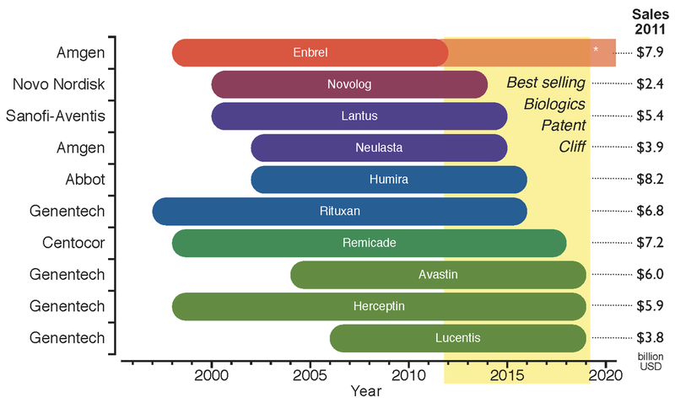
File:Biosimilars Patent Cliff.png

Slide 23
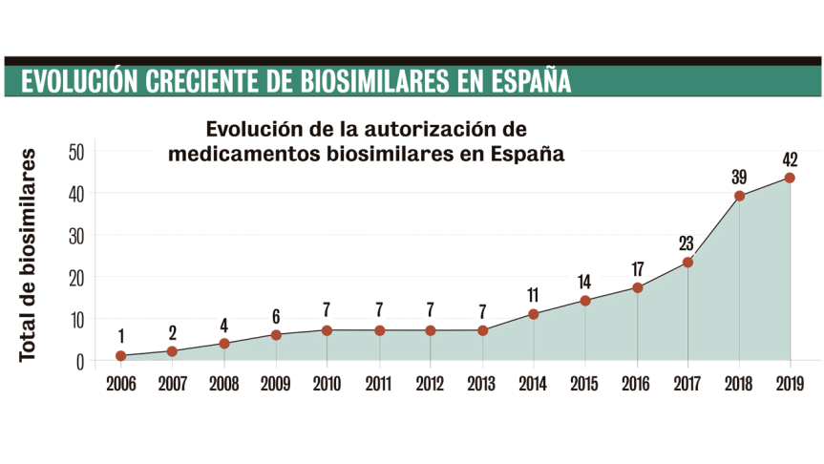
Evolución creciente de biosimilares en España.
References:
1.Agencia Española del Medicamento; 2019.

Slide 24
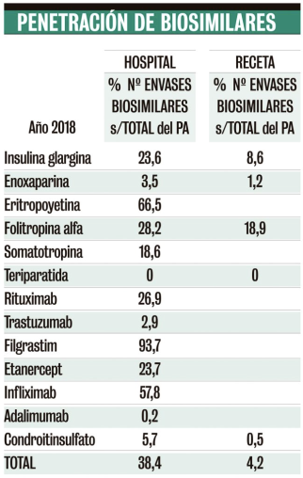
Penetración de biosimilares
References:
1. Junio 2018 Unidad Editorial Revistas, S.L.U

Slide 25
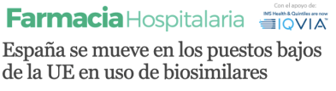
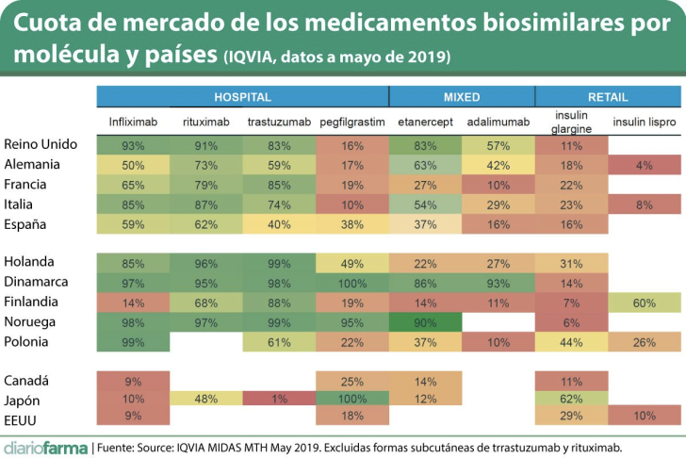
References:
1. Junio 2018 Unidad Editorial Revistas, S.L.U

Slide 26
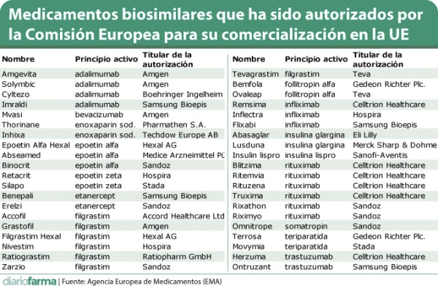
BIOSIMILARES autorizados por la EMA.

Slide 27
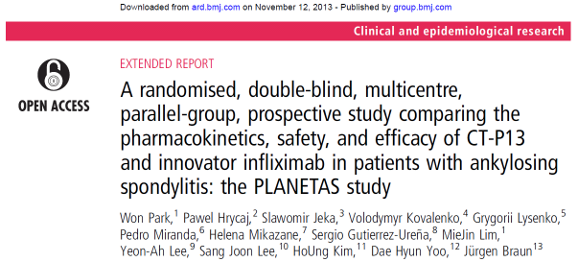
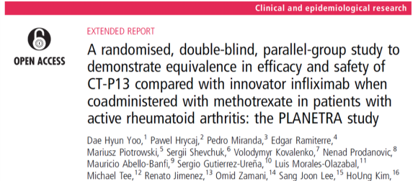
REMSIMA | 2013

Slide 28
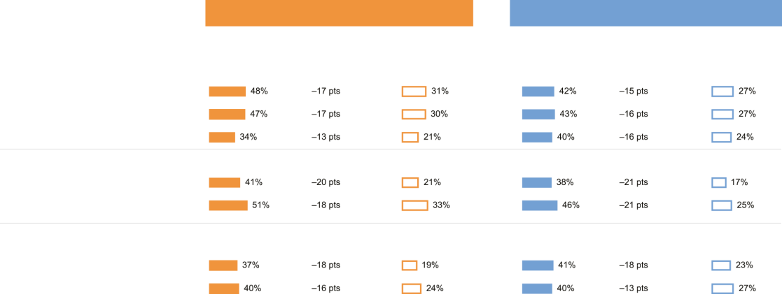
La mayoría de los pacientes no están familiarizados con los biosimilares¹
ESTADOS UNIDOS
EUROPA
Personas que conocen los biosimilares
n=270
Personas que no conocen* los biosimilares
n=610
Personas que conocen los biosimilares
n=496
Personas que no conocen* los biosimilares
n=758
Seguridad
Se sienten cómodos al cambiar a este medicamento
Es seguro
Sus efectos secundarios son mínimos
Brecha de percepción
Brecha de percepción
Eficacia
Es la mejor opción para tratar la enfermedad
Permite tratar la enfermedad de forma eficaz
Acceso/precio
Es asequible
Es eficaz y tiene un precio razonable
References:
1. Peyrin-Biroulet L, et al. J Crohns Colitis. 2017;11(1):128-33;
2. Jacobs I, et al. Patient Prefer Adherence. 2016;10:937-48
.
Notes:
References:
1. Peyrin-Biroulet L, et al. J Crohns Colitis. 2017;11(1):128-33;
2. Jacobs I, et al. Patient Prefer Adherence. 2016;10:937-48

Slide 29

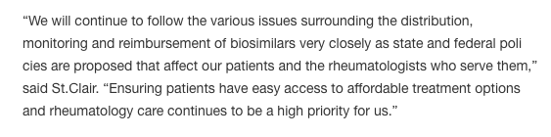
Informe estratégico del ACR sobre los biosimilares | 2015
References:
1. American College of Rheumatology Position Statement on Biosimilars. Revised May 12, 2016. Available at: https://www.rheumatoloqy.org/Portals/0/Files/Biosimilars-Position-Statement.pdf [Accessed March 2018];
2. Davia, K. ACR Backs Biosimilars in New White Paper. Center for Biosimilars.
Feb 2018. Available at: http://www.centerforbiosimilars.com/news/acr-backsbiosimilars-in-new-white-paper. [Accessed March 2018];
3. Bridges SL Jr., et al. Arthritis Rheumatol. 2018;70(3):334-44
.
Notes:
References:
1. American College of Rheumatology Position Statement on Biosimilars. Revised May 12, 2016. Available at: https://www.rheumatoloqy.org/Portals/0/Files/Biosimilars-Position-Statement.pdf [Accessed March 2018];
2. Davia, K. ACR Backs Biosimilars in New White Paper. Center for Biosimilars.
Feb 2018. Available at: http://www.centerforbiosimilars.com/news/acr-backsbiosimilars-in-new-white-paper. [Accessed March 2018];
3. Bridges SL Jr., et al. Arthritis Rheumatol. 2018;70(3):334-44

Slide 30
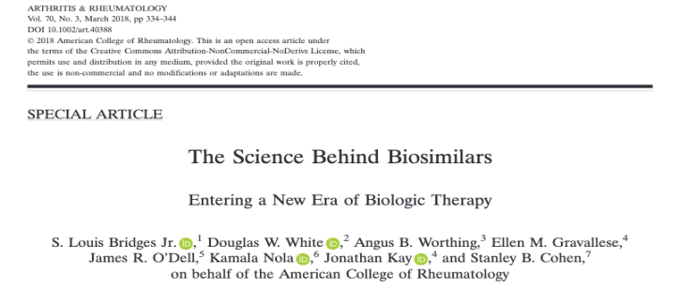
Informe estratégico del ACR sobre los biosimilares | 2018
«Ahora que los biosimilares se han utilizado con éxito en Europa, se dispone de datos adquiridos de forma rigurosa que respaldan un uso más amplio de estos fármacos, y los EE. UU. están a punto de realizar una transición similar, el ACR está dispuesto a reconsiderar su posición»^{2,3}
References:
1. American College of Rheumatology Position Statement on Biosimilars. Revised May 12, 2016. Available at: https://www.rheumatoloqy.org/Portals/0/Files/Biosimilars-Position-Statement.pdf [Accessed March 2018];
2. Davia, K. ACR Backs Biosimilars in New White Paper. Center for Biosimilars.
Feb 2018. Available at: http://www.centerforbiosimilars.com/news/acr-backsbiosimilars-in-new-white-paper. [Accessed March 2018];
3. Bridges SL Jr., et al. Arthritis Rheumatol. 2018;70(3):334-44
.
Notes:
References:
1. American College of Rheumatology Position Statement on Biosimilars. Revised May 12, 2016. Available at: https://www.rheumatoloqy.org/Portals/0/Files/Biosimilars-Position-Statement.pdf [Accessed March 2018];
2. Davia, K. ACR Backs Biosimilars in New White Paper. Center for Biosimilars.
Feb 2018. Available at: http://www.centerforbiosimilars.com/news/acr-backsbiosimilars-in-new-white-paper. [Accessed March 2018];
3. Bridges SL Jr., et al. Arthritis Rheumatol. 2018;70(3):334-44

Slide 31
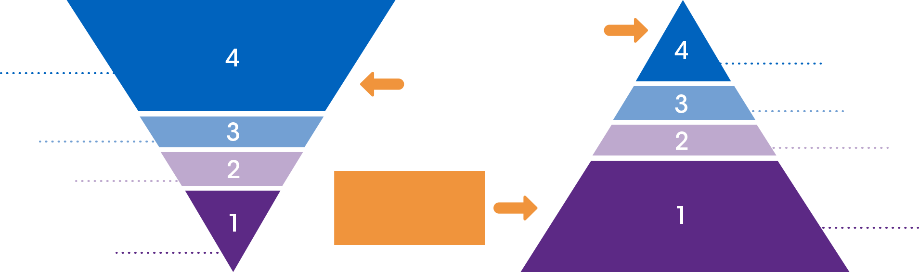
El desarrollo de productos biosimilares es diferente al desarrollo de medicamentos de referencia
Desarrollo de medicamentos de referencia¹:
Debe constatarse que la nueva molécula aporta
beneficios clínicos significativos
Desarrollo de biosimilares²:
Debe constatarse que la molécula es muy similar al medicamentos de referencia
Programa clínico
diseñado a medida
Estudios
clínicos
Estudios
clínicos
Programa clínico
sólido
FC/FD
FC/FD
No clínico
No clínico
El programa analítico es la piedra angular del desarrollo de biosimilares
Programa
analítico
Programa
analítico
References:
1. U.S. Food and Drug Administration (FDA). Guidance for Industry: Providing Clinical Evidence of Effectiveness for Human Drug and Biological Products. 1998 [online]. Available at: https://www.fda.gov/ohrms/dockets/ac/06/
Briefing/2006-4227B1-02-02-FDA-Appendix1.pdf [Accessed March 2018]
2. McCamish M, Woollett G. Cl in Pharmacol Ther. 2012;91:405-17
.
Notes:
References:
1. U.S. Food and Drug Administration (FDA). Guidance for Industry: Providing Clinical Evidence of Effectiveness for Human Drug and Biological Products. 1998 [online]. Available at: https://www.fda.gov/ohrms/dockets/ac/06/
Briefing/2006-4227B1-02-02-FDA-Appendix1.pdf [Accessed March 2018]
2. McCamish M, Woollett G. Cl in Pharmacol Ther. 2012;91:405-17

Slide 32
VARIABILIDAD ENTRE DIFERENTES LOTES DE MEDICAMENTOS BIOLÓGICOS
Variabilidad entre lotes
Modificaciones en el proceso de fabricación
References:
1. Schiestl M, et al. Nat Biotechnol 2011;29(4):310-2.
2. Schneider CK. Ann Rheum Dis 2013;72(3):315-8d
Notes:
References:
Schiestl M, et al. Nat Biotechnol 2011;29(4):310-2;
Schneider CK. Ann Rheum Dis 2013;72(3):315-8d

Slide 33
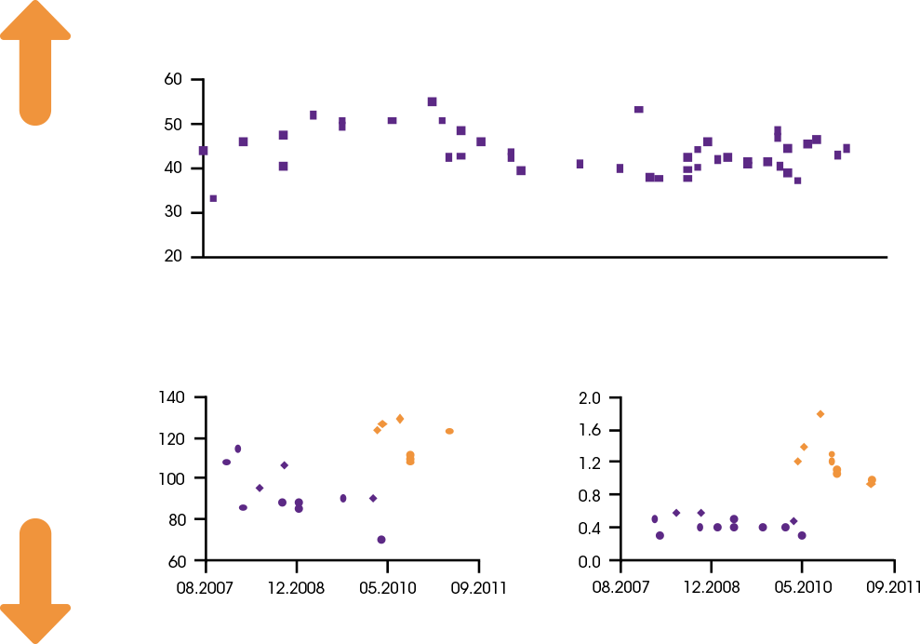
VARIABILIDAD ENTRE DIFERENTES LOTES DE MEDICAMENTOS BIOLÓGICOS
Variabilidad de la variante principal del glicano en un anticuerpo monoclonal comercial
G0 fucosilado
(porcentaje relativo)
Fecha de caducidad
Potencia ADCC (% de referencia)
G0 no fucosilado (% de glicanos)
Posterior al cambio
Posterior al cambio
Anterior al cambio
Anterior al cambio
Fecha de caducidad
Fecha de caducidad
References:
1. Schiestl M, et al. Nat Biotechnol 2011;29(4):310-2.
2. Schneider CK. Ann Rheum Dis 2013;72(3):315-8d
Notes:
ADCC (potencia de citotoxicidad mediada por Ac).

Slide 34
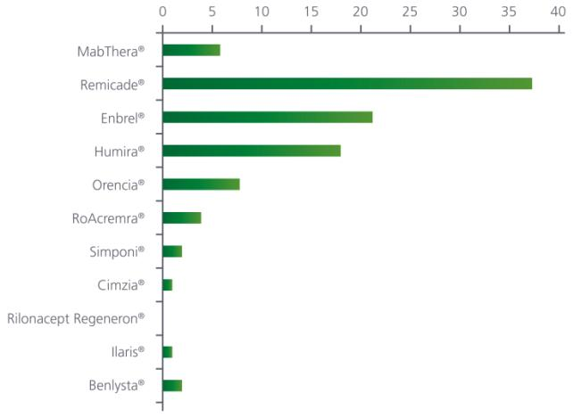
El medicamento que un médico administra hoy a un paciente no es idéntico (pero si comparable) al autorizado años atrás
References:
1. . Biosimilars in rheumatology: the wind of change. Christian K Schneider. Ann Rheum Dis 2013 72: 315-318
Notes:
References:
Figure adapted from: Gailbraith D, BioProcess International 2014. Biosimilars awaken CROS [online]. Available from: http://www.bioprocessintl.com/manufacturing/biosimilars/biosimilars-awaken-cros/ [Accessed March 2018]
Ramanan S. BioDrugs 2014;28:363-72

Slide 35
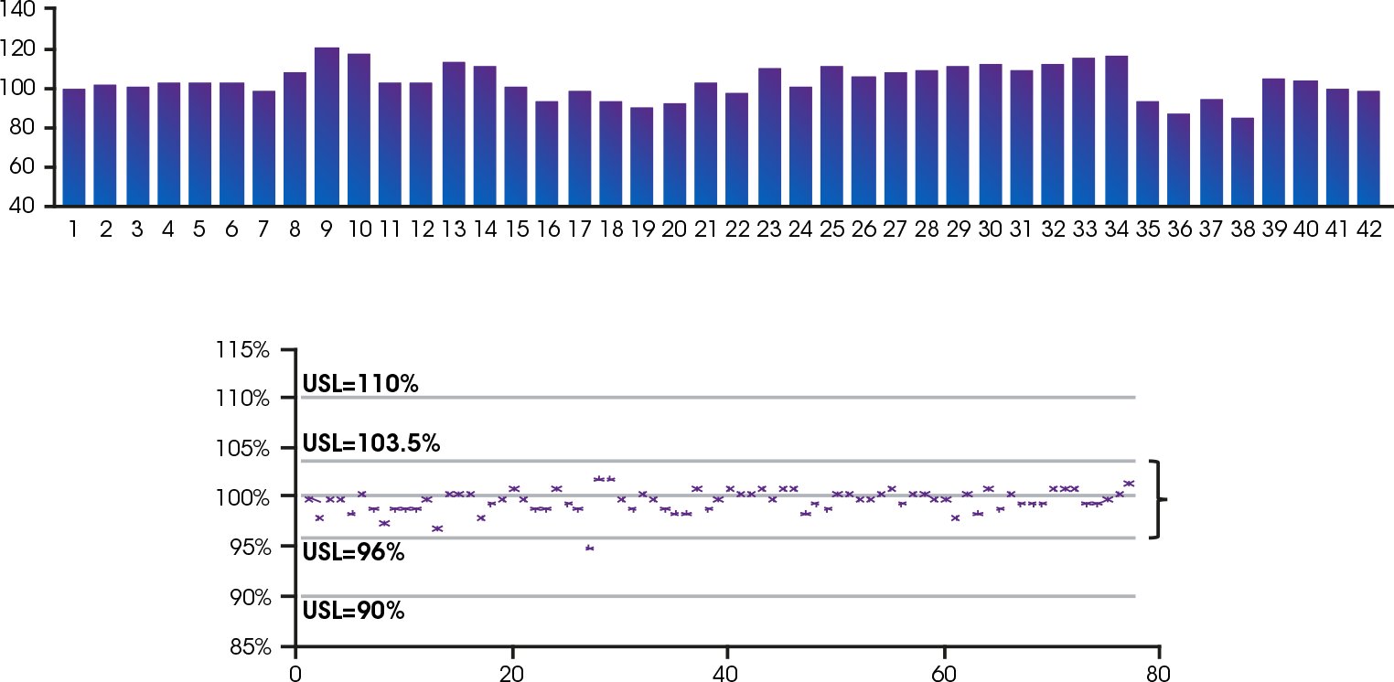
En los medicamentos biológicos, ningún lote es idéntico a otro
Potencia relativa (%)
Variabilidad entre lotes
Número de lote de Humira^{®1}
Concentración de proteínas
(normalizada)
Variabilidad normal
Lotes de producción²
References:
1. Figure adapted from: Gailbraith D, BioProcess International 2014. Biosimilars awaken CROS [online]. Available from: http://www.bioprocessintl.com/manufacturing/biosimilars/biosimilars-awaken-cros/ [Accessed March 2018]
2. Ramanan S. BioDrugs 2014;28:363-72
Notes:
References:
Figure adapted from: Gailbraith D, BioProcess International 2014. Biosimilars awaken CROS [online]. Available from: http://www.bioprocessintl.com/manufacturing/biosimilars/biosimilars-awaken-cros/ [Accessed March 2018]
Ramanan S. BioDrugs 2014;28:363-72

Slide 36
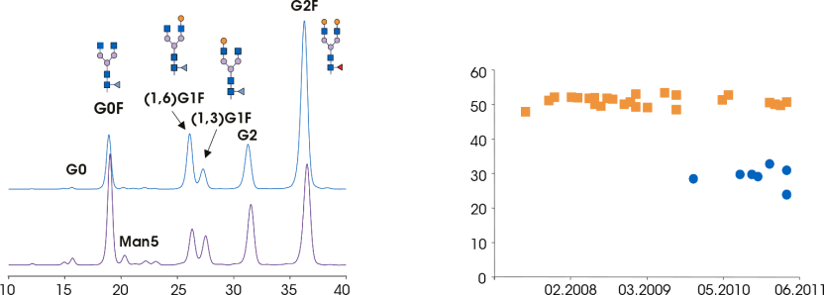
Las modificaciones introducidas en el proceso de fabricación pueden generar variabilidad
Modificaciones en el proceso de fabricación
Comparación de los lotes de etanercept (Enbrel®) antes y después de introducir un cambio en el proceso de fabricación
Glicanos G2F (% área relativa)
Antes del cambio
Antes del cambio
Posterior al cambio
Posterior al cambio
t (min)
Fecha de caducidad
References:
1. Figure adapted from: Gailbraith D, BioProcess International 2014. Biosimilars awaken CROS [online]. Available from: http://www.bioprocessintl.com/manufacturing/biosimilars/biosimilars-awaken-cros/ [Accessed March 2018]
2. Ramanan S. BioDrugs 2014;28:363-72
Notes:
References:
Schiestl M, et al. Nat Biotechnol 2011;29:310-2

Slide 37

Los biosimilares deben encontrarse dentro del margen variación del medicamento de referencia
Un biosimilar puede ser tan similar a su medicamento de referencia como un medicamento de referencia lo es a sí mismo
Medicamento de referencia en el momento de su aprobación
Medicamento de referencia después de un cambio en la fabricación
Variación de un parámetro específico del medicamento de referencia
Biosimilar
References:
1. McCamish M & Woollett G. Clin Pharmacol Ther 2012;91:405-17
Notes:
References:
McCamish M & Woollett G. Clin Pharmacol Ther 2012;91:405-17

Slide 38

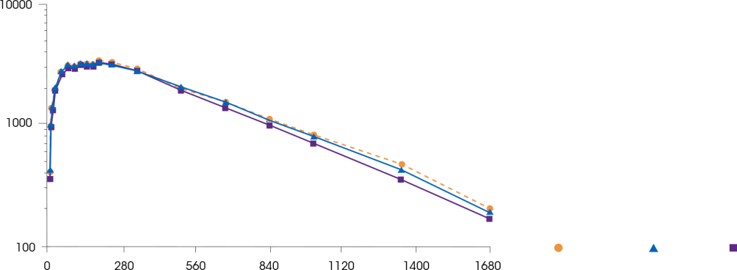
La FC y la FD se utilizan para constatar la biosimilitud con el medicamento de referencia
FC de MSB11022
(biosimilar propuesto de adalimumab) en comparación con el medicamento de referencia
Concentración (ng ml⁻¹)
Perfiles de la concentración sérica media a lo largo del tiempo (en escala semilogarítmica) por tratamiento tras una única inyección administrada por vía subcutánea de 40 mg de MSB11022 y del medicamento de referencia en los Estados Unidos (MR EE.UU) y del medicamento de referencia en Europa (MR UE), adalimumab
MR EE. UU.
MR UE
MSB11022
Tiempo (h)
References:
1. Hyland E, et al. Br J Clin Pharmacol 2016;82:983-93
Notes:
Hyland E, et al. Br J Clin Pharmacol 2016;82:983-93

Slide 39
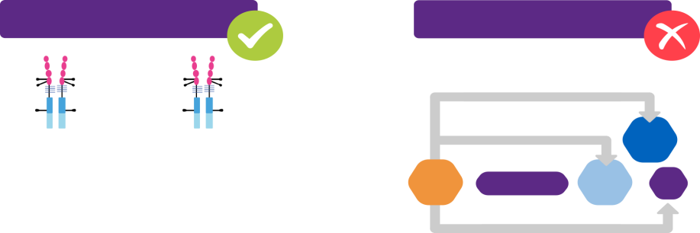

Introducción al concepto de extrapolación
La extrapolación consiste en la aprobación de un biosimilar para una indicación que no se ha evaluado en ensayos clínicos. En este caso, la aprobación se basa en la evaluación clínica y en la aprobación del medicamento de referencia para dicha indicación¹
Extrapolación del medicamento de
referencia a un biosimilar
...no de una indicación
a otra indicación...
La extrapolación no se realiza de una
experiencia clínica a otra...
Equivalencia
Medicamento de referencia
Biosimilar
APs
AR
Extrapolación
CU
EAA
References:
1. Mellstedt H, et al. Ann Oncol. 2008;19(3):411-419;
2. Weise M, et al. Blood 2012;120(26):511-17;
3. European Medicines Agency (EMA). Guideline on similar biological medicinal products containing monoclonal antibodies - non-clinical and clinical issues (EMA/CHMP/BMWP/403543/2010). 2012 [online]. Available at: http://www.ema.Europa.eu/docs/en_GB/document_library/Scientific_guideline/2012/06/WC500128686.pdf [Accessed March 2018]
Notes:
References:a biosimilar
1. Mellstedt H, et al. Ann Oncol. 2008;19(3):411-419;
2. Weise M, et al. Blood 2012;120(26):511-17;
3. European Medicines Agency (EMA). Guideline on similar biological medicinal products containing monoclonal antibodies - non-clinical and clinical issues (EMA/CHMP/BMWP/403543/2010). 2012 [online]. Available at: http://www.ema.Europa.eu/docs/en_GB/document_library/Scientific_guideline/2012/06/WC500128686.pdf [Accessed March 2018]

Slide 40
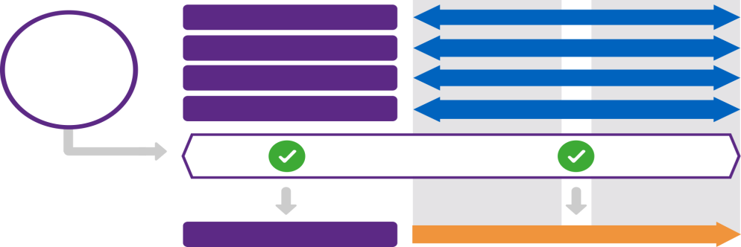
La extrapolación se basa en los datos acumulados
La extrapolación se basa en una comparación exhaustiva entre todos los datos obtenidos sobre el biosimilar y los estudios clínicos y la experiencia acerca del medicamento de referencia en todas las indicaciones clínicas
Medicamento de referencia
Biosimilar
Atributos estructurales
MUY SIMILAR
Funciones biológicas
MUY SIMILAR
Datos acumulados
FC/FD en humanos
MUY SIMILAR
Indicación sensible
MUY SIMILAR
Extrapolación
Indicaciones menos sensibles
JUSTIFICADO
References:
1. Weise M, et al. Blood 2012;120(26):511 -17;
Kurki P, et al. J Crohns Colitis 2014;8(3):258
Notes:
References:
Weise M, et al. Blood 2012;120(26):511 -17;
Kurki P, et al. J Crohns Colitis 2014;8(3):258

Slide 41



Comparación de la ficha técnica de un medicamento biosimilar con la ficha técnica de un medicamento de referencia
La Ficha técnica de un biosimilar puede ser idéntica a la del medicamento de referencia (si el conjunto de datos es lo suficientemente congruente y constata una similitud suficiente con este)
También es posible que un fabricante opte por eliminar determinadas indicaciones por razones comerciales, como por ejemplo, en el caso de que decida optar por no desarrollar presentaciones pediátricas y, por lo tanto, no deba incluir las indicaciones sobre la población pediátrica en la Ficha técnica.
FT

Slide 42
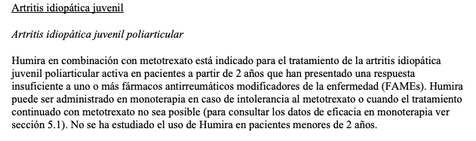
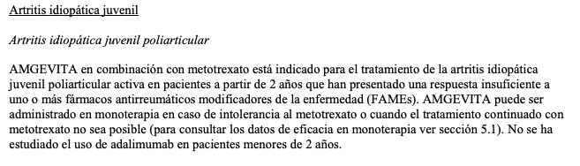
FICHA TÉCNICA. Bo vs Bs

Slide 43
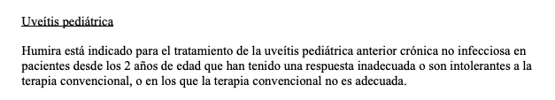
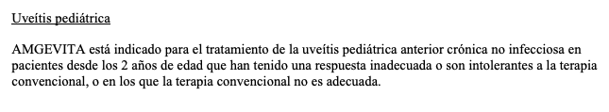
FICHA TÉCNICA. Bo vs Bs

Slide 44


Comprender la capacidad de intercambio entre los medicamentos
CAPACIDAD DE INTERCAMBIO
CAMBIO
SUSTITUCIÓN
Consiste en el intercambio de un medicamento por otro que se espera que tenga el mismo efecto clínico sin un riesgo significativo de que se produzca un resultado adverso para la salud^{1,2}:
Puede consistir, por ejemplo, en la sustitución de un medicamento de referencia por un producto biosimilar (o viceversa), o la sustitución de un biosimilar por otro
Situación en la que un paciente cambia de un medicamento a otro bajo la supervisión de un médico^{1,2}
Situación en la que la decisión de cambiar el tratamiento la toma el farmacéutico sin el consentimiento del médico que lo ha prescrito^{1,2}
Es, por ejemplo, el caso habitual de optar por un medicamento genérico
de los fármacos tradicionales
No obstante, en la mayoría de los países europeos, exceptuando Polonia, los farmacéuticos no pueden modificar el tratamiento prescrito por el médico
References:
1. Mellstedt H, et al. Ann Oncol. 2008;19(3):411-19;
2. Stanton, D. 2017. Biosimilar interchangeability: Do you know your switching from your substitution? Available at: https:/ /www.biopharma-reporter.com/ Article/2017/03/21/Biosimilr-switching-interchangeability-and-substitution-the-EU-view [Accessed March 2018).
Notes:
References:
1. Mellstedt H, et al. Ann Oncol. 2008;19(3):411-19;
2. Stanton, D. 2017. Biosimilar interchangeability: Do you know your switching from your substitution? Available at: https:/ /www.biopharma-reporter.com/
Article/2017/03/21/Biosimilr-switching-interchangeability-and-substitution-the-EU-view [Accessed March 2018).

Slide 45
Comprender la capacidad de intercambio entre los medicamentos
CAPACIDAD DE INTERCAMBIO
CAMBIO
SUSTITUCIÓN
Consiste en el intercambio de un medicamento por otro que se espera que tenga el mismo efecto clínico sin un riesgo significativo de que se produzca un resultado adverso para la salud^{1,2}:
Puede consistir, por ejemplo, en la sustitución de un medicamento de referencia por un producto biosimilar (o viceversa), o la sustitución de un biosimilar por otro
Situación en la que un paciente cambia de un medicamento a otro bajo la supervisión de un médico^{1,2}
Situación en la que la decisión de cambiar el tratamiento la toma el farmacéutico sin el consentimiento del médico que lo ha prescrito^{1,2}
Es, por ejemplo, el caso habitual de optar por un medicamento genérico
de los fármacos tradicionales
No obstante, en la mayoría de los países europeos, exceptuando Polonia, los farmacéuticos no pueden modificar el tratamiento prescrito por el médico
References:
1. Mellstedt H, et al. Ann Oncol. 2008;19(3):411-19;
2. Stanton, D. 2017. Biosimilar interchangeability: Do you know your switching from your substitution? Available at: https:/ /www.biopharma-reporter.com/ Article/2017/03/21/Biosimilr-switching-interchangeability-and-substitution-the-EU-view [Accessed March 2018).
Notes:
References:
1. Mellstedt H, et al. Ann Oncol. 2008;19(3):411-19;
2. Stanton, D. 2017. Biosimilar interchangeability: Do you know your switching from your substitution? Available at: https:/ /www.biopharma-reporter.com/
Article/2017/03/21/Biosimilr-switching-interchangeability-and-substitution-the-EU-view [Accessed March 2018).

Slide 46

INTERCAMBIO DE MEDICAMENTOS EN LA UE/LOS EE. UU.
En la UE, el intercambio y sustitución de medicamentos se encuentra fuera del alcance de la aprobación de la EMA. Cada estado miembro de la UE sigue una política propia en esta materia^{1,2}
En los EE. UU., el intercambio de medicamentos no se aborda de forma específica en las directrices sobre biosimilares de la FDA, pero se define de forma clara en la Ley de Competencia de Precios e Innovación en Biológicos de 2009 (enmienda a la Sección 351(k) de la Ley del Servicio de Salud Pública), en la que se establece que los productos «intercambiables» pueden sustituirse sin que sea necesaria la intervención del médico que los receta, siempre que²:
Se disponga de suficiente información que constate la biosimilitud del producto con el medicamento de referencia
El producto produce el mismo resultado clínico que el medicamento de referencia en un paciente dado
En el caso de que un producto se administre más de una vez, el riesgo de que la seguridad o eficacia disminuya al sustituir el medicamento de referencia por un biosimilar no debe superar el riesgo de utilizar únicamente el medicamento de referencia
Notes:
References:
1. EMA. Questions and answers on biosimilar medicines (similar biological medicinal products). September 27, 2012. Available at: http://www.medicinesforeurope.com/wp-content/uploads/2016/03/WC500020062.pdf [Accessed March 2018];
2. Heinemann L, et al. Diabetes Technol Ther.2015;17(7):510-26.

Slide 47
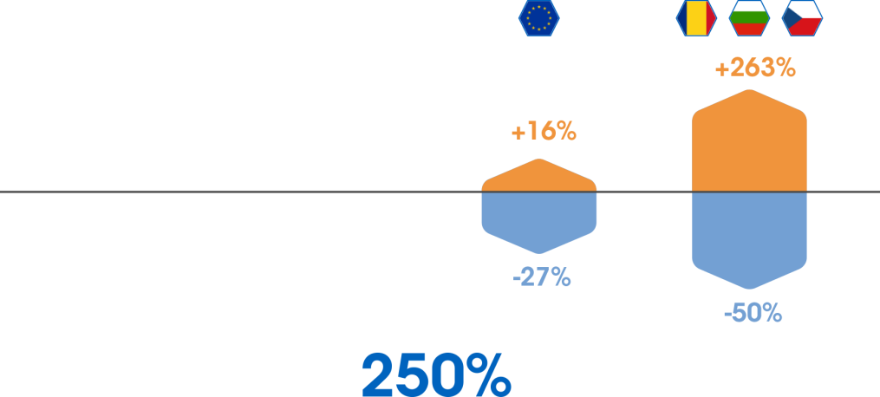
Los biosimilares pueden reducir los costes y facilitar el acceso de los pacientes a los medicamentos
Uso de la epoetina en la UE tras la introducción de biosimilares en el mercado
Aumento medio del volumen de días de tratamiento
Variación en el precio por día de tratamiento
En todo el mercado, entre su comercialización y el año 2014
Aumento del uso promedio de epoetina tras introducir los biosimilares en los países en los que su acceso estaba restringido anteriormente
References:
1. IMS Institute 2016. Delivering on the Potential of Biosimilar Medicines.
Notes:
References:
IMS Institute 2016. Delivering on the Potential of Biosimilar Medicines.

Slide 48

Los biosimilares ofrecen ventajas para los sistemas sanitarios
El aumento de la COMPETENCIA entre los medicamentos biológicos puede generar un ahorro significativo en los sistemas sanitarios de todo el mundo gracias al uso de medicamentos que garantizan la mejor relación calidad-precio, entre los cuales se encuentran los biosimilares.
Uso del 44 %
en los 14 meses
posteriores a su comercialización
Actualmente, el 80 % de los pacientes son tratados con el biosimilar
Infliximab
Uso del 44 %
en los 10 meses
posteriores a su comercialización
Actualmente, el 58 % de los pacientes son tratados con el biosimilar
Etanercept
References:
1. NHS. Commissioning framework for biological medicines (including biosimilar medicines). Sep 2017. Available at: https://www.england.nhs.uk/wp-content/uploads/2017/09/
biosimilar-medicines-commissioning-framework.pdf [Accessed March 2018]
Notes:
References:
NHS. Commissioning framework for biological medicines (including biosimilar medicines). Sep 2017. Available at: https://www.england.nhs.uk/wp-content/uploads/2017/09/
biosimilar-medicines-commissioning-framework.pdf [Accessed March 2018]

Slide 49
FÁRMACOS BIOLÓGICOS
ORIGINALES VS BIOSIMILARES
ÚLTIMAS PUBLICACIONES

Slide 50
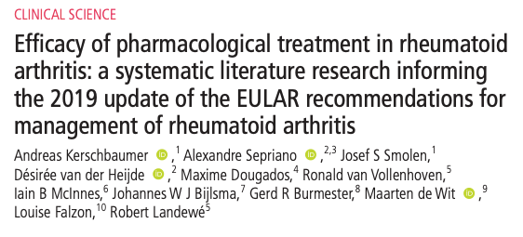
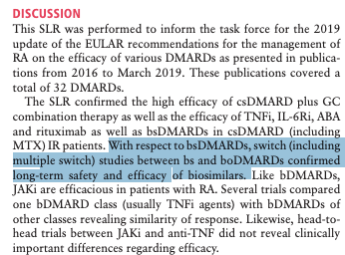
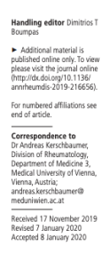
Rheumatoid Arthritis 2020 | Revisión Sistemática
Uso del 44 %
en los 14 meses
posteriores a su comercialización
Actualmente, el 80 % de los pacientes son tratados con el biosimilar
Infliximab
Uso del 44 %
en los 10 meses
posteriores a su comercialización
Actualmente, el 58 % de los pacientes son tratados con el biosimilar
Etanercept
Notes:
References:
NHS. Commissioning framework for biological medicines (including biosimilar medicines). Sep 2017. Available at: https://www.england.nhs.uk/wp-content/uploads/2017/09/
biosimilar-medicines-commissioning-framework.pdf [Accessed March 2018]

Slide 51
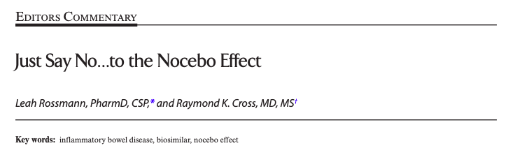
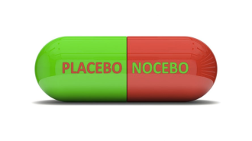

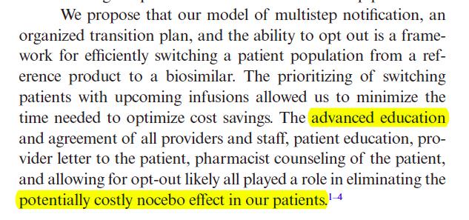
Inflamm Bowel Dis 2020.
Uso del 44 %
en los 14 meses
posteriores a su comercialización
Actualmente, el 80 % de los pacientes son tratados con el biosimilar
Uso del 44 %
en los 10 meses
posteriores a su comercialización
Actualmente, el 58 % de los pacientes son tratados con el biosimilar
Etanercept
Notes:
References:
NHS. Commissioning framework for biological medicines (including biosimilar medicines). Sep 2017. Available at: https://www.england.nhs.uk/wp-content/uploads/2017/09/
biosimilar-medicines-commissioning-framework.pdf [Accessed March 2018]

Slide 52
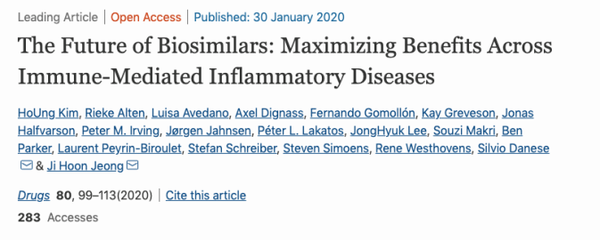
Drugs 2020.
Uso del 44 %
en los 14 meses
posteriores a su comercialización
Actualmente, el 80 % de los pacientes son tratados con el biosimilar
Uso del 44 %
en los 10 meses
posteriores a su comercialización
Actualmente, el 58 % de los pacientes son tratados con el biosimilar
Etanercept
Notes:
References:
NHS. Commissioning framework for biological medicines (including biosimilar medicines). Sep 2017. Available at: https://www.england.nhs.uk/wp-content/uploads/2017/09/
biosimilar-medicines-commissioning-framework.pdf [Accessed March 2018]

Slide 53
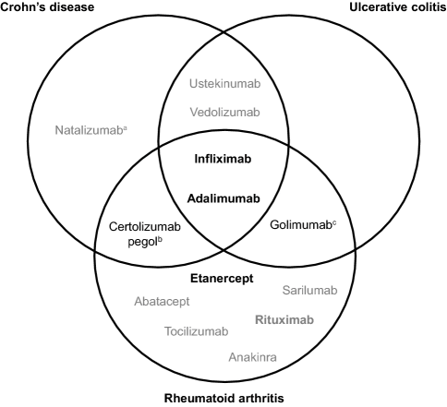
Drugs 2020.
Uso del 44 %
en los 14 meses
posteriores a su comercialización
Actualmente, el 80 % de los pacientes son tratados con el biosimilar
Uso del 44 %
en los 10 meses
posteriores a su comercialización
Actualmente, el 58 % de los pacientes son tratados con el biosimilar
Etanercept
Notes:
References:
NHS. Commissioning framework for biological medicines (including biosimilar medicines). Sep 2017. Available at: https://www.england.nhs.uk/wp-content/uploads/2017/09/
biosimilar-medicines-commissioning-framework.pdf [Accessed March 2018]

Slide 54
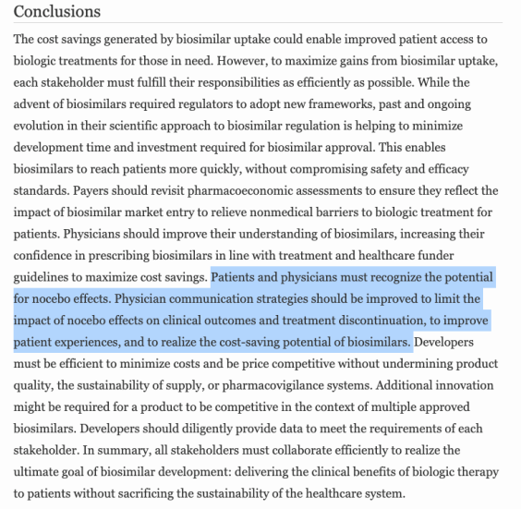
Drugs 2020.
Uso del 44 %
en los 14 meses
posteriores a su comercialización
Actualmente, el 80 % de los pacientes son tratados con el biosimilar
Uso del 44 %
en los 10 meses
posteriores a su comercialización
Actualmente, el 58 % de los pacientes son tratados con el biosimilar
Etanercept
Notes:
References:
NHS. Commissioning framework for biological medicines (including biosimilar medicines). Sep 2017. Available at: https://www.england.nhs.uk/wp-content/uploads/2017/09/
biosimilar-medicines-commissioning-framework.pdf [Accessed March 2018]

Slide 55
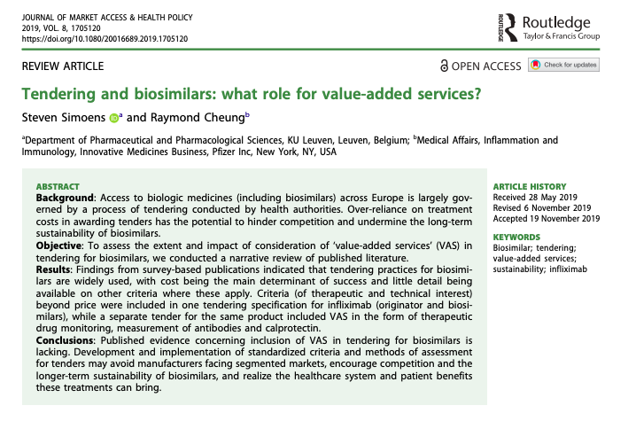
Journal of Market Access 2019 | VALOR AÑADIDO
Uso del 44 %
en los 14 meses
posteriores a su comercialización
Actualmente, el 80 % de los pacientes son tratados con el biosimilar
Uso del 44 %
en los 10 meses
posteriores a su comercialización
Actualmente, el 58 % de los pacientes son tratados con el biosimilar
Etanercept
Notes:
References:
NHS. Commissioning framework for biological medicines (including biosimilar medicines). Sep 2017. Available at: https://www.england.nhs.uk/wp-content/uploads/2017/09/
biosimilar-medicines-commissioning-framework.pdf [Accessed March 2018]

Slide 56
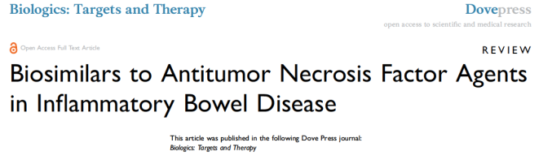
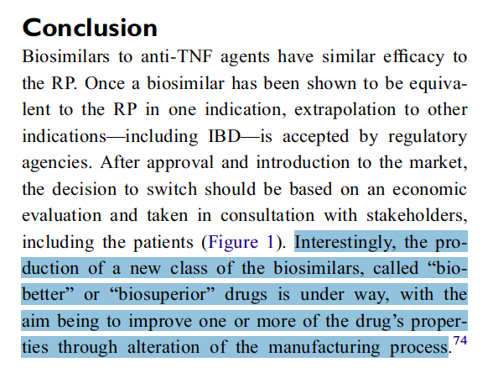
Biologics: Targets and Therapy 2020 | Biobetter
Uso del 44 %
en los 14 meses
posteriores a su comercialización
Actualmente, el 80 % de los pacientes son tratados con el biosimilar
Uso del 44 %
en los 10 meses
posteriores a su comercialización
Actualmente, el 58 % de los pacientes son tratados con el biosimilar
Notes:
References:
NHS. Commissioning framework for biological medicines (including biosimilar medicines). Sep 2017. Available at: https://www.england.nhs.uk/wp-content/uploads/2017/09/
biosimilar-medicines-commissioning-framework.pdf [Accessed March 2018]

Slide 57
Biobetter

Slide 58
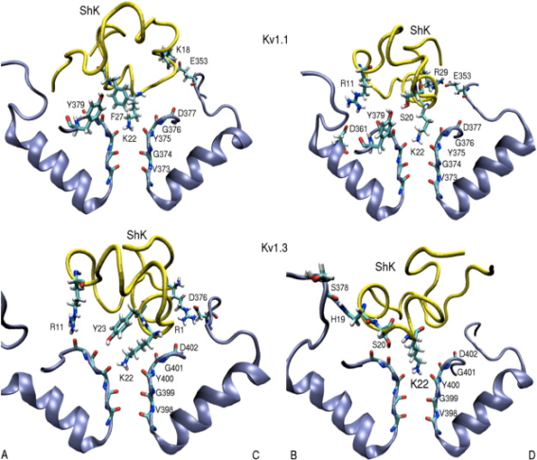
Biobetter

Slide 59
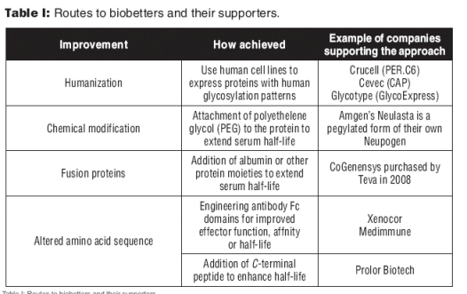
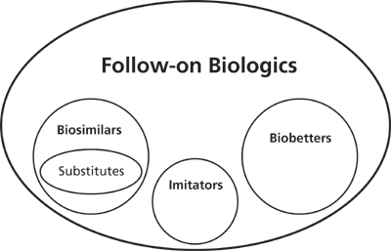
Biobetter

Slide 60
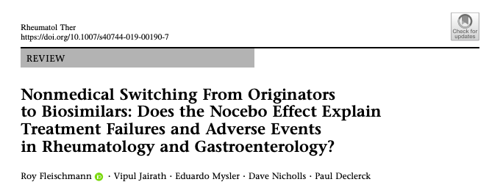
Inflamm Bowel Dis 2020.
Uso del 44 %
en los 14 meses
posteriores a su comercialización
Actualmente, el 80 % de los pacientes son tratados con el biosimilar
Uso del 44 %
en los 10 meses
posteriores a su comercialización
Actualmente, el 58 % de los pacientes son tratados con el biosimilar
Etanercept
Notes:
References:
NHS. Commissioning framework for biological medicines (including biosimilar medicines). Sep 2017. Available at: https://www.england.nhs.uk/wp-content/uploads/2017/09/
biosimilar-medicines-commissioning-framework.pdf [Accessed March 2018]

Slide 61
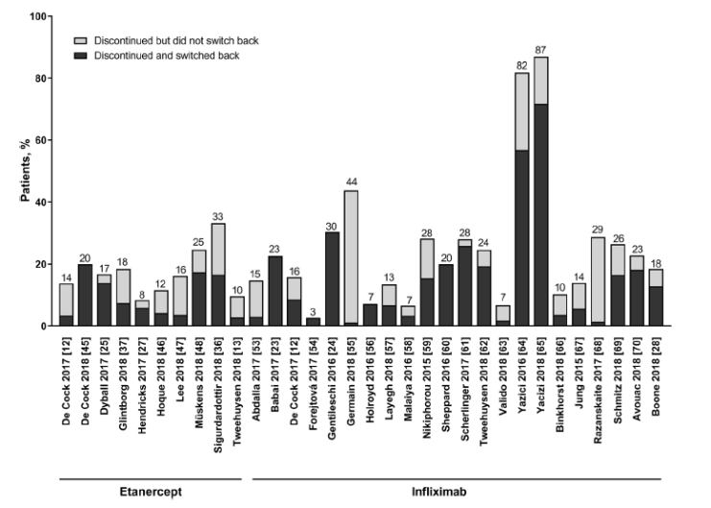
Inflamm Bowel Dis 2020.
Uso del 44 %
en los 14 meses
posteriores a su comercialización
Actualmente, el 80 % de los pacientes son tratados con el biosimilar
Uso del 44 %
en los 10 meses
posteriores a su comercialización
Actualmente, el 58 % de los pacientes son tratados con el biosimilar
Etanercept
Notes:
References:
NHS. Commissioning framework for biological medicines (including biosimilar medicines). Sep 2017. Available at: https://www.england.nhs.uk/wp-content/uploads/2017/09/
biosimilar-medicines-commissioning-framework.pdf [Accessed March 2018]

Slide 62
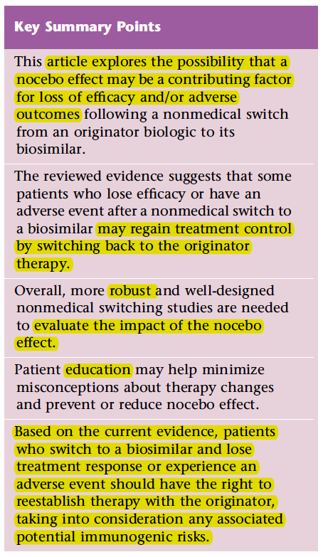
Inflamm Bowel Dis 2020.
NOCEBO EFFECT
SWITCHING BACK TO ORIGINATOR
ROBUST STUDIES
EDUCATION
SWITCHING BACK TO ORIGINATOR
Uso del 44 %
en los 14 meses
posteriores a su comercialización
Actualmente, el 80 % de los pacientes son tratados con el biosimilar
Uso del 44 %
en los 10 meses
posteriores a su comercialización
Actualmente, el 58 % de los pacientes son tratados con el biosimilar
Etanercept
Notes:
References:
NHS. Commissioning framework for biological medicines (including biosimilar medicines). Sep 2017. Available at: https://www.england.nhs.uk/wp-content/uploads/2017/09/
biosimilar-medicines-commissioning-framework.pdf [Accessed March 2018]

Slide 63
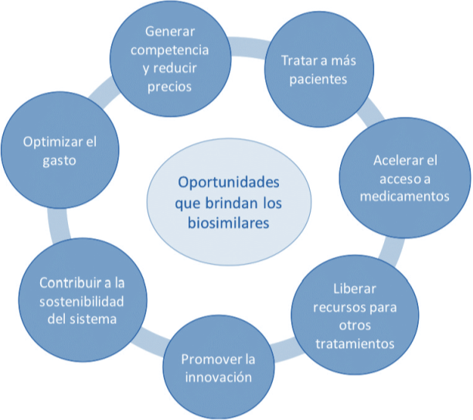
Resumen de los beneficios que ofrecen los biosimilares

Slide 64
Resumen de los beneficios que ofrecen los biosimilares
EFECTO Nocebo.
No a la SUSTITUCION.
INTERCAMBIO (con comunicación y aprobación M-P).
Discontinued and switched back originator.
Chequear a nuestros pacientes tras el intercambio.
BIOBETTERS

Slide 65
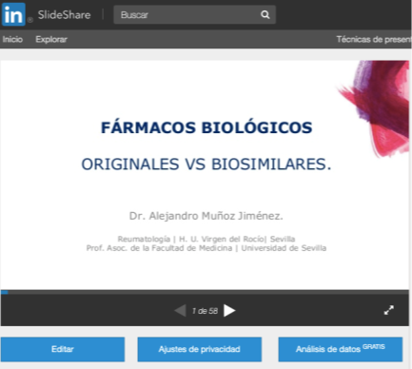
SlideShare

Slide 66
FIN
Muchas Gracias

