Slide 1

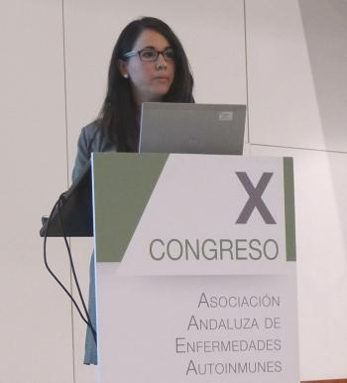



Genetic basis of systemic sclerosis
Elena López-Isac
Málaga, Feb 14 2020

Slide 2



Genetic basis of systemic sclerosis
Elena López-Isac
Málaga, Feb 14 2020
Instituto de Parasitología y Biomedicina López-Neyra

Slide 3


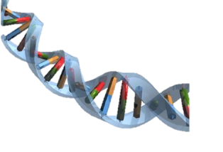



Systemic Sclerosis: etiology
GENETIC FACTORS
ENVIRONMENTAL FACTORS
Chemical agents
HLA
SYSTEMIC SCLEROSIS
IRF8
CSK
IRF5
TNIP1
STAT4
CD247
Silica
Organic solvents
IL12RB2
Infections
IL12A
ATG5
DNASE1L3
Parvovirus B19
Herpesvirus family
Pregnancy

Slide 4
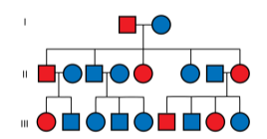

Systemic Sclerosis
Familial occurrence
Heritability underestimated in twin concordance studies
h2 > 0.1 (Bossini-Castillo et al., J Autoimmun. 2015 )
Prevalence variation observed among populations
First-degree relatives: relative risk 10-16-fold higher than in the general population
Siblings showed relative risk ranging from 10–27-fold higher than normal
Arnett et al., Arthritis Rheum. 2001
Caucasian: 0.01%
Afro-American: 0.02%
Choctaw: 0.04%

Slide 5

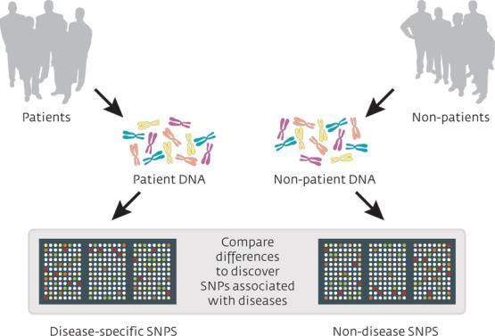
High-throughput genotyping platforms
Genome-Wide Association Studies = GWASs
Genetic markers across the whole genome (from 300.000 to 2 million SNPs)

Slide 6



High-throughput genotyping platforms

Slide 7
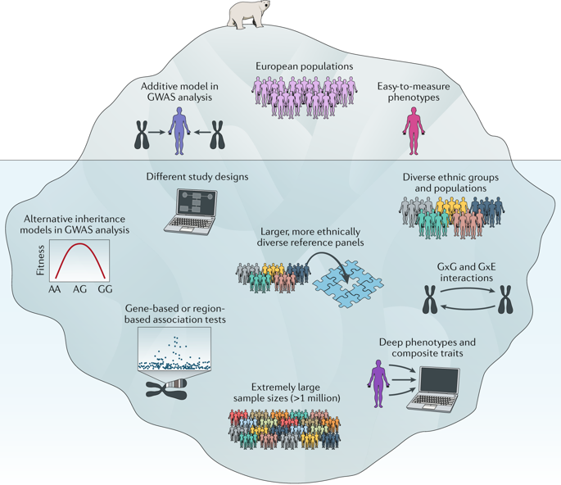
High-throughput genotyping platforms
Tam, V., et al. Nat Rev Genet (2019)

Slide 8











Meta-GWAS strategy
PUBLISHED
GWAS
2,166 cases
NEW GWAS
6,929 cases
9,095 cases
META-GWAS
4,859 controls
12,725 controls
17,587 controls
4.72 million SNPs

Slide 9
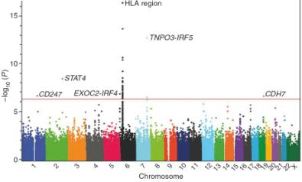

Meta-GWAS systemic sclerosis
2010
Radstake et al. Nat Genet (2010)

Slide 10

Meta-GWAS systemic sclerosis
2010
Radstake et al. Nat Genet (2010)
2019
Lopez-Isac et al. Nat Commun (2019)

Slide 11
Meta-GWAS systemic sclerosis
Twenty-seven signals independently associated with SSc
Lopez-Isac et al. Nat Commun (2019)

Slide 12

Meta-GWAS systemic sclerosis

Slide 13
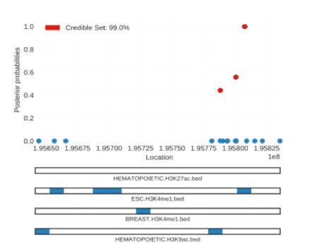
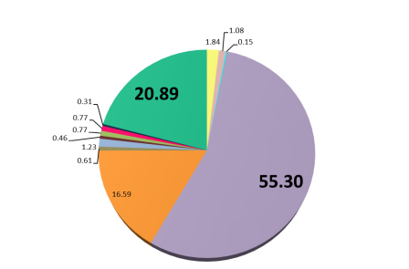



Identification of the causal SNPs
Bayesian fine-mapping
Likely causal variants
48% loci fine-mapped to < 5 SNPs
72% fine-mapped to < 10 SNPs

Slide 14

Identification of the target genes
Functional evidences to identify the target genes of SSc susceptibility signals

Slide 15
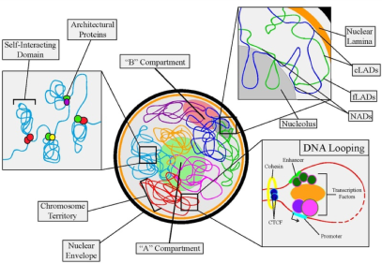
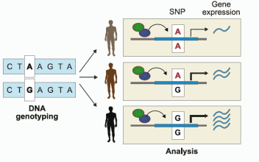
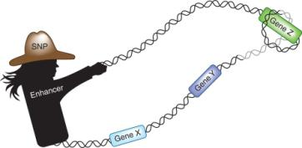
Identification of the target genes
Chromatin interaction analyses
eQTL validation
eQTL
genomic loci that regulate gene expression levels
Trynka G., Nat Genet 2017
Adapted from Lee et al. Science, 2014

Slide 16
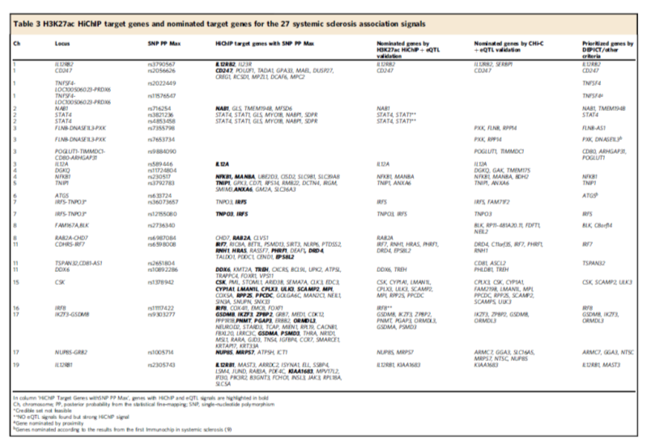
Identification of the target genes
> 65 robust SSc target genes

Slide 17
Identification of the target genes
Interrogation of the biological pathways that are involved in SSc

Slide 18
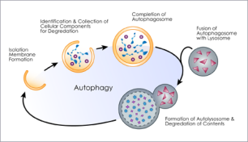
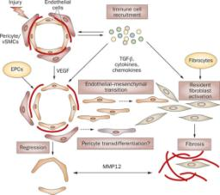
Target genes
RAB2A Chr 8q12.1
GSDMB Chr 17q21.1
DDX6 Chr 11q23.3
It has been shown to regulate the vascular endothelial growth factor under hypoxic conditions
GSDMB, member of the gasdermin-domain containing protein family. It is involved in pyroptosis
Required for autophagosome clearance. Second SSc gene related to autophagy
Trojanowska M. Nat Rev Rheumatol. 2010
FLNB Chr 3p14.3
The encoded protein is involved in the process to repair vascular injuries
Pyroptosis, a lytic form of cell death that is crucial for immune defenses and diseases.
Bergsbaken et al., Nat Rev Microbiol. 2010

Slide 19
Target genes & drugs
SSc target genes are significantly enriched in
pharmacological active targets for SSc

Slide 20
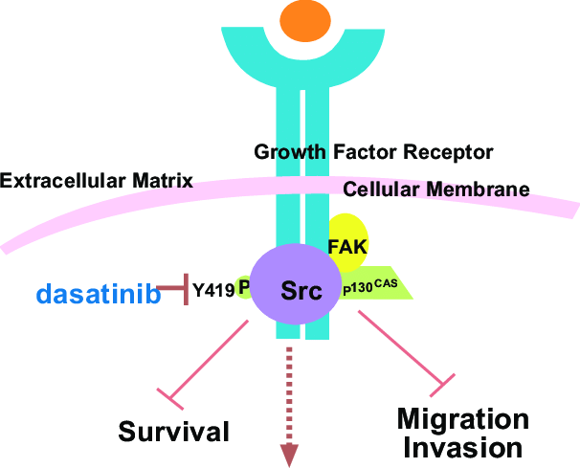
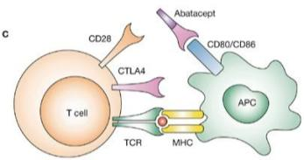
Target genes & drugs
Ruderman et al. Nat Rev Rheumatol (2006)
CD80 and BLK are targets of drugs for SSc in any phase of clinical trial
(abatacept and dasatinib, respectively)

Slide 21
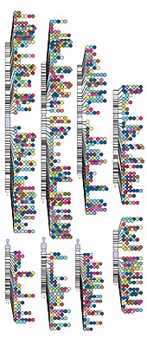
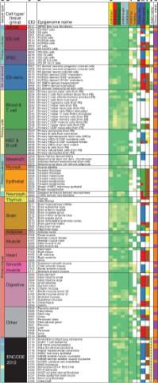
SSc loci inform relevant cell types and tissues
Genetic factors
Active genomics regions
by cell type
Relevant cell types and tissues

Slide 22
SSc loci inform relevant cell types and tissues
Critical cell types for the disease that could be interesting for future functional studies
Strong immune signature
Dr. Martin Kerick

Slide 23
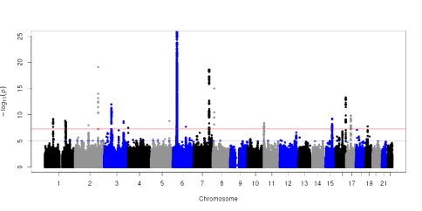
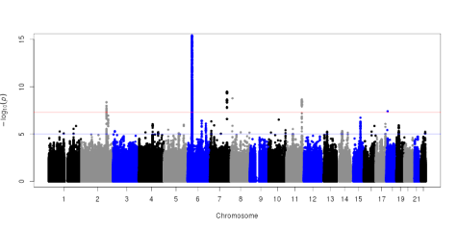
Stratified analysis
lcSSc (5,686) vs Controls (17,584)
LIMITED SSc
MERTK Chr 2q13, MER tyrosine kinase
MERTK
dcSSc (2,524) vs Controls (17,584)
DIFFUSE SSc
ANKRD12 Chr 18p11.22,
ankyrin repeat domain 12
ANKRD12
Dr. Marialbert Acosta-Herrera

Slide 24


Stratified analysis
lcSSc (5,686) vs Controls (17,584)
LIMITED SSc
MERTK Chr 2q13, MER tyrosine kinase
MERTK
dcSSc (2,524) vs Controls (17,584)
DIFFUSE SSc
The associated variant is an eQTL for TWSG1 in fibroblasts.
TWSG1 enhances TGF-beta signaling
in activated T lymphocytes.
ANKRD12
Dr. Marialbert Acosta-Herrera

Slide 25
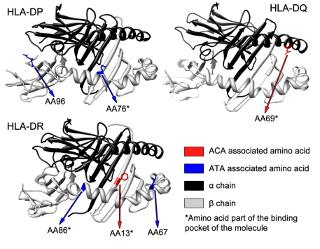


HLA in systemic sclerosis
Immunochip study: An in-depth look into the HLA region
HLA class II : Peptide binding sites and also SNPs
Mayes et al. AJHG (2014)
Dr. Lara Bossini-Castillo

Slide 26

























ACKNOWLEDGMENTS

Slide 27
















ACKNOWLEDGMENTS

Slide 28

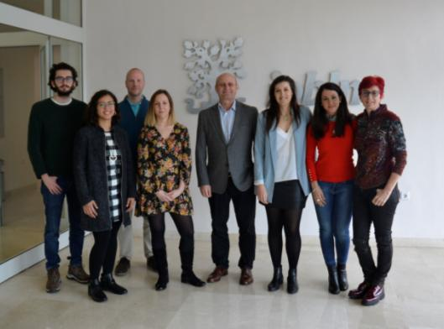

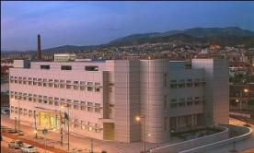

ACKNOWLEDGMENTS
Prof. Javier Martin’s group

Slide 29
Thanks so much for
your attention!
Elena López Isac | PhD
eisac.csic@gmail.com
Centre for Genetics and Genomics Versus Arthritis
University of Manchester
UK

Slide 31
Stratified analysis
lcSSc (5,686) vs Controls (17,584)
dcSSc (2,524) vs Controls (17,584)
NAB1 | STAT4
IKZF3-GSDMB
TNPO3-IRF5
NAB1 | STAT4
TNPO3-IRF5
TNFSF4
DNASE1L3
CD247
IRF8
BLK
DDX6
ANKRD12
IL12RB2
TNIP1
BLK
CD81
IL12RB1
IL12A
MERTK
DGKQ
ATG5
IRF7
CSK

Slide 32
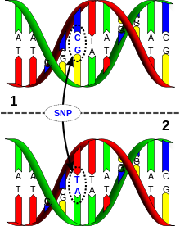
INTRODUCTION
Genetic component of complex diseases
Identification of GENETIC MARKERS associated with the SUSCEPTIBILITY to the disease
Single-Nucleotide Polymorphisms (SNPs)

Slide 33
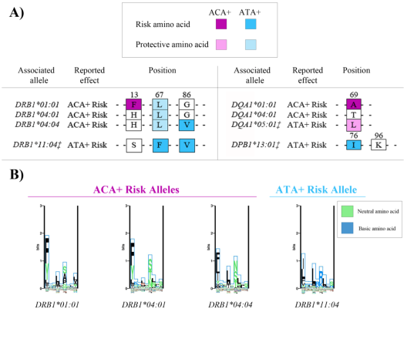

HLA in Systemic Sclerosis
Immunochip study: An in-depth look into the HLA region
Mayes, Bossini-Castillo et al. AJHG (2014)

Slide 34
INTRODUCTION
Systemic Sclerosis: Genetic component
Outside HLA region…
Several loci confirmed at genome-wide significance level.
Second-tier associations have also been described.
IRF5
IRF8
TNIP1
…
CD247
CSK
STAT4
IL12A
IL12RB2 …
…
SSc
DNASE1L3
ATG5
Innate immunity,
interferon signature, inflammation
B and T cell proliferation, survival and cytokine production
Apoptosis
Autophagy

Slide 35
INTRODUCTION
Systemic Sclerosis: Genetic component
Interrogation of the biological pathways that are involved in SSc

Slide 36
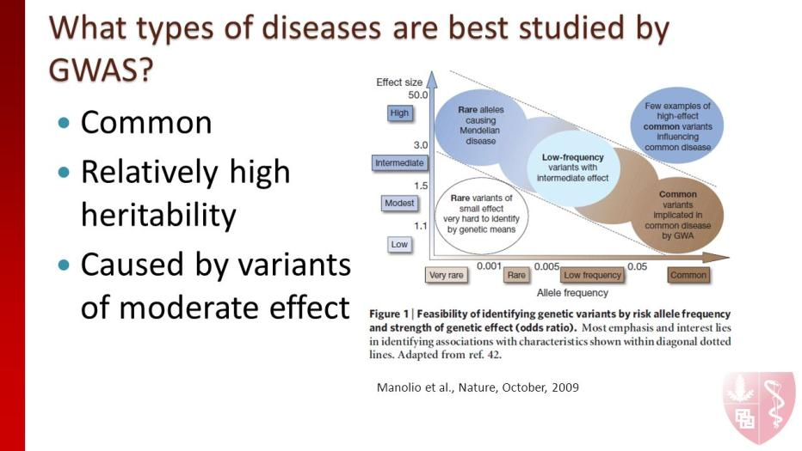

Slide 37
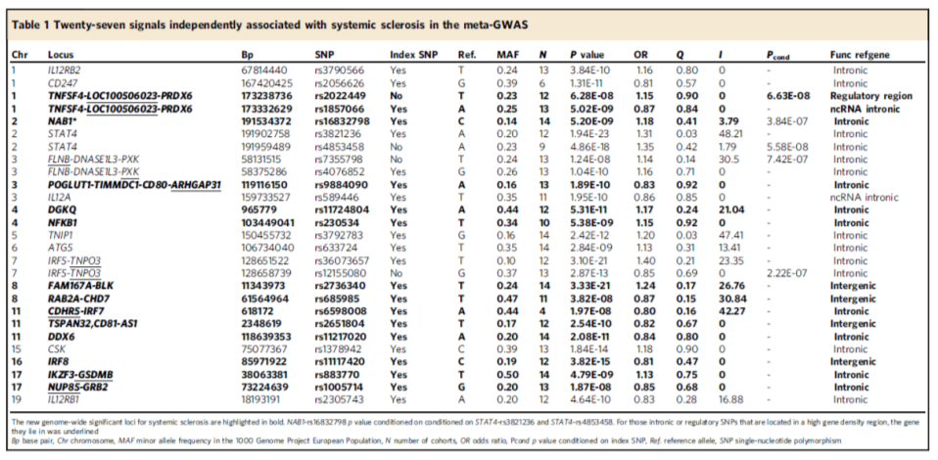
Meta-GWAS systemic sclerosis

