Slide 1

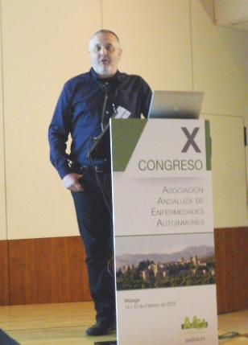


Diagnóstico de las
enfermedades autoinflamatorias en pacientes adultos
José Hernández-Rodríguez
Unidad Clínica de Enfermedades Autoinflamatorias.Unidad de Vasculitis
Servicio de Enfermedades Autoinmunes. Hospital Clínic de Barcelona
IDIBAPS. Universitat de Barcelona

Slide 2
What to know for diagnosing autoinflammatory diseases in adults
Definition and history
Spectrum between autoimmunity and autoinflammation
Spectrum of autoinflammatory diseases: different types
Genetic particularities: interpretation of genetic variants
Monogenic autoinflammatory diseases
Identification of diseases (more and less common)
Diagnostic process in children and adult patients
Clinical and genetic differences between children and adults
Autoinflammatory diseases in adults: the real life

Slide 3
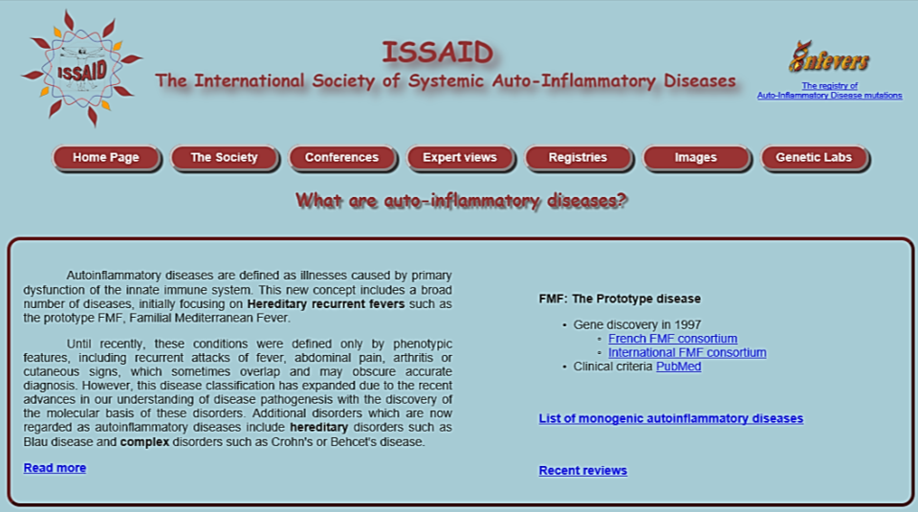
Autoinflammatory diseases
Definition
Autoinflammatory diseases are defined as illnesses caused by primary dysfunction of the innate immune system. This new concept includes a broad number of diseases, initially focusing on Hereditary recurrent fevers such as the prototype FMF, Familial Mediterranean Fever.
Until recently, these conditions were defined only by phenotypic features, including recurrent attacks of fever, abdominal pain, arthritis or cutaneous signs, which sometimes overlap and may obscure accurate diagnosis.
However, this disease classification has expanded due to the recent advances in our understanding of disease pathogenesis with the discovery of the molecular basis of these disorders. Additional disorders which are now regarded as autoinflammatory diseases include hereditary disorders such as Blau disease and complex disorders such as Crohn's or Behçet's disease.

Slide 4
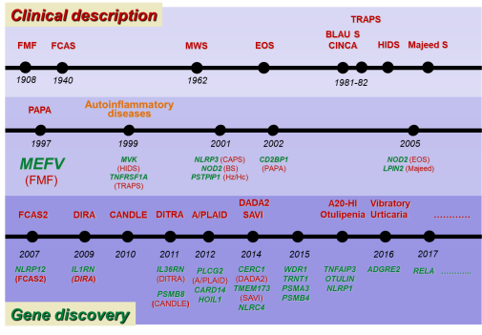
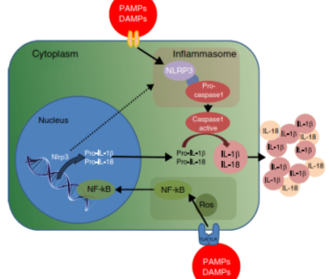
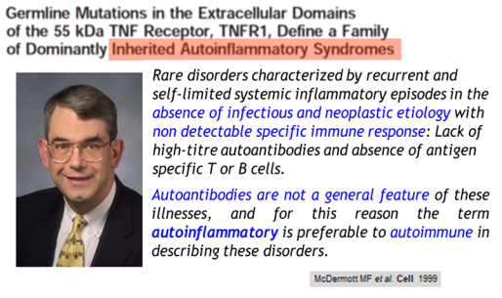
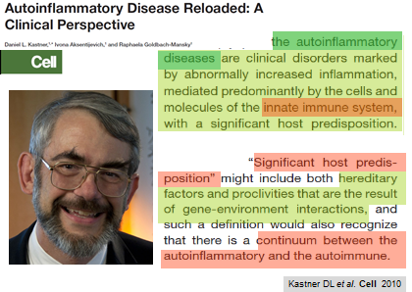
Autoinflammatory diseases
Definition
2002

Slide 5
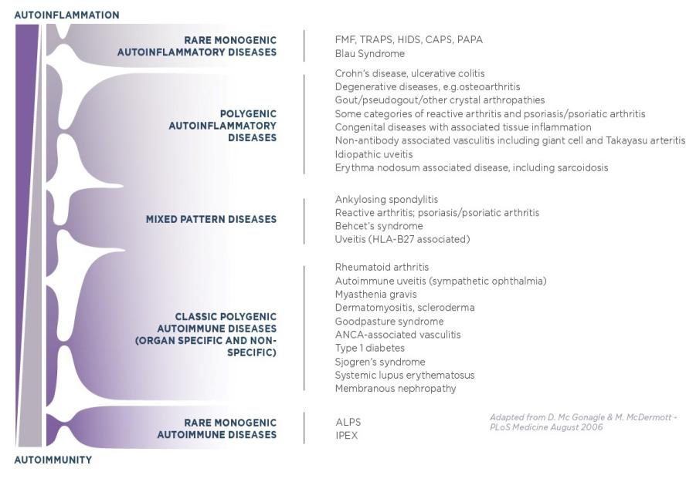
Spectrum of
Autoimmune / Autoinflammatory diseases
Mostly affecting children
Innate immune system
Proinflammatory cytokines
Neutrophils/macrophages
Fever / Tisssue damage
Mostly affecting adults
Adaptive immune system
Loss of self-tolerance
T and B cell activation
Autoantibodies
Tisssue damage
Notes:
A century ago Paul Ehrlich proposed that immune reactivity against self, which he called “horror autotoxicus” and which is now called autoimmunity, would be incompatible with life because of potentially devastating consequences for the host. But Ehrlich was proven wrong after the demonstration of autoantibodies and the emergence of a theoretical basis for autoreactivity. Conceptually, autoimmunity is viewed as a defect of either B or T lymphocyte selection, with aberrant lymphocytic responses to autoantigens. In recent years, an improved genetic understanding of both common and rare diseases, collectively associated with mutations reflecting immune system perturbations—ranging from the thymus, to B and T cells, to T regulatory cells—has vindicated the autoimmunity paradigm …
Autoimmune lymphoproliferative syndrome (ALPS) is a rare genetic disorder of the immune system that affects both children and adults. In ALPS, unusually high numbers of white blood cells called lymphocytes accumulate in the lymph nodes, liver, and spleen, which can lead to enlargement of these organs. ALPS can cause numerous autoimmune problems such as anemia (low count of red blood cells), thrombocytopenia (low count of platelets), and neutropenia (low count of neutrophils, the most common type of white blood cell in humans). ALPS can cause debilitating symptoms and put those affected at an increased risk of developing autoimmune diseases and lymphoma.
Immune dysregulation, polyendocrinopathy, enteropathy, X-linked (IPEX) syndrome primarily affects males and is caused by problems with the immune system. The immune system normally protects the body from foreign invaders, such as bacteria and viruses, by recognizing and attacking these invaders and clearing them from the body. However, the immune system can malfunction and attack the body's own tissues and organs instead, which is known as autoimmunity. IPEX syndrome is characterized by the development of multiple autoimmune disorders in affected individuals. Although IPEX syndrome can affect many different areas of the body, autoimmune disorders involving the intestines, skin, and hormone-producing (endocrine) glands occur most often. IPEX syndrome can be life-threatening in early childhood.

Slide 6
The expanding spectrum of
Autoinflammatory Diseases
Typical clinical picture
Clearly pathogenic mutations
(germ-line or somatic)
Monogenic
AID
Polygenic/
Multifactorial AID
Still, Behçet’s, Crohn’s,
Gout, PFAPA, SoJIA, …
Incomplete/atypical presentation
Low-penetrance mutations
or combination of different variants
(i.e. R92Q in TNFR1, Q703K in NLRP3…)
Undifferentiated
AID
Atypical/overlap manifestations
Negative genetic tests
Response to specific treatments
Unknown/new monogenic disorders

Slide 7
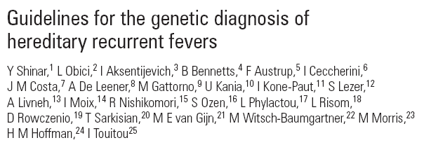
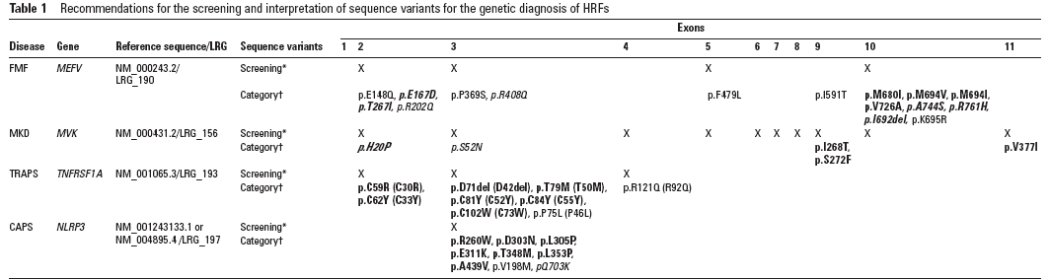
Autoinflammatory diseases
Interpretation of genetic results
Pathogenic or disease-causing mutations
Low- or incomplete-penetrance variants (uncertain clinical significance)
Benign variants or polymorphisms
Notes:
7

Slide 8

Most common monogenic autoinflammatory diseases in our area
FMF → Familiar Mediterranean fever
TRAPS → Tumour necrosis factor (TNF)-receptor
associated periodic syndrome
CAPS → Cryopyrin associated periodic syndrome
FCAS → Familial cold induced autoinflammatory syndrome
MWS → Muckle Wells syndrome
CINCA/NOMID → Neonatal multisystemic disease
(neurologic, cutaneous, articular)
MKD → Mevalonate kinase deficiency
HIDS → Hyper-IgD syndrome and periodic fever
** PFAPA → Periodic fever, aphtous stomatitis, pharingitis and cervical adenitis
Tamir N et al. Am J Med Genet 1999
Marek-Yagel D et al. Arthritis Rheum 2009
Ravet N et al. Ann Rheum Dis 2006
Cantarini L et al. Semin Arthritis Rheum 2014
Cantarini L et al. Clin Exp Rheumatol 2012
Hernández-Rodríguez J et al. AutoimmunRev 2016

Slide 9
Monogenic autoinflammatory diseases with possible onset in adults
Prevalence
FMF → Familiar Mediterranean fever
TRAPS → Tumour necrosis factor (TNF)-receptor associated periodic syndrome
CAPS → Cryopyrin associated periodic syndrome
FCAS → Familial cold induced autoinflammatory syndrome
MWS → Muckle Wells syndrome
HIDS → Hyper-IgD syndrome and periodic fever
1-5/10.000
1-9/1.000.000
1-3/1.000.000
NLRP12-AD → NLRP12 associated disease (FCAS-2)
MAS-NLRC4 → Macrophage activation syndrome associated to NLRC4 (FCAS-4)
DITRA → Deficiency of interkeukin-36 receptor antagonist
Pediatric granulomatous arthritis →Blau syndrome and early onset sarcoidosis
DADA2 → Deficiency of ADA2
SAVI → STING-associated vasculopathy with onset in infancy
<1/1.000.000
or
???
** PFAPA → Periodic fever, aphtous stomatitis, pharingitis and cervical adenitis

Slide 10

Study of autoinflammatory diseases in a reference center for adults
2008-2014

Slide 11
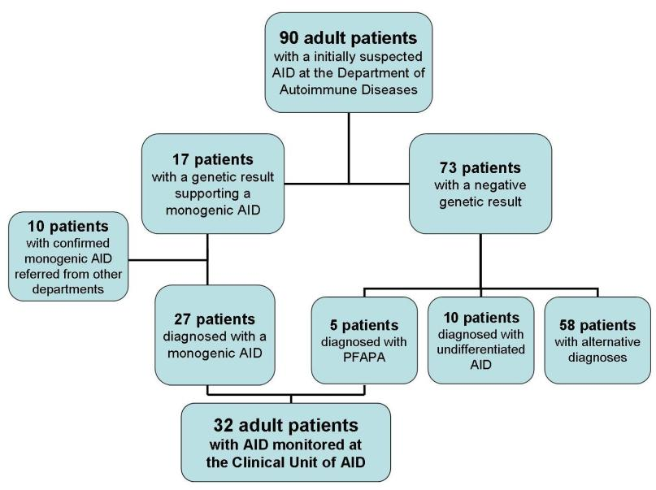
Autoinflammatory diseases in adults: diagnostic process
Flow chart & Results
19%
Hernández-Rodríguez J et al. Autoimmun Rev 2016

Slide 12
Autoinflammatory diseases in adults: diagnostic process
Results
73 (81%) patients with a negative genetic result…
Alternative diagnoses (n=58; 64%)
  Autoimmune diseases (mainly Lupus-like): 21 (32%) patients
  Inflammatory bowel disease (any type): 4 (6%)
  Hypocomplementemic vasculitis, cancer and infections in 2 (3%) each
  Other non-conclusive diagnoses
    Long-lasting / recurrent episodes of abdominal pain/pleuropericarditis: 6
    Ocular/optic nerve involvement: 3
    Angioedema: 3
    Inflammatory lymphadenopathy: 2
    Recurrent lymphocytic meningitis: 2
  Polygenic/multifactorial diseases (n=13; 15%)
    PFAPA: 5 (8%)
    Adult-onset Still disease: 5 (8%)
    Behçet’s disease: 3 (5%)
Probable undifferentiated autoinflammatory diseases (n=10; 12%)
→ negative genetic results but suggestive or atypical clinical manifestations with good response to conventional or biological drugs for autoinflammatory diseases
Hernández-Rodríguez J et al. Autoimmun Rev 2016
Notes:
En un estudio de pacientes atendidos en un centro especializado en enfermedades autoinflamatorias de adultos, de aquellos pacientes en los que se realizó un estudio genético por una sospecha inicial de una enfermedad autoinflamatoria, únicamente el 19% se pudo diagnosticar de una enfermedad monogénica, mientras que los diagnosticados de enfermedades autoinflamatorias poligénicas e indiferenciadas, representaron el 19% y el 12%, respectivamente. En el 50% de casos restante se llegó a un diagnóstico alternativo que no incluía ninguna enfermedad autoinflamatoria.

Slide 13
Autoinflammatory diseases in adults: diagnostic process
Results
32 patients with AID
  FMF 12 (37.5%)
  CAPS 8 (25%) (3 MWS / 5 overlap FCAS/MWS, 1 overlap FCAS/HIDS) – No CINCA patients
  TRAPS 6 (18.8%) (2 overlap with FMF)
  HIDS 1 (3%) (+ 1 overlap FCAS/HIDS)
  PFAPA 5 (16%)
Hernández-Rodríguez J et al. Autoimmun Rev 2016

Slide 14
Autoinflammatory diseases in adults: diagnostic process
Clinical features
Disease-onset: during childhood in 15 (47%) patients
during adulthood in 17 (53%) patients
Disease diagnosis ≥ 16 yrs.
Mean Range
Symptoms onset: 21 yrs ( 1-68 yrs)
Diagnosis: 32 yrs (16-68 yrs)
Diagnostic delay: 12 yrs ( 4-47 yrs)

Slide 15
Autoinflammatory diseases in adults: diagnostic process
Response to treatment / Outcomes
17 (53%)
12 (38%)
(amyloidosis)

Slide 16
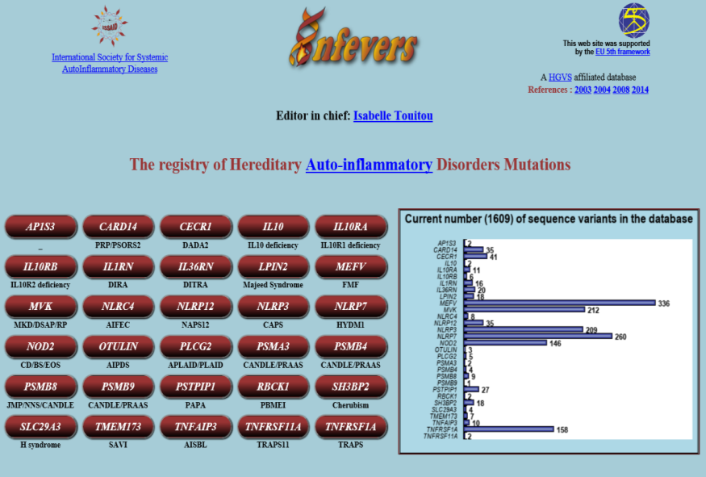
Autoinflammatory diseases in adults
Genetic results
Notes:
16

Slide 17
Autoinflammatory diseases in adults
Genetic results
FMF
TRAPS
CAPS
MKD
MEFV | TNFRSF1A | NLRP3 | MVK
p.M694I/WT (2) p.K695R/WT p.E148Q/WT | p.R92Q/WT (5) | p.V198M/WT (3) p.A439V/WT (3) p.H49R/WT (1) | p.V80I/WT
p.M694I/p.V726A p.M694V/p.E148Q p.M694I/p.R202Q p.I640M/p.R653H p.M582L/p.R202Q p.A744S/p.R202Q p.I591T/p.R202Q p.V690L/E467E | p.P46L/WT (1) | p.R135H/WT (1*) | +p.V377I/WT * same patient

Slide 18
Autoinflammatory diseases in adults
Genetic results
FMF
TRAPS
CAPS
MKD
MEFV | TNFRSF1A | NLRP3 | MVK
p.M694I/WT (2) p.K695R/WT p.E148Q/WT | p.R92Q/WT (5) | p.V198M/WT (3) p.A439V/WT (3) p.H49R/WT (1) | p.V80I/WT
p.M694I/p.V726A p.M694V/p.E148Q p.M694I/p.R202Q p.I640M/p.R653H p.M582L/p.R202Q p.A744S/p.R202Q p.I591T/p.R202Q p.V690L/E467E | p.P46L/WT (1) | p.R135H/WT (1*) | +p.V377I/WT * same patient
50%
100%
75%
50%
73% Genetic variants of uncertain clinical significance
Low-penetrance mutations
Novel mutations
Polymorphysms
100% Heterozygous (simple or compounds)

Slide 19
Autoinflammatory diseases in adults
Genetic results
TRAPS
TNFRSF1A
p.R92Q/WT (5)
p.P46L/WT (1)
Almost all “TRAPS” with onset in the adulthood were caused by the R92Q variant…
… in our series

Slide 20
Autoinflammatory diseases in adults
TRAPS
Eurofever/EUROTRAPS International Registry
 | Pediatric onset | Adult onset | Total Variants
Cysteine residue /T50M mutations | 50 (41%) | 8 (23%) | 58 (37%)
Other variants | 31 (25%) | 10 (28%) | 41 (26%)
R92Q / P46L variants | 42 (34%) | 17 (49%) | 59 (37%)
Total patients | 123 (78%) | 35 (22%) | 158 (100%)
Lachmann HL et al. Ann Rheum Dis 2014
Our TRAPS (R92Q) extended series → 7 patients with adult-onset
18 patients → 11 patients with pediatric onset
4 diagnosed during adulthood
Ruiz-Ortiz E et al. Frontiers Immunol 2017

Slide 21
Autoinflammatory diseases in adults
TRAPS – TREATMENT & OUTCOMES
TRAPS (STRUCTURAL MUTATIONS)
→ 100% on continuous treatment (glucocorticoids or biologics)
TRAPS (R92Q-related disease)
→28% asymptomatic and treatment-free
→50% NSAIDs or glucocorticoids on-demand
→ 22% biologic agents
Pelagatti MA et al. Arthritis Rheum 2011
Cantarini L et al. Semin Arthritis Rheum 2014
Ruiz-Ortiz E et al. Frontiers Immunol 2017

Slide 22
Autoinflammatory Diseases
in pediatric and adult patients
Pediatric age
More severe disease
Disease-causing mutations
Adulthood
Clinical onset in adult life
Clinical onset during childhood → diagnostic in adulthood
Diagnostic delay
→ symptoms misinterpreted by physicians
… mild / minimized by patients??
Less severe / mild disease
Low-penetrance mutations

Slide 23
FMF
Adult onset
Characteristics in adult onset compared to children onset | FMF
Clinical | Lower frequency of abdominal pain, arthralgia, myalgia, pleuritis, skin lesions
Genetic | Higher frequency of simple heterozygous variants and heterozygous compounds by pathogenic mutations, low penetrance variants (E148Q) or polymorphisms (R202Q)
Hernández-Rodríguez J et al. Med Clin (Barc) 2018

Slide 24
TRAPS
Adult onset
Characteristics in adult onset compared to children onset | TRAPS
Clinical | Lower frequency of myalgia, painful rash, conjunctivitis, periorbital edema
Genetic | Higher frequency of low-penetrance variants (mostly R92Q)
Hernández-Rodríguez J et al. Med Clin (Barc) 2018

Slide 25
CAPS
Adult onset
Characteristics in adult onset compared to children onset | CAPS FCAS / MWS
Clinical | Lower frequency of urticarial rash, myalgia, arthralgia and neurosensory hearing loss
Genetic | Low-penetrance variants and polymorphisms (V198M, A439V, Q703K) in mild phenotypes (FCAS/MWS) ** Somatic mutations may be associated with adult onset (mild FCAS) and also with a severe phenotype of FCAS and MWS in adults (neurosensorial hearing loss and amyloidosis) … probably due to a diagnostic and treatment delay …
Bujan-Rivas S et al. Clin Exp Rheumatol 2017
Rowczenio DM et al. Front Immunol 2017
Hernández-Rodríguez J et al. Med Clin (Barc) 2018

Slide 26
HIDS
Adult onset
Characteristics in adult onset compared to children onset | HIDS
Clinical | Predominance of abdominal symptoms (abdominal pain, nausea and vomits) and maculopapular rash No oral aphthae or adenopathies
Genetic | Presence of c.769.38 C>T variant (considered as probably benign), in homozygous or heterozygous compounds
Tas DA et al. Clin Rheumatol 2012
Hernández-Rodríguez J et al. Med Clin (Barc) 2018

Slide 27
PFAPA
Adult onset
Characteristics in adult onset compared to children onset | PFAPA
Clinical | Incomplete clinical triad (oral aphthae, pharyngitis /tonsillitis and cervical adenitis) Lower frequency of oral aphthae
Treatment | Glucocorticoids (high dose – 1-2 days) effective (similar to children) Poor response to tonsillectomy
Cantarini L et al. Clin Exp Rheumatol 2012
Hernández-Rodríguez J et al. Med Clin (Barc) 2018

Slide 28
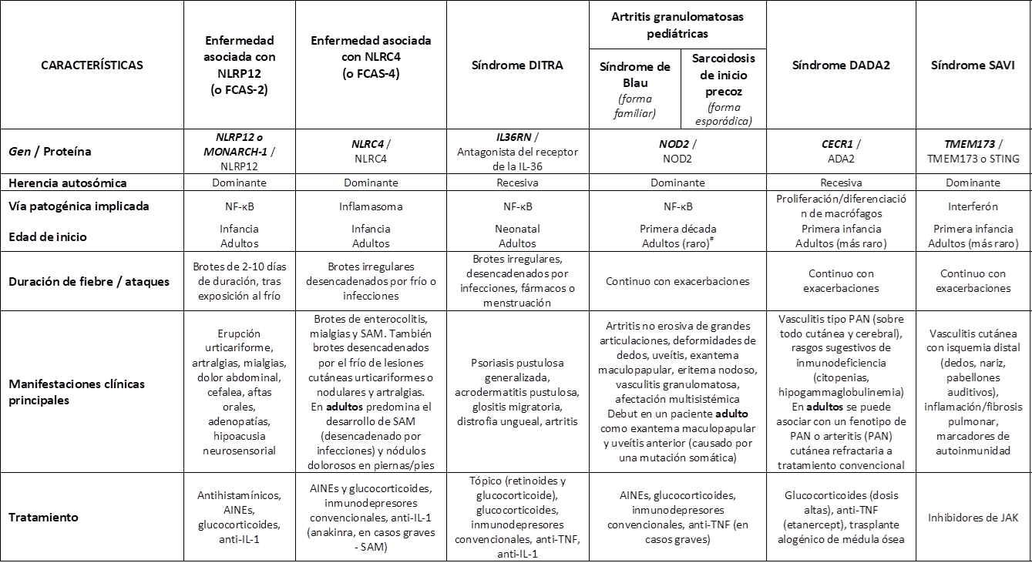
Less frequent
autoinflammatory diseases in adults

Slide 29
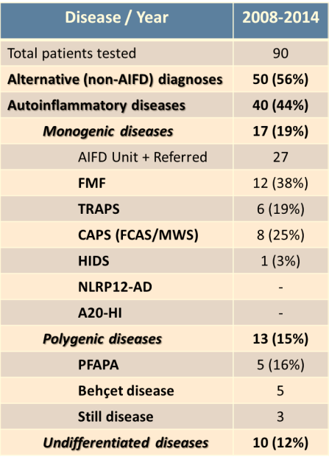
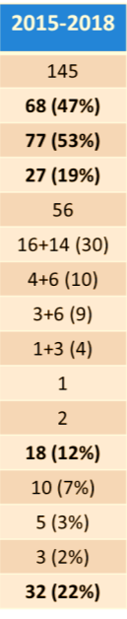
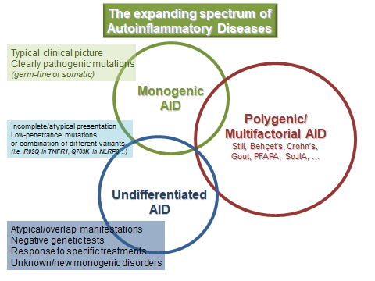
Autoinflammatory diseases in adults: real life
Notes:
19% 13% 18%

Slide 30
Autoinflammatory diseases in adults
Conclusiones I
Las enfermedades autoinflamatorias monogénicas generalmente afectan a los niños, pero también pueden tener un inicio en la edad adulta, y se presentan con un fenotipo algo diferente al que manifiestan los niños, con frecuencia atípico o incompleto
Algunos casos que debutan en la edad pediátrica pueden llegar a ser diagnosticadas durante la edad adulta, con un retraso diagnóstico considerable
Las enfermedades autoinflamatorias poligénicas o multifactoriales, y otras consideradas indiferenciadas, también pueden tener su inicio en la edad adulta

Slide 31
Autoinflammatory diseases in adults
Conclusiones II
Las enfermedades autoinflamatorias poligénicas o multifactoriales son enfermedades sistémicas que también pueden compartir algún mecanismo de autoinmunidad
Las enfermedades autoinflamatorias indiferenciadas son aquellas que se presentan con manifestaciones inflamatorias, en las que el estudio de los genes conocidos es negativo y el tratamiento dirigido a bloquear mismas vías inflamatorias que funcionan en las enfermedades monogénicas es efectivo
Las enfermedades autoinflamatorias en pacientes adultos tienen un espectro de presentación muy amplio y con frecuencia atípico, y su proceso diagnóstico suele ser complejo

Slide 32
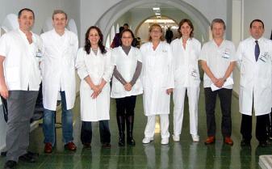

Acknowledgments:
Autoinflammatory Diseases Clinical Unit
Autoinflammatory Diseases Laboratory
Department of Autoimmune Diseases
Department of Immunology
Dept. Internal Medicine
Dept. Rheumatology
Dept. Infectious Diseases
Dept. Dermatology
Dept. Ophthalmology
…
… other centers in Spain …
Notes:
32

Slide 33
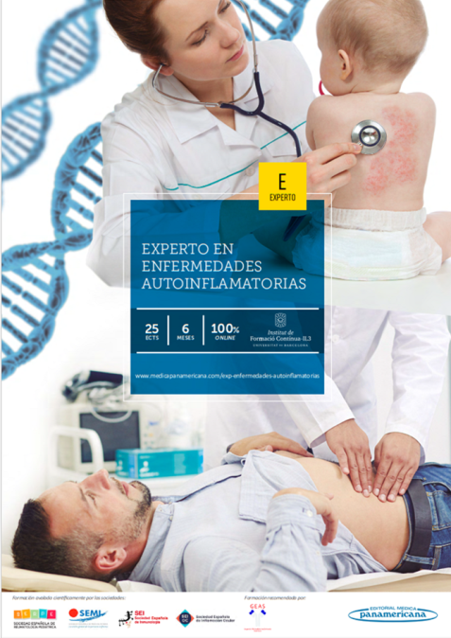
¡¡Gracias por su atención !!

