Slide 1
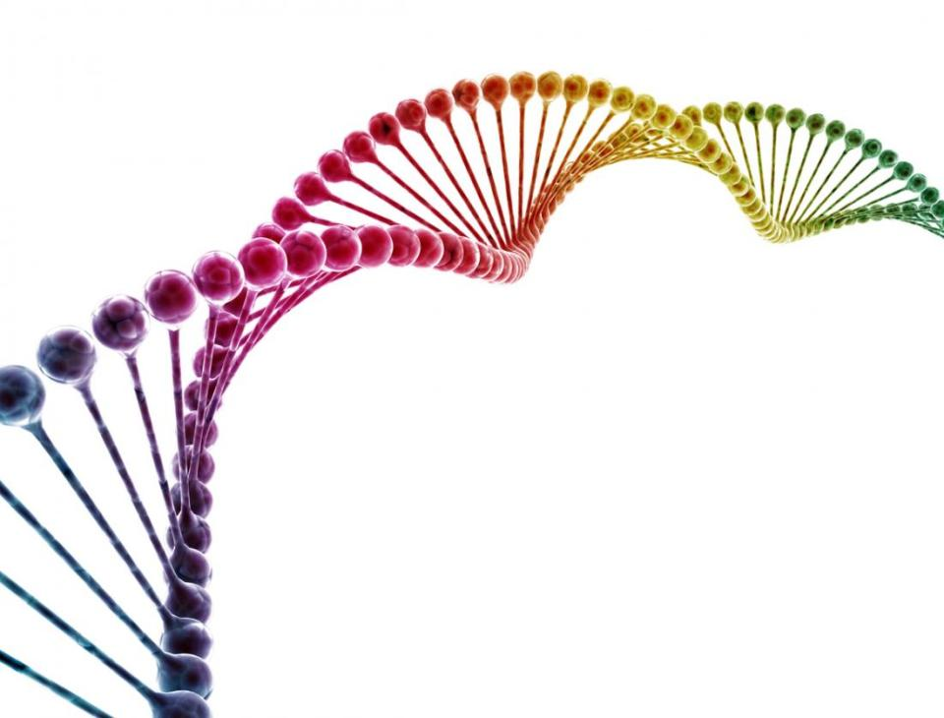
Deciphering the genetic compoment of giant cell arteritis
Ana Márquez Ortiz
Córdoba, 2018

Slide 2
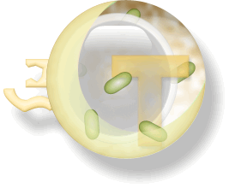
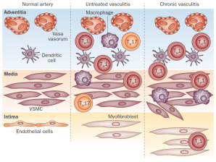
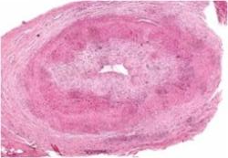
Aetiology of Vasculitis
Genetic factors
Environmental factors
(viral, bacterial)
Anti-endothelial response
Pro-inflammatory cytokines

Slide 3
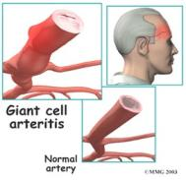
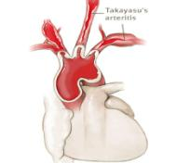
Why to study the genetics of vasculitides
Mechanisms of disease
Biomarkers /
Prognosis
Evidence of change BEFORE disease onset
Discriminate between pathways and cells that cause disease rather than those that are a consequence of disease
Strong clues into disease mechanism
May identify biomarkers for prognosis or targets for therapeutic intervention
Precision Medicine
Stratified Medicine
New therapeutic targets

Slide 4
GCA genetics
HLA region (HLA-DRB1*04)
Cytokines and their receptors (IL10, IL6, IFGN, IL12RB2, …)
Molecules involved in the endothelial function (ICAM1, VEGF, NOS2A, …)
Genes of the innate immunity (TLR4, FCGR2A/3A, …)

Slide 5
GCA genetics
HLA region (HLA-DRB1*04)
Cytokines and their receptors (IL10, IL6, IFGN, IL12RB2, …)
Molecules involved in the endothelial function (ICAM1, VEGF, NOS2A, …)
Genes of the innate immunity (TLR4, FCGR2A/3A, …)
UNDERPOWERED

Slide 6
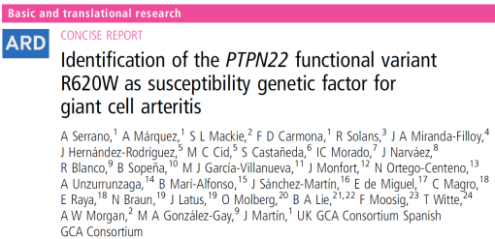
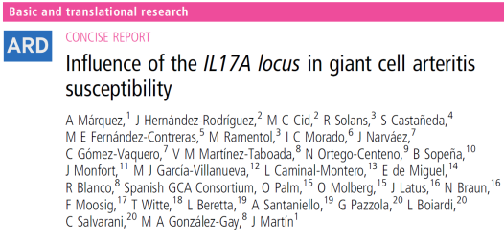
GCA genetics
 | GCA cases | Controls
Spain | 931 | 1845
Italy | 178 | 1175
UK | 156 | 5199
Norway | 83 | 279
Germany | 74 | 480
 | 1,422 | 8,978

Slide 7
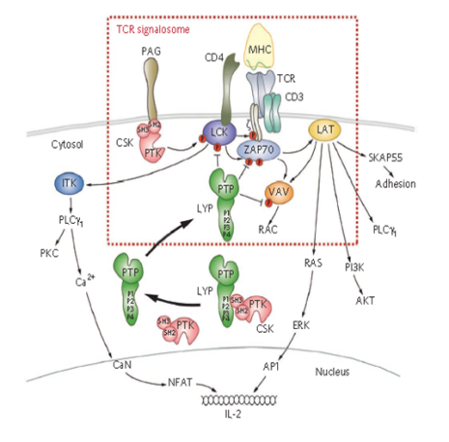
PTPN22
Lymphoid tyrosine phosphatase (LYP).
Critical regulator of signalling in T and B lymphocytes.
Vang et al., Nat Chem Biol, 2012; 8:437-46.

Slide 8
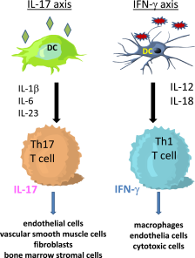
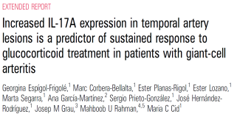
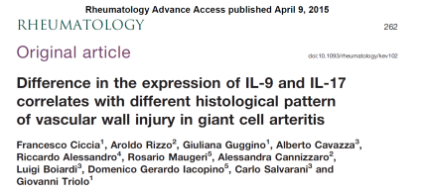
IL17A
Circulation. 2010.
Weyand et al., Curr Opin Rheumatol, 2011; 23:43-9.

Slide 9
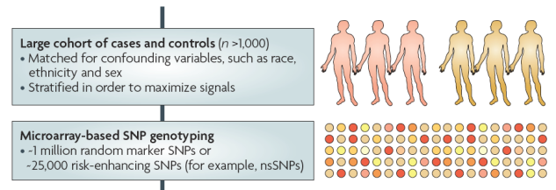
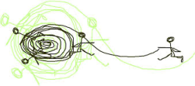
The era of Genome Wide Association Studies – GWAS
Genetic markers across the whole genome / Common variants > 5%
Non-hypothesis-driven analysis
Hypothesis generating approach

Slide 10
The Immunochip (iChip)
Rheumatoid
arthritis
Custom Illumina array
186 GWAS hits and fine mapping of immune-related loci
196,524 polymorphisms
Dense HLA set
Multi disease project makes identification of overlapping loci feasible.
Systemic lupus erythematosus
Crohn’s disease
Coeliac disease
Type 1
diabetes
Ankylosing
spondylitis
IgA deficiency
Autoimmune thyroid disease
Ulcerative colitis
Multiple sclerosis
Psoriasis
Primary biliary cirrhosis

Slide 11
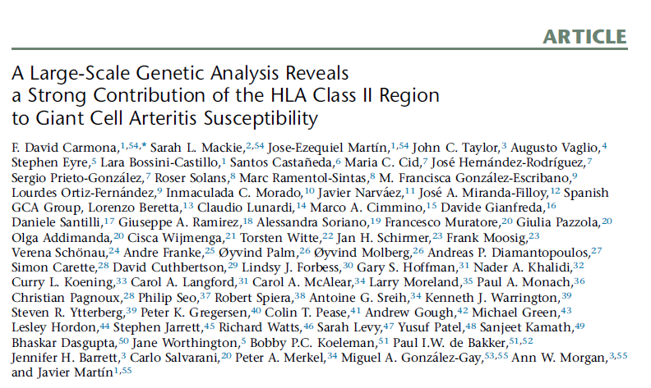
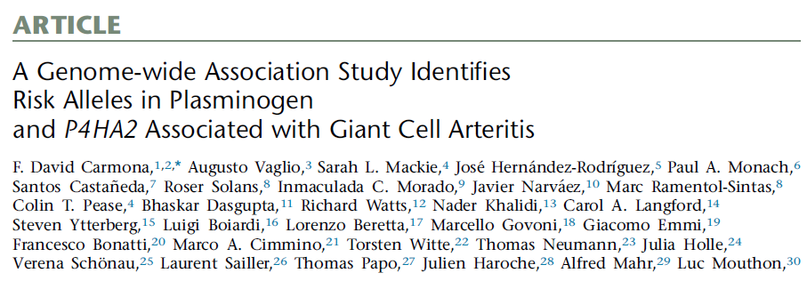
GCA genetics – GWAS and Immunochip

Slide 12
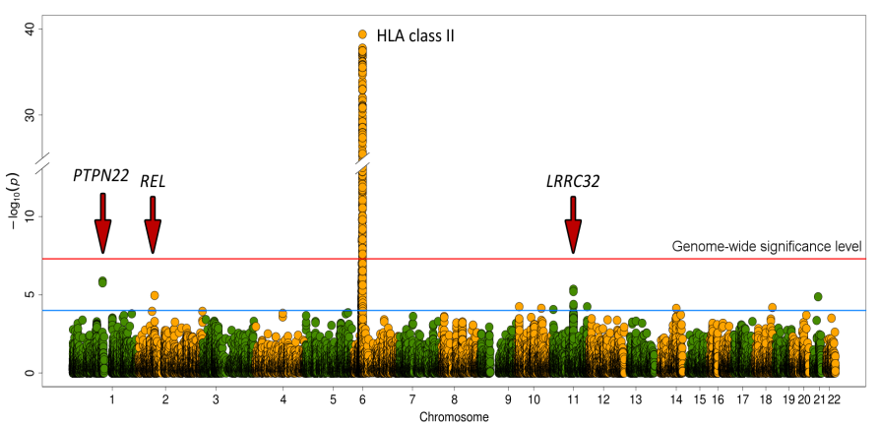
Giant Cell Arterits - ImmunoChip
1,651 GCA cases
and 15,306 controls
Carmona FD et al., AJHG, 2015.

Slide 13
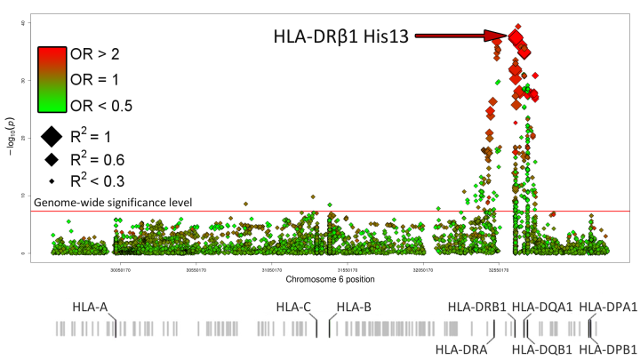
HLA region
Carmona FD et al., AJHG, 2015.

Slide 14
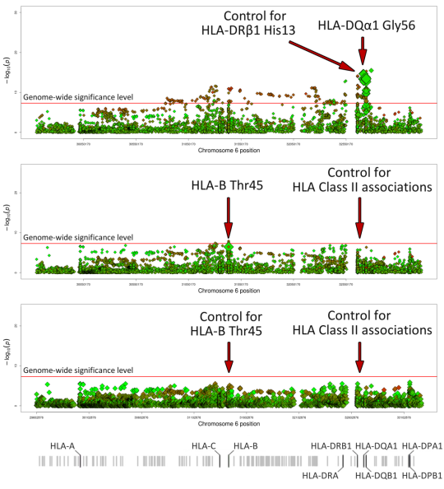
Step-wise analysis
Carmona FD et al., AJHG, 2015.

Slide 15
Amino acid positions
Carmona FD et al., AJHG, 2015.

Slide 16
Non-HLA region
Chr | rs ID | Position (GRCh36) | Locus | Change | P-value | OR [95% CI]
1 | rs2476601 | 114,179,091 | PTPN22 | A<G | 1.73E-06 | 1.38 [1.21-1.58]
11 | rs10160518 | 75,974,319 | LRRC32 | A<G | 4.39E-06 | 1.20 [1.11-1.29]
Carmona FD et al., AJHG, 2015.

Slide 17
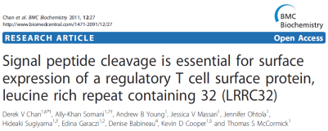
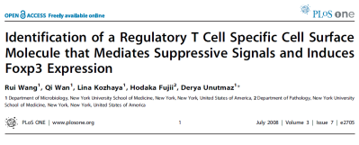
LRRC32
High and specific expression on T regs.
Alters the surface expression of T cell activation markers.
Associated with atopic dermatitis and allergic rhinitis.

Slide 18
Giant Cell Arteritis - GWAS
2,141 GCA cases and 9,125 controls
Carmona FD et al. Am J Hum Genet 2017

Slide 19
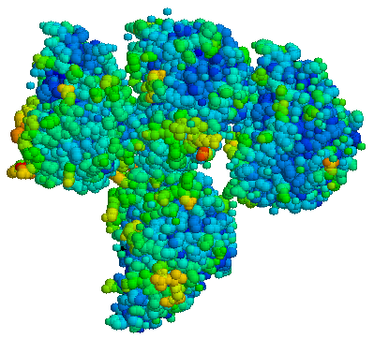
Plasminogen –PLG
Plasminogen is the precursor of the serine protease plasmin, a central enzyme of the fibrinolytic system.
Plasminogen is involved in a wide spectrum of physiological processes, some of which are relevant for GCA pathogenesis, such as wound healing, angiogenesis, lymphocyte recruitment and inflammation
Carmona FD et al. Am J Hum Genet 2017

Slide 20
Prolyl4-hydroxylase subunit alpha 2 (P4HA2)
P4HA2 is an essential enzyme in collagen synthesis
P4HA2 expression is induced by hypoxia through hypoxia-inducible factor-1 (HIF-1), which also induces the expression of genes coding for proteins involved in GCA pathogenesis, such as IL-6, MMP9 and VEGF

Slide 21
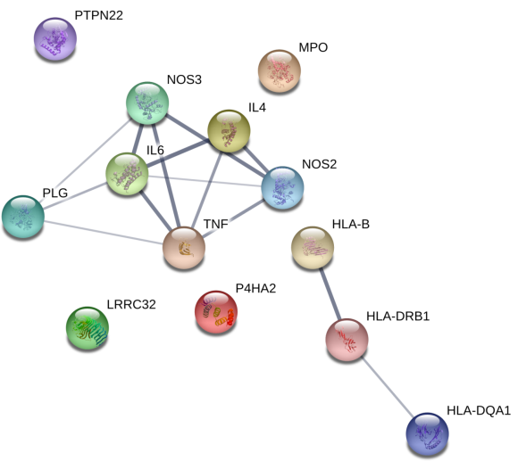
Pathway analysis
GO biological process | P-value
Cytokine production | 7.74E-08
Response to external stimulus | 9.91E-08
Cell-cell adhesion | 2.12E-07
Response to wounding | 2.78E-07
Response to stress | 3.35E-07
Cell activation | 1.06E-06
Response to bacterium | 1.24E-06
Interleukin-6 production | 2.98E-05
Leukocyte activation | 3.37E-05
Defense response | 4.81E-05
Inflammatory response | 9.95E-05
Carmona FD et al. Am J Hum Genet 2017

Slide 22
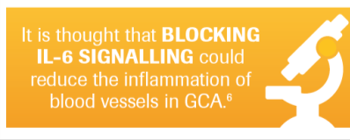
Anti -IL6R therapy in GCA

Slide 23
Cross-disease meta-analysis
Difficulty in identifying genetic risk variants with modest effects
Large sample size
Low prevalence of immune-mediated diseases
To increase the statistical power.
To determine novel shared genetic risk factors.
To better understand the pathophysiological pathways common to these diseases.
Common genetic
background
Combining GWAS/Ichip data from different diseases as a single phenotype

Slide 24
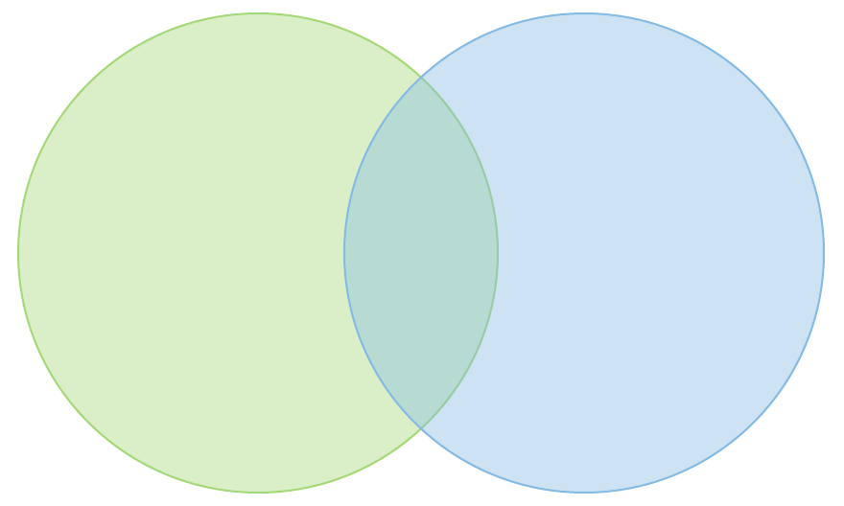
Meta-iChip of LVV
1,434 cases and 3,814 controls
Giant Cell Arteritis (GCA)
Takayasu Arteritis (TAK)
IL12B
Carmona FD et al. Sci Rep 2017

Slide 25
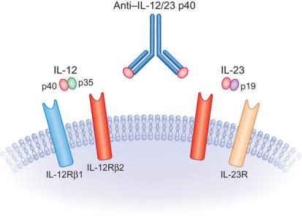
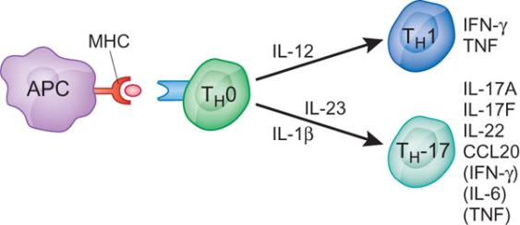
IL12B
IL12B encodes the P40 subunit.
It is common to IL-12 and IL-23.
They are involved in TH1 and TH-17 differentiation and function.
Steinman et al., Nat Immunol, 2010.

Slide 26
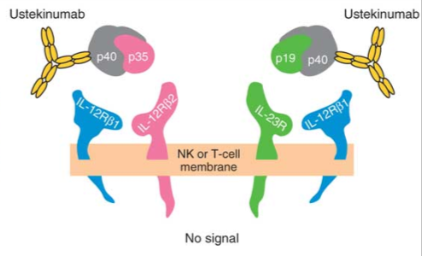
IL12B: Novel therapeutic target in vasculitis
Ustekinumab, a human monoclonal antibody against the shared p40 subunit of IL-12 and IL-23
Used in psoriatic arthritis treatment
Very promising for other immune-mediated diseases
Benson et al., Nat Biotechnol, 2011

Slide 27
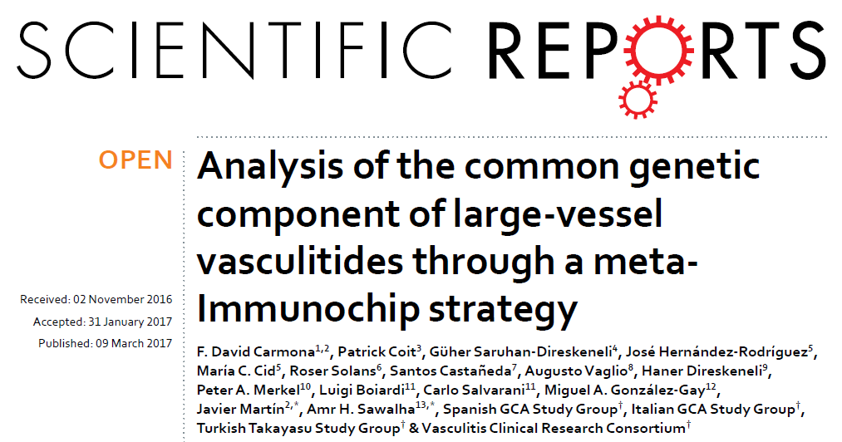
Meta-iChip of LVV

Slide 28
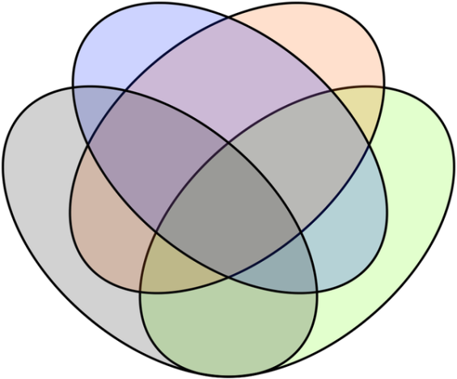
Meta-Ichip of 4 vasculitides
2,465 cases and 4,632 controls
Takayasu Arteritis (TAK)
Henoch-Schönlein Purpura (IgAV)
ANCA- Associated Vasculitis (AAV)
Giant Cell Arteritis (GCA)
Ortiz-Fernández L et al. Ann Rheum Dis 2018

Slide 29
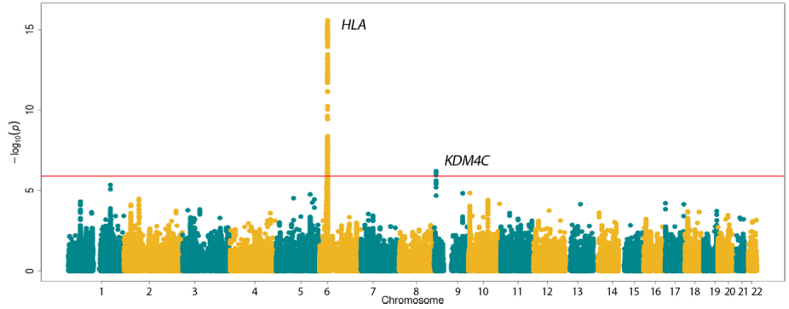
Meta-Ichip of 4 vasculitides
2,465 cases and 4,632 controls
KDM4C encodes a trimethylation-specific demethylase that controls the methylation state of histone residues, affecting gene expression and chromatin structure
Ortiz-Fernández L et al. Ann Rheum Dis 2018

Slide 30
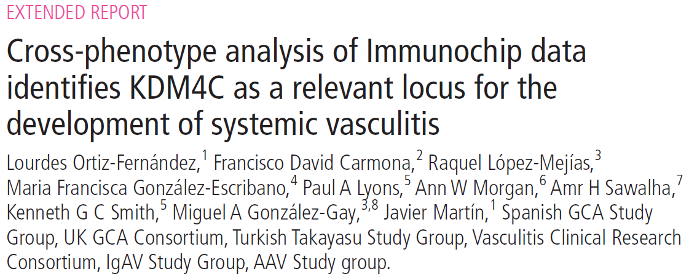
Meta-Ichip of 4 vasculitides

Slide 31
Aetiology of Vasculitis
Epigenetics
Genetic factors
Environmental factors
(viral, bacterial)
Anti-endothelial response
Pro-inflammatory cytokines

Slide 32
Future Directions
Integrative –omics for GCA
Untreated patients in remission
Treated patients in remission
Untreated patients with active disease
Healthy controls
CD4+ T cells
Monocytes
Genomics
Transcriptomics
Epigenomics
Integrative analysis of multi-omic data
Vs.
Vs.
Case/control study
Case/case study
Insights into disease pathogenesis
Biomarkers for diagnosis and treatment response
New targets for intervention

Slide 33
Collaborators
- P.A. Merkel
- A.H. Sawalha
VCRC
M.A. González-Gay
M.C. Cid
Pepe Hernández
S. Castañeda
- R. Solans
Spanish GCA Consortium
C. Salvarani
L. Beretta
- M. Cimmino
- Italian GCA Consortium
- A.W. Morgan
S. L. Mackie
- UK GCA Consortium
- E. Molloy / P. Gallagher
- E. Brouwer
- A. Voskuyl
- T. Daikeler / C. Berger
- D. Blockmans
- M. Milchert / K. Fischer
- T. Witte
- J. Holle
- F. Moosig
V. Schönau
GermanGCA Consortium
- Ø. Molberg / Ø. Palm
- A. Diamantopoulos
- Thomas Papo
- J. Haroche
- L. Mouthon
- A. Mahr

Slide 34
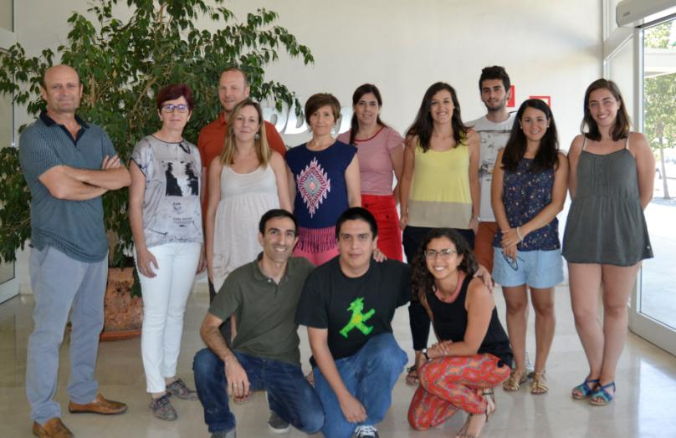
Javier Martin’s group

Slide 35
Thanks so much for
your attention!

