Slide 1


Seguridad de los tratamientos biológicos
Juan J Gomez-Reino
Fundación Ramón Domínguez, IDIS
Hospital Clínico Universitario
Santiago de Compostela

Slide 2
Cellular and molecular players of rheumatoid synovitis: Novel treatments
Semerano L et al. Trends Mol Med.2016 Mar;22:214-29

Slide 3
Overview of risk characterisation model: bDMARD as comparator
Curtis JR, et al. Clin Rheumatol. 2017;36:683-688

Slide 4
Overview of risk characterisation model
Event | IR reported for external bDMARD comparator population per 100 pt-yrs | Exposure (pt-yrs) to tofacitinib to detect an assumed increased risk relative to bDMARDs with 90 % power
 |  | 1.2× | 1.5× | 2.0×
SIE | Point estimate 4.90 | 6151 | 1076 | 311
 | Lower 95 % CI 4.41 | 6568 | 1230 | 348
 | Upper 95 % CI 5.44 | 5384 | 985 | 296
Malignancies (excluding NMSC) | Point estimate 0.95 | 30,945 | 5704 | 1699
 | Lower 95 % CI 0.79 | 38,165 | 6872 | 2004
 | Upper 95 % CI 1.14 | 25,734 | 4743 | 1413
NMSC | 0.35 | 84,544 | 15,241 | 4349
 | Low 0.21 | 137,762 | 25,444 | 7263
 | High 1.34 | 22,366 | 3933 | 1146
MACE | 0.54 | 54,684 | 10,084 | 2942
OI | 0.25 | 118,491 | 21,363 | 6098
Lymphoma | Low 0.019 | 1,562,987 | 281,872 | 80,494
 | High 0.34 | 87,040 | 15,691 | 4478
GI perforation | 0.13 | 228,162 | 39,228 | 11,746
 | Lower 95 % CI 0.08 | 370,964 | 66,896 | 19,101
 | Upper 95 % CI 0.19 | 156,011 | 28,129 | 8030
Adapted from Curtis JR, et al. Clin Rheumatol. 2017;36:683-688

Slide 5
Infections and bDMARD

Slide 6
Infections among patients with RA and healthy controls from a Minnesota cohort in the pre-biologic era
Infection type | Patients, no. |  | Infections, no. |  | Incidence/100 person-years (all events/person) |  | Rate ratio | 95% confidence interval
 | RA | Non-RA | RA | Non-RA | RA | Non-RA
Total | 389 | 343 | 1,481 | 1,137 | 19.64 | 12.87 | 1.53 | 1.41–1.65
Bacteremia/ septicemia | 53 | 39 | 60 | 47 | 0.78 | 0.51 | 1.50 | 1.10–2.08
Septic arthritis | 22 | 2 | 31 | 2 | 0.40 | 0.02 | 14.89 | 6.12–73.71
Osteomyelitis | 11 | 1 | 13 | 1 | 0.17 | 0.01 | 10.63 | 3.39–126.81
Pneumonia | 179 | 135 | 311 | 218 | 4.02 | 2.39 | 1.68 | 1.46-1.95
Lower respiratory tract | 52 | 35 | 83 | 52 | 1.07 | 0.57 | 1.88 | 1.41–2.53
Skin/soft tissue | 132 | 59 | 231 | 83 | 2.99 | 0.91 | 3.28 | 2.67–4.07
Intra-abdominal | 17 | 7 | 17 | 7 | 0.22 | 0.08 | 2.76 | 1.39–6.22
Other | 23 | 15 | 29 | 17 | 0.38 | 0.19 | 1.99 | 1.22–3.36
Doran MF, et al. Arthritis Rheum 2002;46:2287–93

Slide 7
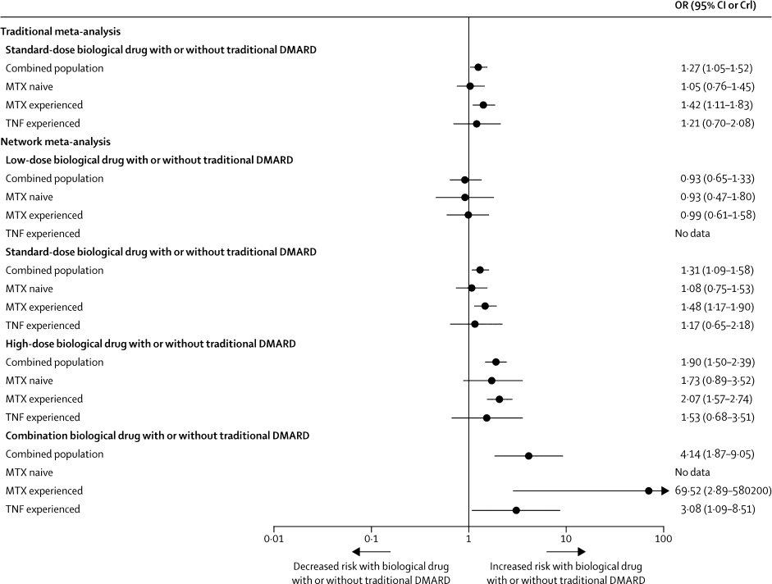
Risk of serious infection in biological treatment of patients with rheumatoid arthritis: meta-analysis
Singh JA, et al. Lancet. 2015;386(9990):258-65

Slide 8
Histogram showing percentage of patients from the 2 clinical RA cohorts that would be ineligible for the 30 biologic RCTs.
Vashisht P, et al. Arthritis Care Res (Hoboken). 2016;68:1478-88

Slide 9
Relevant differences across biologic registries
Number and types of clinical variables
Proportion of patients receiving each agent
Eligibility criteria, number of patients enrolled, and recruiting methods
Baseline characteristics of RA patients
Reimbursement criteria and physician practices/preferences
Prescribing practices for traditional DMARDs
Biologic usage, patterns of comorbidity, and socio-demographic and geographic factors (eg, background rates of opportunistic infections)
Heterogeneous efficacy and safety between individual registries can be explained by differences in:
  Recruitment methods and inclusion criteria for both biologic and comparator cohorts
  Patient demographics and comorbidities
  Analytic approaches
Curtis JR et al. et al. Semin Arthritis Rheum 2010 40: 2–14; Zink et al. Ann Rheum Dis 2009;68:1240–1246

Slide 10
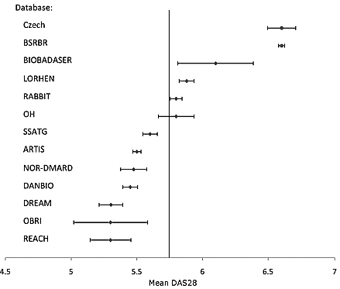
Mean baseline DAS28 scores from the Canadian (OH, OBRI, REACH) and 10 European RA registries
Pease C et al. et al. Semin Arthritis Rheum 2011;41:81-9

Slide 11
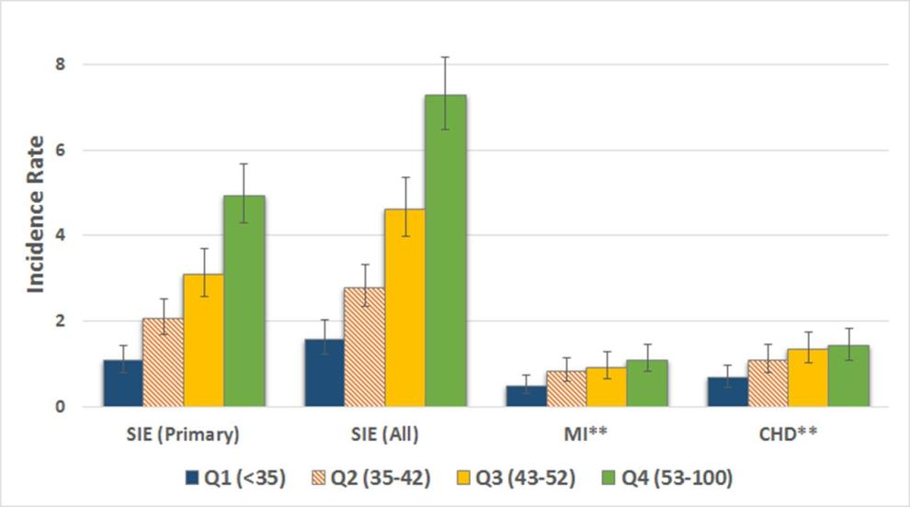
Incidence rates of hospitalised infections, MI and CHD events by quartile of MBDA
a validated 12-protein biomarker assay
Jeffrey R Curtis et al. Ann Rheum Dis doi:10.1136/annrheumdis-2017-211727
Notes:
Incidence rates* of hospitalised infections, MI and CHD events by quartile of MBDA. Error bars represent the 95% CIs around the incidence rate. *Rates per 100 patient-years. **Primary or Secondary. CHD, coronary heart disease; MBDA, multibiomarker disease activity; MI, myocardial infarction; SIE, serious infection event.

Slide 12
Estimated incidences of serious infections in 100 patients per year by treatment and risk profile.
Additional risk factors are one or two of the following: age >60 years, chronic lung disease, chronic renal disease or high number of treatment failures; three risk factors: two of the above risk factors plus prior serious infections. DMARD, disease-modifying antirheumatic drug; TNFi, tumour necrosis factor inhibitor.
Strangfeld A et al. Ann Rheum Dis. 2011;70:1914-20

Slide 13
Incidence of serious infections with anti-TNF therapy in registries
5.0
Follow-up period of risk estimate
4.0
UK national register
US claims data
3.0
RCT meta-analysis
Incidence rate ratio (95% CI)
Swedish national register
2.0
German national register
1.0
1
2
3
0.8
0.6
Time period of risk assessment (years)
modified from: Askling & Dixon, Curr Opin Rheumatol, 2008; 20:138-44
Notes:
If all the publications in the field are ordered according to the average length of time on the drug then another reason for the differences emerges. The risk is increased early after starting the drug but then plateaus as the highest risk patients stop taking the drug. One registry might eventually have hit on this explanation but it emerged much more quickly because of investigators trying to understand the underlying pattern

Slide 14
Crude rates of serious infections per 100 patient-years (pyrs): RABBIT
 | Exposure time (pyrs) | n | Per 100 pyrs | 95% CI | Incidence rate ratio (IRR)
Year 1
DMARD treatment | 1765 | 40 | 2.3 | 1.6 to 3.1 | 2.13
Anti-TNF agents | 3041 | 147 | 4.8 | 4.1 to 5.7
Year 2
DMARD treatment | 1696 | 40 | 2.4 | 1.7 to 3.2 | 1.36
Anti-TNF agents | 2564 | 82 | 3.2 | 2.9 to 4.0
Year 3
DMARD treatment | 1397 | 35 | 2.5 | 1.8 to 3.5 | 0.88
Anti-TNF agents | 2186 | 48 | 2.2 | 1.6 to 2.9
Strangfeld A et al. Ann Rheum Dis. 2011;70:1914-20

Slide 15
One year infection risk difference between various biologics referent to abatacept: Medicare data
Risk score
Comparing individual biologics, abatacept and etanercept had the lowest rate of subsequent hospitalized infection
Yun H, et al. Ann Rheum Dis. 2015; 74: 1065–1071

Slide 16
Active tuberculosis and bDMARD

Slide 17
Risk of active tuberculosis in RA patients never exposed to TNF antagonists
 | Country | Type of study | Risk
Brassard et al. | Canada | Billing and hospitalization databases | IR 45/100,000
Yamada et al. | Japan | Database from a single institution | IR 42/100,000
Carmona et al. | Spain | Data from registries | IR 176/100,000
Seong et al. | Korea | Data from Korean National Tuberculosis Association | IR 134/100,000
Askling J et al. | Sweden | Data from population-based registries | IR 49/100,000
Wolfe F et al. | USA | National Data Bank for Rheumatic Diseases | IR 6.2/100,000
Brassard P, et al. Arthritis Rheum 2009: 61: 300; Yamada T , et al. Ann Rheum Dis 2006: 65: 1661; Carmona L, et al. J Rheumatol 2003: 30: 1436; Seong SS, et al. J Rheumatol 2007: 34: 706; Askling J, et al. Arthritis Rheum 2005: 52: 1986 Wolfe F, et al. Arthritis Rheum 2004: 50: 372-379

Slide 18
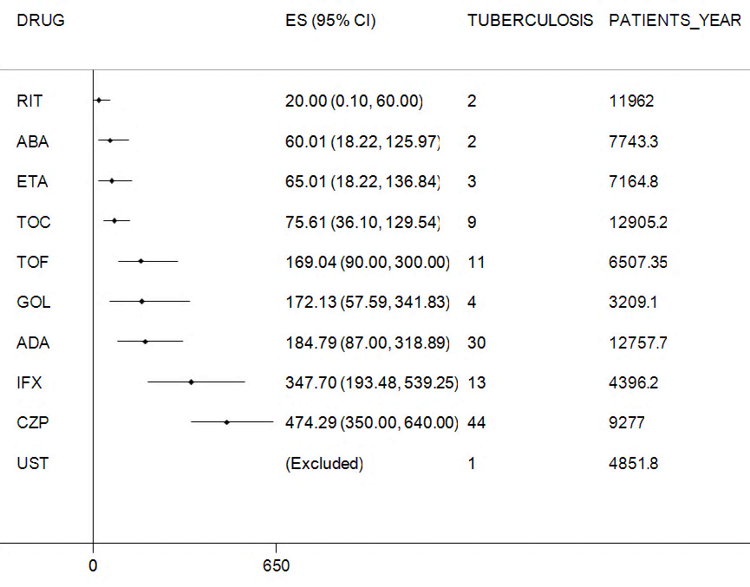
Incidence rate of active tuberculosis in LTE clinical trials with biologics
Souto et al. Rheumatology 2014;53:1872–1885.

Slide 19
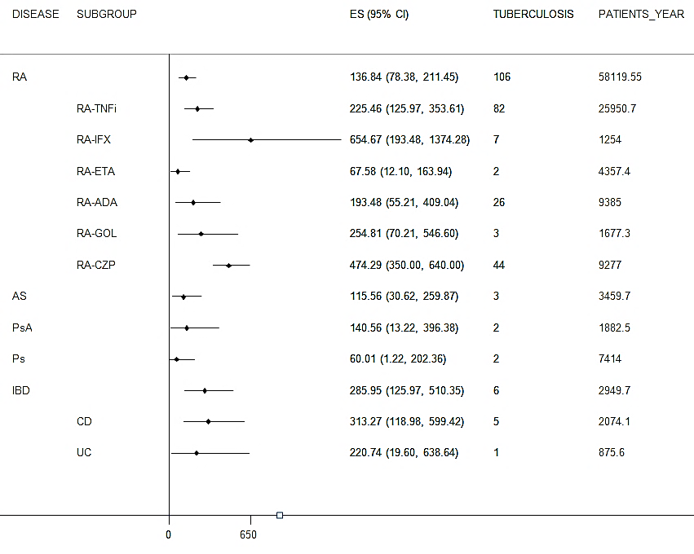
Active tuberculosis in LTE clinical trials with biologics by disease
Souto et al. Rheumatology 2014;53:1872–1885.

Slide 20
Incidence rate of active TB in RCT by background TB infection incidence rate in RA
Certolizumab
Background rate | USA | Western Europe | Central Europe | Eastern Europe
Rate in RCT | 50/100000 | 230/100000 | 580/100000 | 1020 /100000
Tofacitinib
Background rate | Low rate TB | Medium rate TB | High rate TB
Rate in RCT | 37/100000 | 34/100000 | 781/100000
Winthrop K, et al. Arthritis Rheum 2012; 2012;64,(Suppl 10 ):1268
Vencovsky J, et al. Ann Rheum Dis 2013;72(Suppls 3):233

Slide 21
Herpes zoster and bDMARD

Slide 22
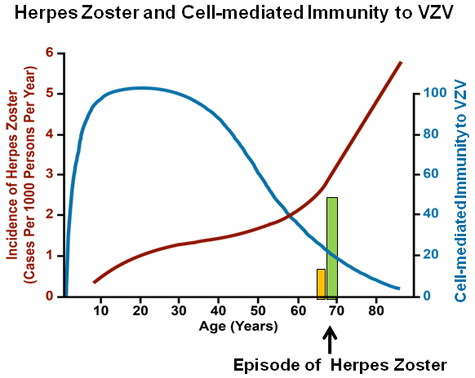
Herpes zoster incidence
Adapted from Hope-Simpsom RE. Proc Royal Soc Med 1965; 58:9-20

Slide 23
Serious infections in patients on biologics (observational studies): Herpes zoster
Study ID | Registry | Intervention | Control | aHR (Intervention vs comp/control) | Risk of bias
Galloway (2010) ARD | BSRBR | 3 TNFi | csDMARDs | 1.7 (1.1, 2.7); adjusted for drop-outs 1.5 (1.0, 2.4) | Low
McDonald (2009) Clin Inf Diseases | Claim Database | 3 TNFi | csDMARDs | 1.4 (1.1, 1.8) | Moderate
Strangfeld (2009) JAMA | RABBIT | 3 TNFi | csDMARDs | 1.6 (1.0, 2.7) | Low
Garcia-Doval (2010) ARD | BIOBADASER | TNFi (3?) | General population | 10 (3, 26) | Low
Winthrop (2013) JAMA | Claim Dabatase | 3 TNFi | csDMARDs | 1.0 (0.8, 1.3) | Moderate
Ramiro S, et al. Ann Rheum Dis. 2014 Mar;73:529-35.

Slide 24
Absolute IR and adjusted HR of herpes zoster by biologic agents and other RA medications-Medicare data
 | N | PYs | Absolute IR per 100 PYs (95% CI) | Adjusted HR (95% CI)b
Biologic agent
Non–anti-TNF MOA
Abatacept | 142 | 7,614 | 1.87 (1.58–2.20) | 1.00 (ref)
Rituximab | 82 | 3,611 | 2.27 (1.83–2.82) | 1.20 (0.88–1.63)
Tocilizumab | 18 | 839 | 2.15 (1.35–3.40) | 1.05 (0.60–1.84)
Anti-TNF MOA
Adalimumab | 46 | 2,638 | 1.74 (1.31–2.33) | 1.04 (0.72–1.51)
Certolizumab | 19 | 774 | 2.45 (1.57–3.85) | 1.30 (0.77–2.23)
Etanercept | 48 | 2,229 | 2.15 (1.62–2.86) | 1.26 (0.87–1.81)
Golimumab | 11 | 683 | 1.61 (0.89–2.91) | 0.91 (0.47–1.76)
Infliximab | 57 | 3,135 | 1.82 (1.40–2.36) | 0.98 (0.69–1.39)
Other RA medications
Methotrexate
No | 172 | 8,844 | 1.94 (1.67–2.26) | 1.00 (ref)
Yes | 251 | 12,678 | 1.98 (1.75–2.24) | 1.07 (0.88–1.29)
Prednisone -equivalent dose, mean mg/day
None | 128 | 8,548 | 1.50 (1.26–1.78) | 1.00 (ref)
≤7.5 | 209 | 9,841 | 2.12 (1.85–2.43) | 1.55 (1.25–1.93)
>7.5 | 86 | 3,134 | 2.74 (2.22–3.39) | 2.35 (1.81–3.04)
Yun H, et al. Arthritis Care Res (Hoboken). 2015;67:731-6

Slide 25
Malignancies and bDMARD

Slide 26
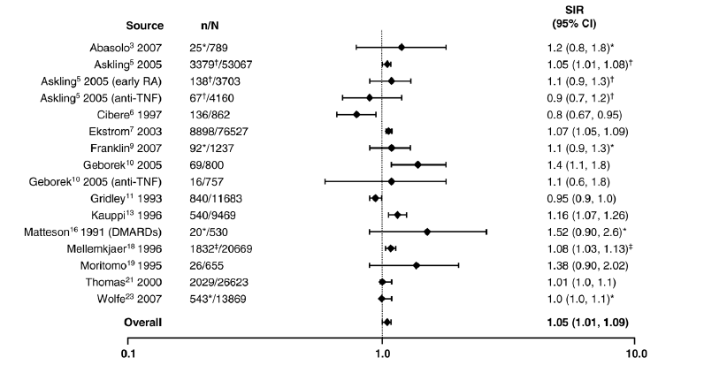
Risk of malignancies in patients with rheumatoid arthritis compared with the population
*Excluding non-melanoma skin; †all solid tumors; ‡excluding lymphatic and hematopoetic. CI, confidence interval; DMARDs, disease-modifying antirheumatic drugs; MTX, methotrexate; n, number of malignancies; N, population size; SIR, standardized incidence ratio; TNF, tumor necrosis factor
Adapted from Smitten et al. Arthritis Research & Therapy 2008 10:R45

Slide 27
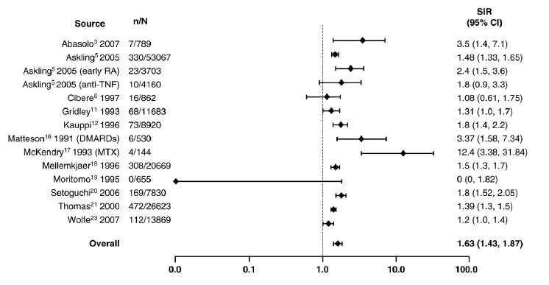
Risk of malignancies in patients with rheumatoid arthritis compared with the population
Adapted from Smitten et al. Arthritis Research & Therapy 2008 10:R45

Slide 28
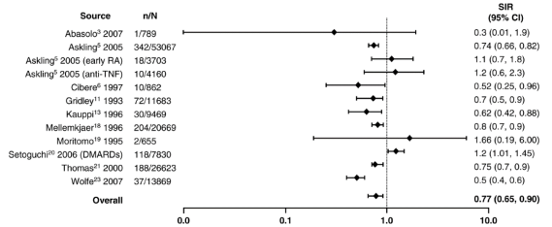
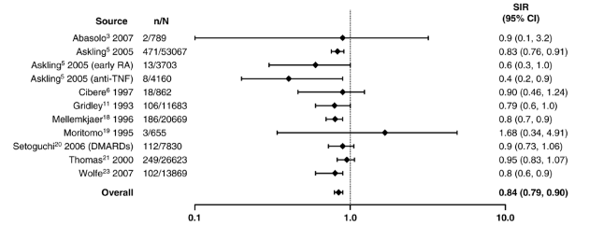
Risk of colon and breast cancer in patients with rheumatoid arthritis compared with the population
Colorectal cancer
Breast cancer
Adapted from Smitten et al. Arthritis Research & Therapy 2008 10:R45

Slide 29
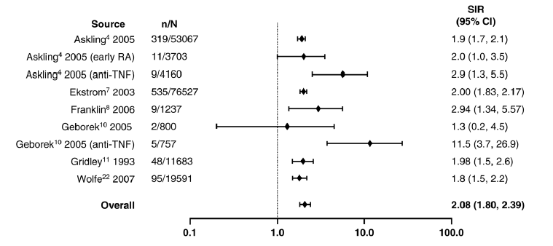
Risk of lymphoma in patients with rheumatoid arthritis compared with the population
Adapted from Smitten et al. Arthritis Research & Therapy 2008 10:R45

Slide 30
Risk of lymphoma in patients with rheumatoid arthritis related to inflammatory activity and functional class
 | Cases, no. (%) | Controls, no. (%) | OR (95% CI)
Inflamatory activity
Baja | 94 (25) | 278 (74) | 1 (reference)
Media | 196 (52) | 94 (25) | 7.7 (4.8–12.3)
Alta | 86 (23) | 4 (1) | 71.3 (24.1–211.4)
Fuctional class
I | 34 (9) | 138 (37) | 1 (reference)
II | 185 (49) | 204 (54) | 3.9 (2.4–6.3)
III | 105 (28) | 31 (8) | 13.8 (7.2–26.2)
IV | 52 (14) | 3 (1) | 67.5 (18.9–239.8)
Baecklund E, et al. Arthritis Rheum. 2006 Mar;54(3):692-701

Slide 31
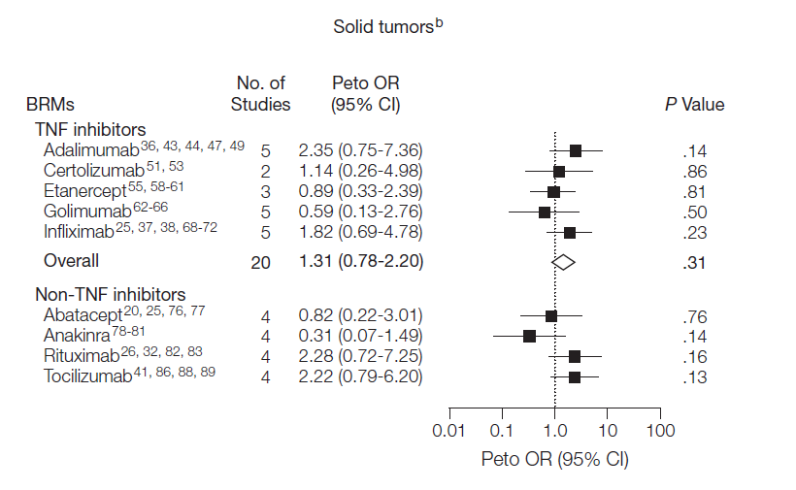
Meta-analysis of solid tumors in RCT of rheumatoid arthritis patients treated with bDMARD
Sixty-three RCTs with 29,423 patients
Adapted from Lopez-Olivo M et A. JAMA 2012;308:898-908

Slide 32
Network meta-analysis of overall malignancies
Maneiro J et al. Semin Arthritis Rheum 47 (2017) 149–156

Slide 33
Network meta-analysis of solid malignancies.
Maneiro J et al. Semin Arthritis Rheum 47 (2017) 149–156

Slide 34
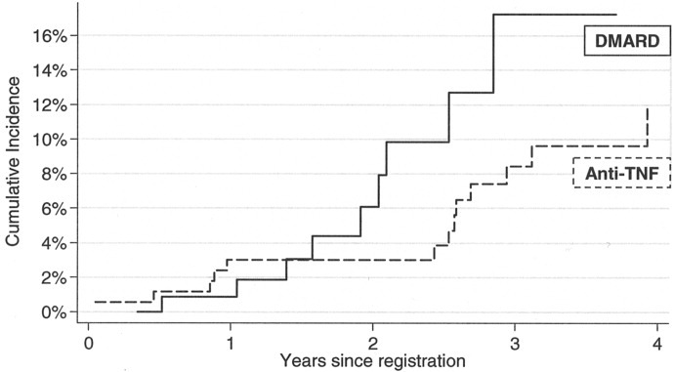
Incident rate of malignancy in the TNFi treated patients with a prior malignancy in BSRBR
293 patients with prior malignancy from more than 14,000 patients with RA
IRR of 0.58 (0.23–1.43)
anti-TNF–treated vs DMARD treated
Incident rate of malignancy was lower in the TNF inhibitor group, but selection bias was possible
Dixon WJ et al. Arthritis Care Res (Hoboken). 2010 Oct;62(10):1514

Slide 35
Observed numbers (Obs) and HRs of a SMN in patients with rheumatoid arthritis according to bDMARD treatment in DANBIO
Treatment | SMN, Obs | Person- years | HR (95% CI)
Non-use of bDMARDs | 70 | 2461 | 1 (Ref)
Ever bDMARDs | 38 | 1225 | 1.11 (0.74 to 1.67)
bDMARDs before first cancer | 11 | 272 | 1.06 (0.52 to 2.14)
bDMARDs after first cancer | 27 | 953 | 1.13 (0.71 to 1.80)
bDMARDs only after first cancer | 21 | 760 | 1.15 (0.68 to 1.95)
bDMARDs both before and after first cancer | 6 | 193 | 1.09 (0.46 to 2.57)
Type of bDMARD after first cancer**
TNF-I | 21 | 723 | 1.21 (0.73 to 2.03)
Rituximab | 7 | 235 | 1.05 (0.47 to 2.34)
Dreyer L,et al.Ann Rheum Dis2017;0:1–5

Slide 36
Incident rate of new malignancy or relapse in the TNFi treated patients with a prior malignancy in three BSRBR, RABBITT and BIOBADASER
Registry | N Patients prior tumor | Recurrent or new tumor IR/1000 pyrs (CI) | IRR TNFi vs DMARD
BSSBR 2010 | 239 | 25.3 (13.4–43.2) | 0.58 (0.23–1.43)
RABITT 2010 | 122 | IR 45.5 (20.8-86.3) TNF-I, IR 32.3 (0.8-179.7) anakinra IR 31.4 (10-273.4) csDMARD | 1.4 ( 0.5 to 5.5)
BIOBADASER 2011 | 24 | IR 26.4 (4.1-171.5)
Dixon WJ et al. Arthritis Care Res (Hoboken). 2010 Oct;62(10):1514
Strangfeld A et al. Arthritis Res Ther 2010, 12:R5
Carmona L, et al. Semin Arthritis Rheum. 2011; 41:71-80

Slide 37
Conclusiones
Las enfermedades inflamatorias crónicas mediadas por inmunidad se asocian con un mayor riesgo de infecciones serias, y tumores
La actividad de la enfermedad, las comorbilidades y los corticosteroides aumentan el riesgo de infecciones serias incluidas la tuberculosis y el herpes zoster
Lospacientes con RA tratados con bDMARD tiene un riesgo aumentado de infecciones serias, tuberculosis, y herpes zoster
No hay evidencias actualmente que muestren un aumento del riesgo de tumores malignos en pacientes tratados con bDMARDs

Slide 38
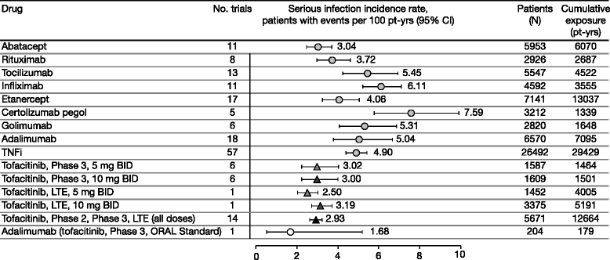
Incidence rates for serious infections with biologic DMARDs and tofacitinib across RCTs* and LTE studies
Adapted from Strand V, et al. Arthritis Res Ther. 2015 Dec 15;17:362.

Slide 39
Risk of serious infection by drug in BSRBR
Dixon WG et al Arthritis Rheum 2007; 56: 2896-2904
Notes:
El riesgo de infección seria aumentó aproximadamente durante los 6 primeros meses de terapia anti-TNF, pero posteriormente disminuyó de forma progresiva hasta equipararse con el asociado a los FAMEs.

Slide 40
Rate of active tuberculosis in patients treated with different TNF antagonists in registries
 | Country | Type of study | Adalimumab | Etanercept | Infliximab | Comments
Wallis et al. | USA | Cases voluntarily reported to US FDA |  | IR 28/100,000 | IR 54/100,000 | Etanercept vs infliximab P<0.0001
Brassard et al. | Canada | Large pharmacy prescription database |  | RR 1.2 (0.9-1.8) | RR 1.6 (1.0-2.6)
Gomez-Reino et al. | Spain | Data from registry | IR 176 /100,000 | IR 114 /100,000 | IR 383 / 100,000 | P= NS. Wide confidence interval
Tubach et al. | France | Data from registry | IR 215 / 100,000 | IR 9.3 /100,000 | IR 187/ 100,000 | SIR 29.3 for adalimumab SIR 1.8 for etanercept SIR 18.6 for infliximab. P< 0.0001
Fonseca et al. | Portugal | Data from registry | 4 cases / 171 pts | 1 case / 333 pts | 8 cases / 456 pts | Exposure is not provided
Dion et al. | UK | Data from registry | IR 144/100,000 | IR 39/100,000 | 136/100,000 | Included patients collected prior and following TB screening recommendations
Salgado E and Gomez-Reino JJ. Expert Rev. Clin. Immunol. 7(3), 329–340 (2011)

Slide 41
Risk of TB with TNFi may vary across registries
Versus
Population
BIOBADASER
Anti-TNF IRR=7 (3 - 13)
Gomez-Reino, A&R 07
BIOBADASER
Anti-TNF(IRR=2.4 [0.8-7.2])
Versus
RA without biologics
Gomez-Reino, A&R 07
ARTIS
Anti-TNF RR=3.1 (0.7-13)
Askling, EULAR 2009
Etanercept RR=2.5 (1.0-6.1)
Adalimumab RR=3.1 (1.1-8)
Infliximab RR=5.2 (2.7-11)
Adalimumab
(OR=17.1 [3.6-80.6])
Versus
Etanercept
RATIO
Tubach, A&R 09
Infliximab
(OR=13.3 [2.6-69.4])
BSRBR
Infliximab (IRR=3.1 [1.0-9.5])
Dixon, ARD 10
Adalimumab (IRR=4.2 [1.4-12.4])
0
1
5
10
15
20
TB epidemiology and local screening recommendations vary among countries
TB prophylaxis was not consistently administered in all registries.
The registries used different comparator populations
The number of cases were low, as seen by the wide confidence intervals
Gomez-Reino et al. Arth & Rheum 2007;57(5):756–761
Askling J. Ann Rheum Dis 2009;68(Suppl3):42
Tubach F. Arthritis & Rheumatism 2009;60(7):1884–1894
Dixon WG et al. Ann Rheum Dis 2010 69: 522-528
Notes:
Example of challenges with comparing across registries:
Different measures
Different comparators
Different breakdowns by treatment
Different screening and treatment practices
Different TB incidences in the respective countries

Slide 42
Rate of active tuberculosis in patients treated with different TNF antagonists in BIOBADASER
Incidence rate (IR) of active tuberculosis by tumor necrosis factor (TNF) antagonist after September 2003
TNF antagonist
Patient-years
Cases
IR per 100,000 (95% CI)*
Infliximab
1,303
5
383 (159-921)
Etanercept
1,740
2
114 (28-459)
Adalimumab
565
1
176 (24-1254)
* 95% CI = 95% confidence interval.
Gomez-Reino J et al. Arthritis Rheum. 2007;57(5):756-61

Slide 43
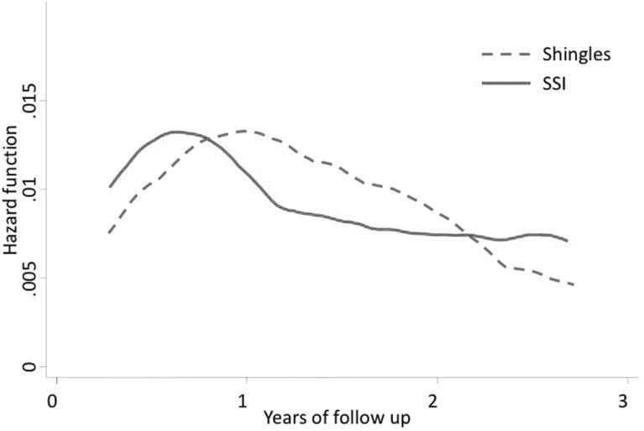
Hazard for soft tissue infections and shingles in an anti-TNF treated cohort
Galloway J B et al. Ann Rheum Dis doi:10.1136/annrheumdis-2011-201108
Notes:
Hazard for soft tissue infections (SSI) and shingles over time in anti-tumour necrosis factor (TNF)-treated cohort. Demonstration of the time-varying risk of events in the anti-TNF cohort. Event rates were higher earlier on during treatment in both cohorts.

Slide 44
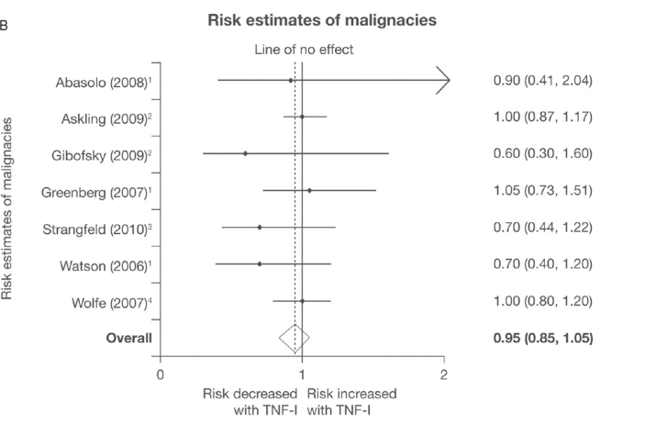
REGISTRO FRANCÉS
Mariette X et al. Ann Rheum Dis 2011;70:1895-1904

Slide 45
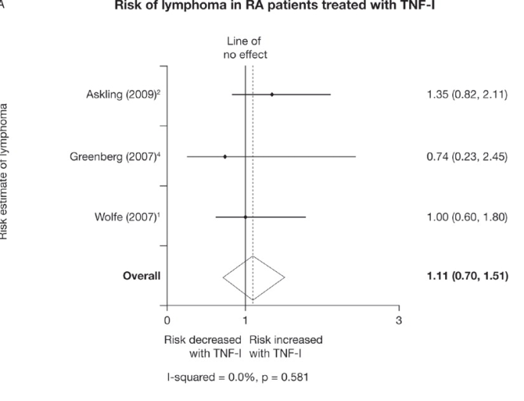
REGISTRO FRANCÉS.
Mariette X et al. Ann Rheum Dis 2011;70:1895-1904

Slide 46
Range of incidence density of SIs, OIs, and TB in RA patients receiving biologic DMARDs – data from RCT, OLE, and observational studies
Drugs | Incidence per 100 PY (range)
 | SI | OI | TB
Rituximab | 2.0–5.2 | – | –
Etanercept | 2.6–11.1 | 0.01–0.12 | 0.01–0.11
Adalimumab | 2.0–8.7 | 0.03–1.12 | 0.08–0.56ª
Abatacept | 1.6–4.3 | 0.2 | 0.18
Infliximab | 3.9–10.3 | 0.29–2.6 | 0.05–2.6
Anakinra | 1.0–5.4 | 0.13 | –
Certolizumab | 4.0–7.3 | – | 0.7–2.5
Tocilizumab | 3.1–9.1 | 0.15–1.1 | 0.08–0.09
Golimumab | 2.5–10.0 | – | 0.46–1.4
TNF inhibitors | 2.2–10.4 | 0.15–3.0ª | –
Biologic DMARDs | 4.6–7.0 | – | –
Methotrexate | 1.0–8.8 | – | –
Nonbiologic DMARDs and corticoid | 1.3–9.6 | – | –
Tran TN, et al. Open Access Rheumatol. 2013;5:21-32

Slide 47
Crude incidence and risk of non-viral OI among patients who were new users of TNFI or non-biological DMARD: SABER study
Exposures | Events* | Person-years | Crude rate (100 ptys), 95% CI | Adjusted HR†
Rheumatoid arthritis
Non-biological DMARD | 13 | 7188 | 1.8 (1.1 to 3.1) | 1.00 (Reference)
New users of TNFI | 67 | 22 213 | 3.0 (2.4 to 3.8) | 1.6 (0.9 to 3.1)
Any baseline glucocorticoid use |  |  |  | 1.7 (1.0, 2.8)
IBD
AZA/6MP | 9 | 4595 | 2.0 (1.0 to 3.8) | 1.00 (Reference)
New users of TNFI | 5 | 2315 | 2.2 (0.9 to 5.2) | 0.97 (0.3 to 2.8)
Psoriasis, psoriatic arthritis, ankylosing spondylitis
Non-biological DMARD | 5 | 3951 | 1.3 (0.5 to 3.0) | 1.00 (Reference)
New users of TNFI | 6 | 4116 | 1.5 (0.7 to 3.2) | 1.4 (0.3 to 6.4)
Any baseline glucocorticoid use |  |  |  | 4.7 (1.2 to 19.6)
All diseases
Comparator | 27 | 15 734 | 1.7 (1.2 to 2.5) | 1.00 (Reference)
New users of TNFI | 78 | 28 493 | 2.7 (2.2 to 3.4) | 1.6 (1.0 to 2.6)
Any baseline glucocorticoid use |  |  |  | 2.5 (1.5 to 4.0)
Baddley JJ et al. Ann Rheum Dis. 2014;73:1942-8

Slide 48
Association between medication use and herpes zoster among patients with rheumatoid arthritis in the US PharMetrics claims database
Medication | Cases (n = 1,611) | Controls (n = 11,277) | Unadjusted OR (95% CI) | Adjusted OR (95% CI)
No DMARDs or oral corticosteroids | 877 (54.4) | 7,690 (68.2) | Reference | Reference
bDMARDs only | 32 (2.0) | 185 (1.6) | 1.52 (1.03–2.23) | 1.54 (1.04–2.29)
csDMARDs only | 306 (19.0) | 2,018 (17.9) | 1.34 (1.17–1.54) | 1.37 (1.18–1.59)
Oral corticosteroids only | 166 (10.3) | 503 (4.5) | 2.95 (2.44–3.58) | 2.51 (2.05–3.06)
csDMARDs and bDMARDs | 19 (1.2) | 129 (1.1) | 1.31 (0.81–2.14) | 1.38 (0.83–2.27)
bDMARDs and oral corticosteroids | 12 (0.7) | 43 (0.4) | 2.49 (1.31–4.76) | 2.44 (1.26–4.73)
csDMARDs and oral corticosteroids | 188 (11.7) | 660 (5.9) | 2.51 (2.11–3.00) | 2.39 (1.99–2.88)
csDMARDs, bDMARDs, and oral corticosteroids | 11 (0.7) | 49 (0.4) | 1.96 (1.02–3.80) | 1.96 (0.99–3.86)
Association between medication use and herpes zoster among patients with rheumatoid arthritis in the UK General Practice Research Database
Medication | Cases (n = 1,719) | Controls (n = 12,033) | Unadjusted OR(95% CI) | Adjusted OR(95% CI)
No DMARDs or oral corticosteroids | 1,084 (63.1) | 8,869 (73.7) | Reference | Reference
csDMARDs only | 273 (15.9) | 1,633 (13.6) | 1.36 (1.81–1.57) | 1.27 (1.10–1.48)
Oral corticosteroids only | 240 (14.0) | 1,061 (8.8) | 1.84 (1.58–2.15) | 1.46 (1.24–1.70)
csDMARDs and oral corticosteroids | 122 (7.1) | 470 (3.9) | 2.13 (1.73–2.63) | 1.82 (1.46–2.26)
Adapted from Smitten AL et al. Arthritis Rheum. 2007;57:1431-8

