Slide 1
Antiphospholipid Syndrome WHAT’S NEW?
Savino Sciascia, MD, PhD
Center of Research of Immunopathology and Rare Diseases-CMID
University of Torino
AADEA
Cordoba, Feb 2018
Notes:
Adding Domain 1
New therapies
HCQ in pregnancy
NATURE REVIEW RHEUMAT In press (figure for mechanism).
The need for for Therapeutic approaches in TMA in SLE/APS

Slide 2
Agenda
What to do when anticoagulation fail?
‘New' avallabile treatments
Target therapy in APS
Is it possible to stop anticoagualtion?

Slide 3
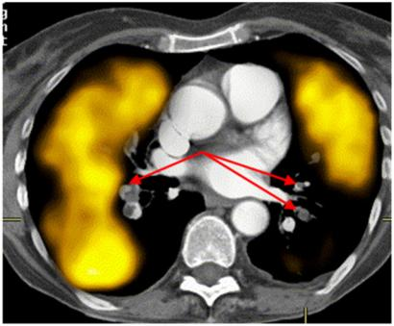
CASE 1
Jan 2014. A 33-year-old woman presented to A&E complaining SOB. A V/Q scan confirmed a diagnosis of bilateral PE.
No provoking factors.
Inherited thrombophilia negative
She was started on Rivaroxaban.
Coregistered CTPA and perfusion SPECT scans (transverse slice) demonstrating extensive perfusion defects on SPECT. Findings correspond to proximal bilateral PE shown on CTPA (arrows)

Slide 4
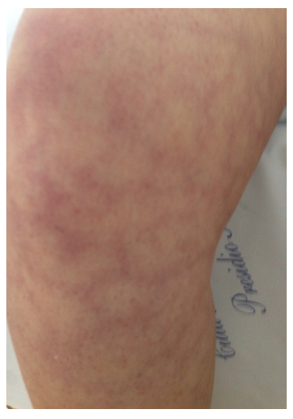
PMH: unremarkable.
PE: She had a livedo reticualaris on the legs and the inferior part of the trunk
Plts 110-120.00
ANA, ENA, anti-dsDNA and Inherited thrombophilia neg
LA, aCL and aBeta2GPI +ve

Slide 5
RAPS Trial
Prospective, randomised, controlled, Phase II/III, non-inferiority trial
Randomisation 1:1 warfarin vs rivaroxaban
Open label
Primary end point at 42 days (endogenous thrombin potential a key parameter of the Thrombin Generation Test)
156 patients
24 month total trial duration
effective and safe alternative in patients with antiphospholipid syndrome and previous venous thromboembolism
Lancet Haematol. 2016;3:e426-36.

Slide 6
DOAC and APS
Safe in patients with VTE
Rheumatology. 2016;55:1726-35.
No solid data in patients with arterial events (Relapse!)
Semin Thromb Hemost. 2017 Feb 14
Careful when interpreting LA testing in patients on DOAC
(e.g. Rivaroxaban acts through FXa as DRVVT)
Clin Chem Lab Med. 2017;55:91-101.

Slide 7
Case 2
RR 39 yrs
Age 24 SLE and aPL+ve
unprovoked PE
6 years VKA with good TTR
(INR 2-3)
Age 30 new unprovoked PE
⇒ What to do when VKA fail?

Slide 8
Cases of refractory APS: no evidence!
Check compliance and TTR for patients onVKA

Slide 9
Cases of refractory APS: no evidence!
Add LDA
PROs: relative safe
CONs: is it adding something in terms of venous TPx?
N Engl J Med. 1995;332:993-7

Slide 10
Cases of refractory APS: no evidence!
Increase VKA INR 3-4
PROs: efficacy as venous TPx
CONs: bleeding risk, difficulties in mantaining TTR
N Engl J Med. 1995;332:993-7.

Slide 11
Cases of refractory APS: no evidence!
Add HCQ
PROs: relative safe
CONs: is it adding enough in terms of venouns TPx?
J Thromb Haemost. 2013;11:1927–9

Slide 12
Anti-CD20 depletion Therapy
Rituximab in APS mainly for extra-criteria manifestations
(severe thrombocytopenia and leg ulcers)
Intern Emerg Med. 2017;12:1-7
Limited experience in thrombotic APS, mostly related to CAPS
Best Pract Res Clin Rheumatol. 2012;26:535-41.
PROs: relative safe, well-known drug now.
CONs: is it adding enough in terms of venouns TPx? Off label. Costs
Which parameters to monitor as outcome?

Slide 13
IVIG
Anecdotal experience
PROs: Safe, data on long term follow-up, can be use when concomitant infection occur
CONs: expensive, limited availability, variability in regimens, dose, length of treatment
Clin Exp Rheumatol. 2012;30:409-13.
Which parameters to monitor as outcome?

Slide 14
Case 3
RR 24 yrs
Age 14 SLE
Lupus nephritis WHO IV
6 years iv cyclophosphamide/
azathioprine
4 years MMF: remission

Slide 15
RR 24 yrs
2014 Nephrotic proteinuria (still on MMF)
Hypertension
Ix Creatinine 1.4 mg/dl
24 hour protein 4.3 g/day
anti-DNA negative
ESR negative; CRP negative
inactive urinary sediment complement normal Renal Ultrasound and Doppler: neg
LAC and aCL high titer
(neg since 2013)

Slide 16
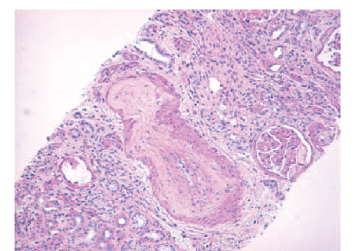
A renal biopsy showed two out of 21 glomuleruli to have global sclerosis.
12/21 glomeruli displayed ischemic changes, with partly collapsed capillary loops, including accentuated, wrinkled and thickened walls and lumen obliterated by swollen endothelial cells.
An artery with obliterative fibrous intimal thickening, most likely representing an organized thrombus, was found in an area presenting atrophy and interstitial fibrosis

Slide 17
Dx Antiphospholipid syndrome
Thrombotic microangiopathy
Lupus nephritis WHO Class IV
Rx Warfarin INR 3 – 4
Warfarin INR 2 – 3
Warfarin INR 2 – 3 plus LDA?

Slide 18
Dx Antiphospholipid syndrome
Thrombotic microangiopathy
Lupus nephritis WHO Class IV
Rx Warfarin INR 3 – 4
Warfarin INR 2 – 3
Warfarin INR 2 – 3 plus LDA?
⇒ Rapid improvement of
nephrotic proteinuria

Slide 19
Evidence fot Eculizumab in TMA in APS
Eculizumab is a recombinant full-humanized IgG2/IgG4 monoclonal antibody that blocks the formation of the terminal complex sC5b-9 and C5a by binding to the C5 complement component and consequently blocking its activation
pathway.
PROs: Safe, now used in several form of TMA, some evidence in LN+TMA or CAPS
CONs: COSTS!
Rheumatol Int. 2017;37:1249-1255

Slide 20
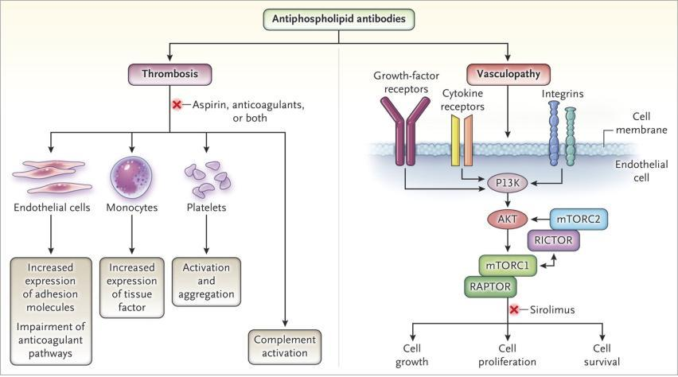
Eikelboom JW, Weitz JI. N Engl J Med 2014;371:369-371.
Pathogenesis of Thrombosis and Vasculopathy in the APS.
Notes:
Figure 1. Pathogenesis of Thrombosis and Vasculopathy in the Antiphospholipid Syndrome. The antiphospholipid syndrome is an acquired autoimmune disorder characterized by persistent elevation in levels of antiphospholipid antibodies, thrombosis, and in some cases vasculopathy. Although multiple mechanisms have been implicated in the pathogenesis of thrombosis, the cause of vasculopathy remains elusive. In this issue of the Journal, Canaud and colleagues 3 hypothesize that antiphospholipid antibodies, in binding to vascular endothelial cells in the kidneys, brain, or other organs, activate the signaling pathway of the mammalian target of rapamycin (mTOR). In response to extracellular and intracellular signals in the phosphoinositide 3-kinase (PI3K)–AKT pathway, the mTOR pathway regulates cell growth, proliferation, and survival. The mTOR enzyme is a component of two complexes, mTORC1 and mTORC2. The activity of mTORC1 is regulated by a subunit of the regulatory-associated protein of mTORC1 (RAPTOR), whereas the activity of mTORC2 is regulated by a subunit of the rapamycin-insensitive companion of mTOR (RICTOR). However, the two pathways are interconnected. Aspirin and anticoagulants are used for the prevention and treatment of thrombosis in patients with antiphospholipid syndrome. Sirolimus, which inhibits the mTORC1 pathway, has the potential to attenuate vasculopathy.

Slide 21
CASE 4
39 yrs old woman
LA (strongly positive) aCL and aBeta2GPI neg
Screening for CTD: negative
4 pregnancies
2 miscarriages (7 and 9 weeks) no treatment
1 miscarriage on LDA
1 fetal death (21^{st week}) on LDA and prophylaxis dose of LMWH
Pregnant ???

Slide 22
CASE 4
39 yrs old woman
LA (strongly positive) aCL and aBeta2GPI neg
Screening for CTD: negative
4 pregnancies
2 miscarriages (7 and 9 weeks) no treatment
1 miscarriage on LDA
1 fetal death (21^{st week}) on LDA and prophylaxis dose of LMWH
Pregnant
on LDA and prophylaxis dose of LMWH
on LDA therapeutic dose of LMWH
IVIG?
Tincani, Lupus 2003
add low-dose prednisone?
Bramham, Blood, 2011

Slide 23
The impact of hydroxychloroquine treatment on pregnancy outcome in women with antiphospholipid antibodies.
Observational retrospective study
170 pregnancies in 96 women with persistent aPL were included in this study.
Sixty-five pregnancies occurred in 31 women who had been treated with HCQ for at least six months prior to pregnancy and then continued throughout gestation (Group A).
119 pregnancies occurred in 65 women who had not been treated with HCQ during pregnancy (Group B)
Am J Obstet Gynecol. 2016

Slide 24
Pregnancy outcomes
HCQ use was safe, with no AE from mother and foetus perspective
HCQ treatment was associated with a higher rate of live births (66.7% in group A vs. 57.1% in group B, p=0.05) and a lower prevalence of overall pregnancy morbidity (47.1% in group A vs. 63.0% in group B, p=0.004), confirmed after multivariate analysis (OR 2.2; 95% CI 1.2, 136.1; p=0.04).
Am J Obstet Gynecol. 2016

Slide 25
HYPATIA
A prospective randomised controlled trial of HYdroxychoroquine versus placebo during Pregnancy in women with AnTIphospholipid Antibodies

Slide 26
Summary of available approaches

Slide 27
Further tools for TPx
Ubiquinol emiliorates prothrombotic profile in APS
Arterioscler Thromb Vasc Biol. 2017: 37:1923-1932
Global effects of fluvastatin on the prothrombotic status of patients with APS
Ann Rheum Dis. 2011;70:675-82.

Slide 28
β2GPI
PS/PT
Coagulation factors
Monocytes
PLTs
Endothelial cells
VKA
DOACs
ASA*
Statins?
HCQ?
Thrombosis
aPL
Complement
Activation and deposition
TMA
Eculizumab
Akt/mTOR
aPL-related Vasculopathy
mTOR
inihibitors?
Nat Rev Rheumatol. 2017;13:548-560.

Slide 29
Target Therapy in APS
(2) use of small inhibitory peptides modeled on domain V (TIFI) or domain I of
b2GPI;
(3) blocking of aPL/b2GPI receptors on target cells

Slide 30
Positive aPL tests
Four possibilities
Stay well
Clots and miscarriages
Clots only
Miscarriages only

Slide 31
Positive aPL tests
Four possibilities
Stay well
Clots and miscarriages
Clots only
Miscarriages only

