Slide 1


HIPERTENSION PULMONAR EN ENFERMEDADES AUTOINMUNES
Dr. J. Todolí Parra
Sección Inmunopatología/EAS
Servicio de Medicina Interna
H. U. La Fe (Valencia)

Slide 2
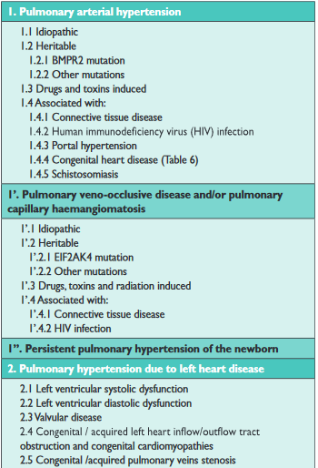
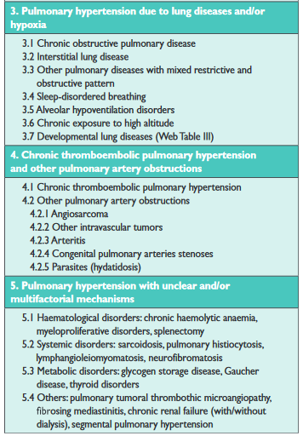

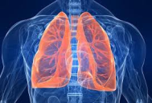
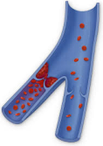
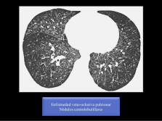



Slide 3

HIPERTENSION ARTERIAL PULMONAR….
Esclerodermia 70% de los casos de HAP-CTD en USA y Europa
En Asia, más frecuente la HAP_CTD (LES-EMTC-SJÖGREN)
Prevalencia para cualquier causa de HAP 15 casos por millón
CTD-HAP 2.3-10 casos por millón
46 % HAPi
25 % HAP-CTD
  75% SScl
  25%
    LES 8-19%
    EMTC 8-9%
    AR 3-5%
    MII 4%
    UTC 2%
    SSjögren 1%

Slide 4
Esclerodermia…..
1/10 pac
Registro francés (0’6 casos por 100 pacientes año)
Incidencia acumulada a 15 años 15%
Prevalencia 5-12%
Subgrupo de alto riesgo*:
  2 años: 10%
  3 años: 13%
  5 años: 25 %
*PHAROS: PsAP>40, DLCO < 55, ratio CFV/DLCO > 1’6
Notes:
Si

Slide 5
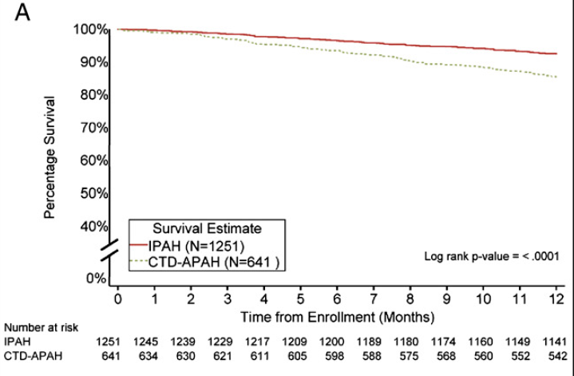
better hemodynamics, but poorer survival, in SSc-APAH compared with IPAH.
REVEAL: CHEST 2010; 138(6):1383–1394

Slide 6
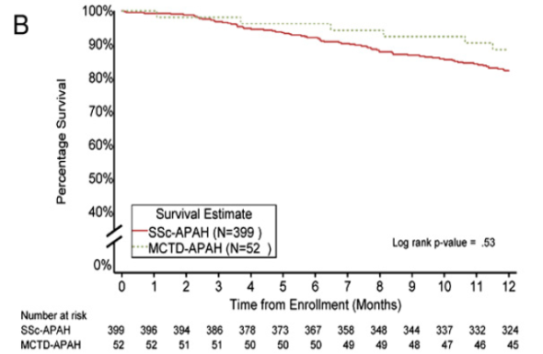
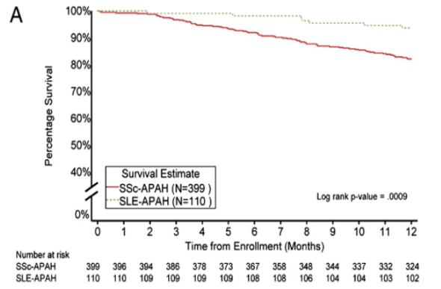
REVEAL: CHEST 2010; 138(6):1383–1394

Slide 7
Mejoría actual de la supervivencia en
HAP-SScl….(diag precoz, nuevos trat….)
 | 1 año | 3 años
Metanálisis de 17 estudios | 82% 77% (HAP+ILD) | 56% 35% (HAP+ILD)
REVEAL | 82% (94% LES, 93% HAP, 86% AR, 88% EMTC)
PHAROS | 93% | 75%
ASCS (cohorte australiana) | 94% | 73%
- Lefevre G et al. Arthritis Rheum 2013;65:2412e23. Epub 2013/06/07.
- Chung et al. Chest 2010;138:1383e94.
- Hachulla E et al. Arthritis Rheum 2009;60:1831e9.
- Hsu et al.Semin Arthritis Rheum 2014;44:55e62. Epub 2014/04/09.eta al
Notes:
Lefevre G, Dauchet L, Hachulla E, et al. Survival and prognostic factors in systemic sclerosis-associated pulmonary hypertension:
a systematic review and meta-analysis. Arthritis Rheum 2013;65:2412e23. Epub 2013/06/07.
Chung L, Liu J, Parsons L, et al. Characterization of connective tissue disease-associated pulmonary arterial hypertension
from REVEAL: identifying systemic sclerosis as a unique phenotype. Chest 2010;138:1383e94.
[6] Hachulla E, de Groote P, Gressin V, et al. The three-year incidence of pulmonary arterial hypertension associated with
systemic sclerosis in a multicenter nationwide longitudinal study in France. Arthritis Rheum 2009;60:1831e9.
*[7] Hsu VM, Chung L, Hummers LK, et al. Development of pulmonary hypertension in a high-risk population with systemic
sclerosis in the pulmonary hypertension assessment and recognition of outcomes in scleroderma (PHAROS) cohort study.
Semin Arthritis Rheum 2014;44:55e62. Epub 2014/04/09.

Slide 8
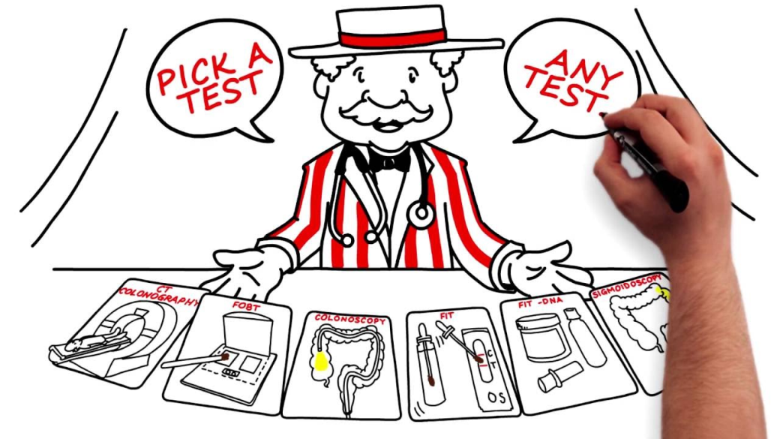
Notes:
Elegir personas
Elegir pruebas… y contar con el azar

Slide 9
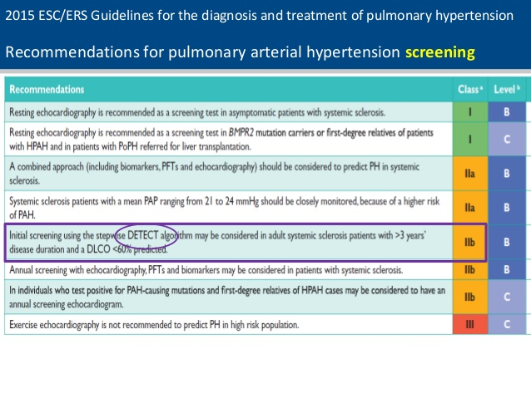

Slide 10
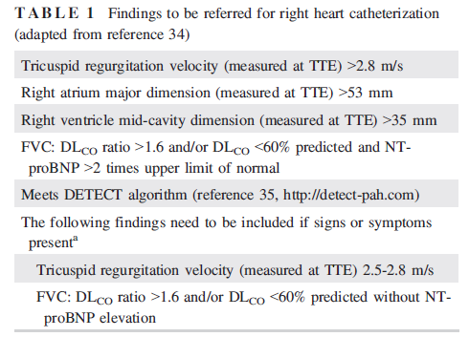
Hallazgos para remitir a cate derecho
Kato M, Atsumi T.
Pulmonary arterial hypertension associated with
connective tissue diseases: A review focusing on
distinctive clinical aspects. Eur J Clin Invest.
2018;48:e12876. https://doi.org/10.1111/eci.12876

Slide 11

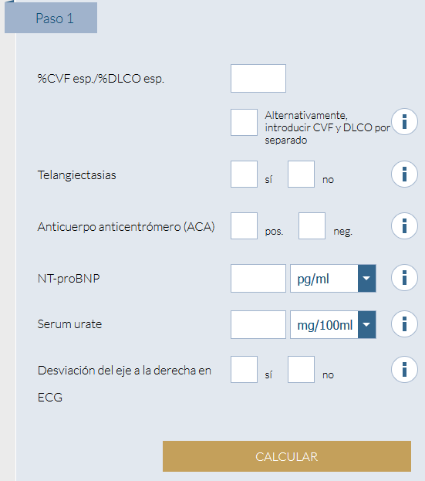
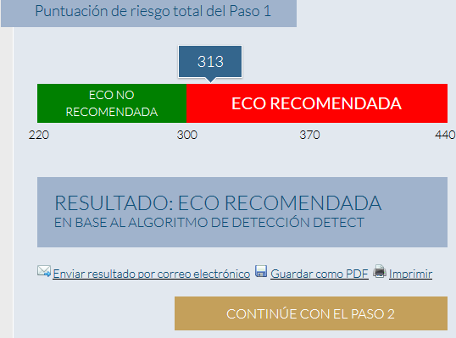
http://www.detect-hap.es
SUBGRUPOS DE RIESGO
X
X

Slide 12
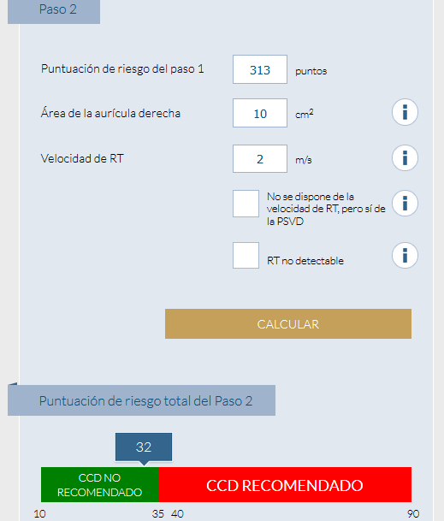
 | DETECT | ACC/ESC 2009
Cateterismos | 62% | 40%
Diag perdidos | 4% | 29%
VPP | 35% | 40%
VPN | 98% | 89%
Sensib | 96% | 71%
Especif | 48% | 69%
Ann Rheum Dis 2014; 73:1340
SScl de “riesgo”
Notes:
A casi todos los que tienen DLCO < 60, cociente >1’6 o alguna alteración en ecocardio les sale cate

Slide 13
 | ACC/ESC 2009 | DETECT* | ESC/ERS 2015 | 2015 ecocardio + DETECT ** | Mis pacientes…n=60..a coste belga
Ecocardio | 195 (100%) | 118 (60%) | 195 (100%) | 195 (100%) | 100%
Cates realizados Cates pedidos | 17 (9%) 17 (9%) | 49 (25%) 59 (30%) | 28 (14%) 34 (17%) | 32 (16%) 40 (21%) | 15%
PFR | - | 195 (100%) | - | 26 ¿¿(195)?? | 90%
ECG | - | 195 (100%) | - | 26 (13%) | 100%
AU | - | 195 (100%) | - | 26 (13%) | 100%
ACA | - | 195 (100%) | - | 26 (13%) | 100%
BNP | - | 195 (100%) | - | 26 (13%) | 30%
Euros | 80 | 224 | 90 | 112 ¿¿(181)?? | 201
*DETECT población no seleccionada: PFR, pro-BNP, AU, ECG, ACA a todos; eco /cate cond
**en subgrupo de riesgo DLCO < 60% y > 3 años de enf
Eur Respir J. 2017 May 11;49(5).
doi: 10.1183/13993003.02275-2016
SScl no seleccionada
Notes:
Ecocardio 63,21
Cate 187
PFF 69
ECG 18
AU 0,48
ACA 40
BNP 11

Slide 14
Pruebas realizadas | ACC/ESC 2009 | DETECT* | ESC/ERS 2015 | 2015 ecocardio + DETECT **
Ecocardio | 195 (100%) | 118 (60%) | 195 (100%) | 195 (100%)
Cate | 17 (9%) | 49 (25%) | 28 (14%) | 32 (16%)
BoHTAP | 4/14 (29%) | 13/14 (93%) | 10/14 (71%) | 10/14 (71%)
HTAP | 3/3 | 3/3 | 3/3 | 3/3
Euros | 80 | 224 | 90 | 112 ¿¿(181)??
- El coste calculado es “facticio”, valorar el “coste real” en nuestra población
Coste asumible
DETECT diagnostica más BoHTAP a costa de más cateterismo (PHAROS: 55% progresarán a HAP vs 32%)
¿CUÁNDO REPETIRLO?
*DETECT población no seleccionada: PFR, pro-BNP, AU, ECG, ACA a todos; eco /cate cond
**en subgrupo de riesgo DLCO < 60% y > 3 años de enf

Slide 15
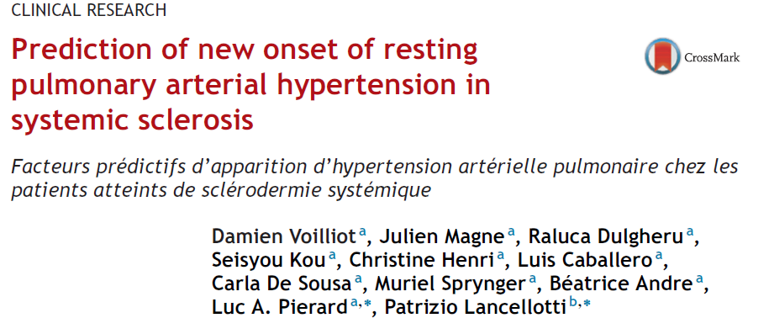
Archives of Cardiovascular Disease (2016) 109, 268—277

Slide 16
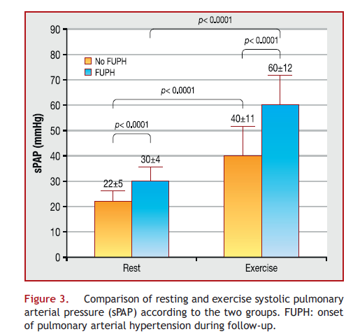
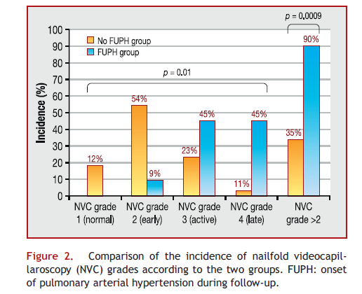
Notes:
EIPH was defined as sPAP > 50 mmHg [12]. mPAP wasestimated using the Chemla formula: mPAP = 0.61 × sPAP + 2.The slope of the mPAP/LVCO relationship was estimated asthe ratio between changes (peak — rest value) in mPAP andchanges in LVCO [13,14]. All echocardiographic variableswere acquired at peak exercise, except for mitral inflowvelocities and tissue Doppler imaging at the mitral annulus.A symptom-limited graded bicycle exercise test was per-formed in a semisupine position on a tilted table. After aninitial workload of 25 W maintained for 2 minutes, the work-load was gradually increased by 25 W every 2 minutes.
A peakvalue > 35 mmHg was considered to define resting PH [10]at baseline and FUPH. At peak exercise, sPAP was derivedfrom the tricuspid regurgitant jet velocity, with the addi-tion of 10 mmHg for the estimation of right atrial pressure[11]. EIPH was defined as sPAP > 50 mmHg [12]. mPAP wasestimated using the Chemla formula: mPAP = 0.61 × sPAP + 2.

Slide 17
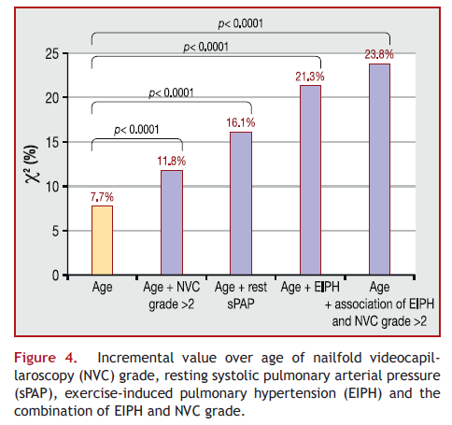
Notes:
Valor aditivo para el diagnóstico evolutivo de HTAP

Slide 18

Pistas….
 | SENSIBILIDAD | ESPECIFICIDAD
VRT > 2,73 | 95% | 43%
DLCO < 70% | 93% | 100%
NT-PRO-BNP > 236 | 45-93% | 83-100%
BNP > 65 | 60% | 87%
VSG > 28 | 50% | 85%
DETECT | 96% | 48%

Slide 19
Screening de HAP en otras Conectivopatías
Capilaroscopia con patrón esclerodérmico
Ac específicos de esclerodermia (blot esclerosis)
EMTC, Overlaps, conectivopatías indiferenciadas
Síndromes esclerodermiformes
Resto de conectivopatías
¿En subgrupos de riesgo?
Sólo si sospecha clínica
Esclerodermia

Slide 20
PaPm 29 mmHg
PaPm 29 mmHg
¿¿¿¿Grupo 1 o grupo 3????
DLCO < 60%
¿¿PaPm 25 - 40 mmHg DLCO 80-60%??
PaPm > 40 mmHg
Kato M, Atsumi T.
Pulmonary arterial hypertension associated with connective tissue diseases: A review focusing on distinctive clinical aspects. Eur J Clin Invest 2018;48:e12876. https://doi.org/10.1111/eci.12876
Notes:
Atención al tratamiento VD en pacientes en los que predomina la ILD porque podemos causar alteraciones de la relación V/P que empeoren al paciente
A igualdad de parámetros hemodinámicos tienen mucho peor pronóstico los pacientes con ILD

Slide 21
1.Confirmar HAP
2.Mecanismos
3.Severidad
*
Kato M, Atsumi T.
Pulmonary arterial hypertension associated with connective tissue diseases: A review focusing on distinctive clinical aspects. Eur J Clin Invest 2018;48:e12876. https://doi.org/10.1111/eci.12876
Notes:
Recordar que la HAP borderline puede ser no sólo un estadio preclínico de la HAP grupo 1, si no también de la grupo 1’ (venooclusiva), grupo 2 (disfunción diastólica, fibrosis endomiocárdica), o de un grupo 3 )ILD) incipiente

Slide 22
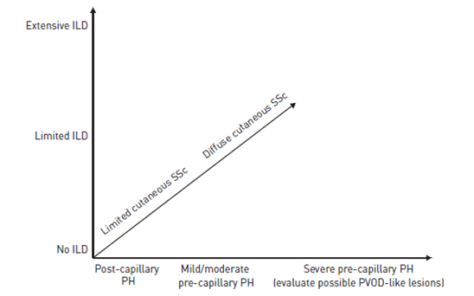
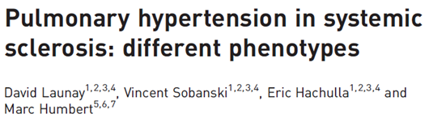
Launay D, Sobanski V, Hachulla E, et al. Pulmonary hypertension in systemic sclerosis:different phenotypes.
Eur Respir Rev 2017; 26: 170056 [https://doi.org/10.1183/16000617.0056-2017].

Slide 23
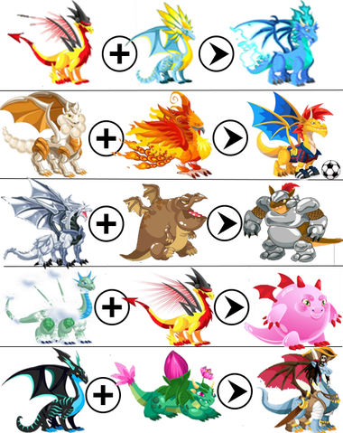
VASCULOPATÍA
INFLAMACIÓN
AUTOINMUNIDAD
FIBROGENESIS
?????????????????

Slide 24
FENOTIPOS HIPERTENSIÓN ARTERIAL PULMONAR ASOCIADA A ESCLERODERMIA
PRECAPILAR PURA | ILD INTERSTICIAL | CPFE INTERSTICIAL-ENFISEMA | VOP VENOCLUSIVA | LH VENT IZQ | TEC TROMBOEMBÓLICA
La más prevalente en los estudios | La más compleja de evaluar | Fumadores/no fumadores Fibrosis+enfisema | Adenopatías Vidrio deslustrado Líneas septales | Muy frecuente Fibrosis miocárdica | Alto riesgo si AAF
55% a 3 años | Peor pronóstico 35% a 3 años |  | Peor pronóstico | Peor pronóstico (Mort 2x)
En realidad es poco frecuente (RESCLE 6%) | Prev 25-50% |  | Prev de hasta el 61% en HAP-SScl | Prev 50-80%
 | Estadiaje de Goh (TACAR/DLCO) Extensa/Limitada | Cociente CV/DLCO puede ser normal | Buscarla al inicio y en el seguimiento | RMN cardiaca Cate (componente postcapilar oculto 20%) | Gamma V/P
 | Grupo? 1, 3? Depende de PaP y DLCO? | Descrito en SS en 2012
VD | Trat? VD? IS? Ambos? Depende? | ¿? | Riego de EAP con VD | VD | Anticoagulación VD
Notes:
Vasodilatar zonas con espacio muerto por lesión intersticial deteriora la oxigenación por efecto shunt

Slide 25
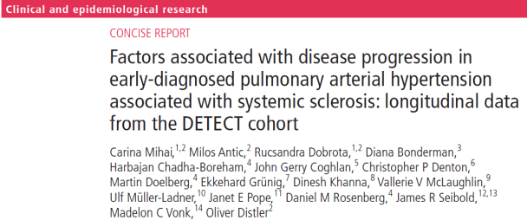
Progresión clínica HAP-SScl
57 pacientes con HAP de la cohort DETEC con seguimiento
Mediana observación 12.6 months, 25 (43.9%) tuvieron progresión clínica (empeoramiento clase F, incremento trat, hospitalización o muerte)
Factores asociados:
  Varones OR 4.1
  Mayor CVF/ (DLCO) Ratio OR 3.6
  Mayor Borg Index OR 1’7
  Baja DLCO (no lineal)
Mihai C,Antic M, Dobrota R,et al.
Ann Rheum Dis 2018;77:128–132.

Slide 26
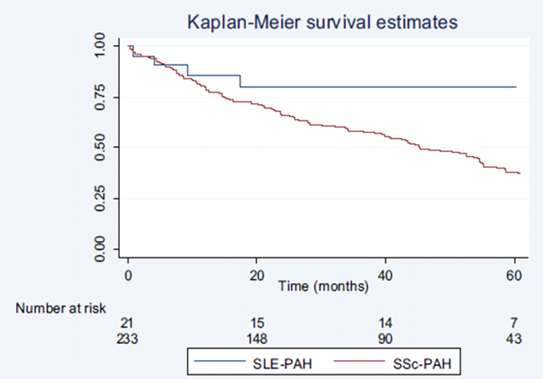
HAP en LES
Factor de riesgo independiente
3ª Causa de mortalidad (infección, nefropatía..
Prevalencia 0,5% a 17’5%, muy variable por:
  Población variada
  Definición de HAP no uniforme
Lupus-cohort United Kingdom (n = 288) fue 4.2% (ecocardio)
  Mujeres 10:1
  18-40 años
  HTP moderada
A igualdad de parámetros hemodinámicos, mejores tasas de supervivencia que EMTC y esclerodermia. 82% a 5 años
Clinical and Developmental Immunology Volume 2012; doi:10.1155/2012/854941

Slide 27
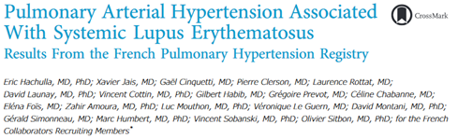
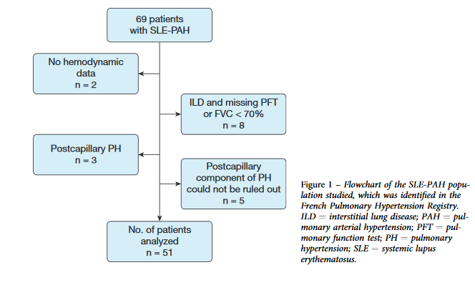

Confirmados por cateterismo derecho
Grupo control 101 patients con LES-no HAP
Más prevalencia de anti-SSA and anti-SSB
Mejor supervivencia en anti-U1-RNP positivos
Notes:
Pocos estudios específicos, la mayoría retrospectivos

Slide 28
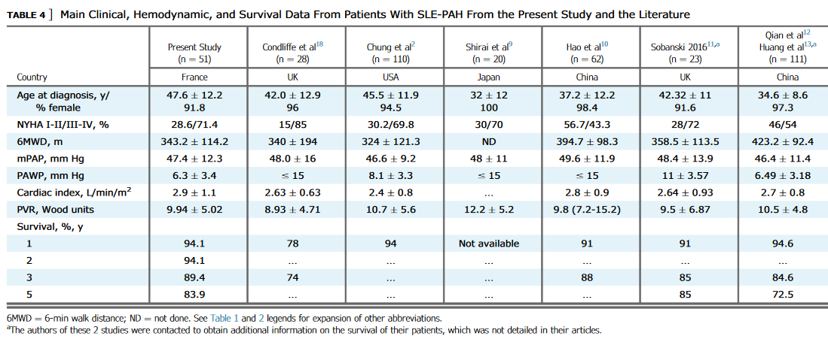
Notes:
Nota_ las guías Chinas recomiendan screening en el subgrupo con Raynaud, ….

Slide 29
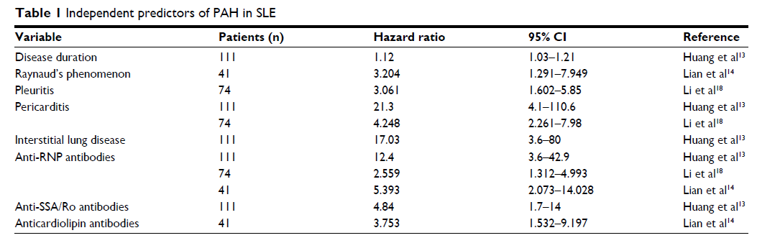
Factores de riesgo para el desarrollo de HTAP asociada a LES………. ¿SCREENING?
37%
Paradójicamente, menos SLEDAI
Open Access Rheumatology: Research and Reviews 2017:9 1–9
Notes:
Con respecto a los AAF, inducen disfunción endotelial aún en ausencia de trombosis

Slide 30
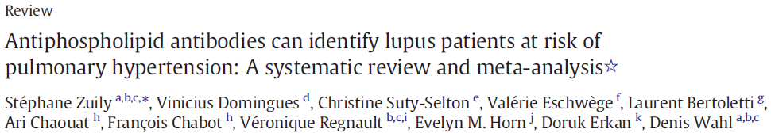
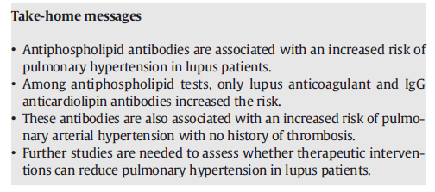
Autoimmunity Reviews 16 (2017) 576–586
Prevalence of PH in aPL-positive vs. aPL-negative SLE patients was 12.3% vs. 7.3%, respectively. The overall pooled odds ratio (OR) for PH was 2.28 (95% CI, 1.65 to 3.15) . Lupus anticoagulant (OR = 1.96 [95% CI, 1.31–2.92]) and IgG anticardiolipin antibodies (OR = 2.64 [95% CI, 1.30–5.36]) while other antibodies were not significantly associated with PH.
“The high prevalence of antiphospholipid antibodies
in SLE-aPAH patients is well known, occurring in 83% of
patients with SLE-aPAH and in 30% to 50% of patients with
SLE without PAH, compared to 7% in patients with systemic
Sclerosis”.

Slide 31
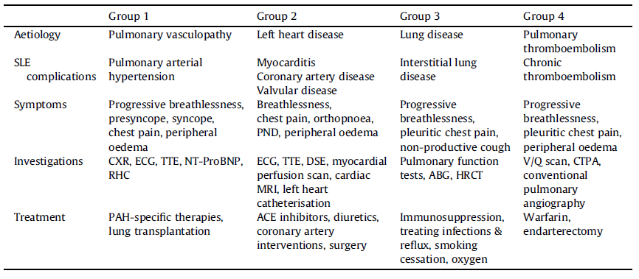
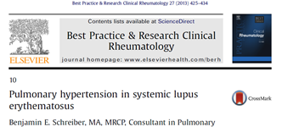
Subtipos clínicos de HTAP-SLE
“Immune-mediated vasculopathy leading to pulmonary vasculitis, relates to SLE activity and may be reversible with immunosuppression therapy”

Slide 32
Consideraciones con respecto al screening
No recomendado en las guías europeas, sí en guías chinas
Expertos:
Screening solo en sintomáticos y/o grupos de riesgo elevado de mala evolución, como en la planificación de embarazo:
    Mortalidad maternal del 56% en HAP secundaria comparada con 30% en la HAP primaria
    Todas las muertes maternas en el puerperio, con periodo crítico en las 72 horas postparto por el incremento de gasto cardiaco asociado a auto transfusion maternal con sobrecarga de VD si hay aumento de resistencias pulmonares
Rheumatol 2009;48:1506-1511

Slide 33
Tratamiento HTAP-LES
Las guías ESC 2015 recomiendan tratar la HTP-CTD con el mismo esquema de vasodilatadores que la HTP primaria, con un comentario de que algunos pacientes mejoran con cortic e IS
Ni el trat VD ni el inmunosupresor han demostrado ser factores pronósticos en HAP-LES
(concordante con el estudio de Hao pero no con el de Shirai)
La respuesta terapéutica es heterogénea porque los pacientes son heterogéneos Una respuesta precoz a los IS predice buena evolución a largo plazo
Los estudios con inmunosupresores son pequeños, no randomizados, observacionales, retrospectivos, no controlados… y casos clínicos
Los estudios con vasodilatadores son generales (CTD-HAP) y por tanto con pocos pacientes con HAP-LES
Pueden predominar el componente inflamatorio en HAP asociada a LES, EMTC y Sjögren mientras que en la esclerodermia predomina la vasculopatía y la fibrosis
Circ J 2018; 82: 546 – 554 doi: 10.1253/circj.CJ-17-0351
Notes:
The key findings in the vasodilator trials (summarized in Table 5) show improvement in exercise capacity, hemodynamic parameters, New York Heart Association Functional Class, increase in time to clinical worsening, and a trend towards improved quality of life in CTD-aPAH patients. The number of patients with SLE-aPAH in these trials was small, andmost studies did not performsubgroup analysis for SLEaPAH patients. As a result, no definitive conclusion can be drawn for this subgroup of patients. However, one study by Badesch et al., on behalf of the SUPER study group (SUPER 1), performed a posthoc analysis to study the efficacy of sildenafil on CTD-aPAH patients (n = 278) of which 23% had SLE-aPAH. This double-blinded study showed significant improvement in pulmonary hemodynamics, exercise capacity, andWHOfunctional class with 20mgs of Sildenafil over a 12-week period [22].

Slide 34
Tratamiento HTAP-LES
Los pacientes con menos alteración functional y HAP no severa son los que más se benefician del tratamiento vasodilatador, sobre todo si hay diagnóstico simultáneo de la conectivopatía y la HAP
MEJORÍA 3 MESES
SI
Continuar
IS
Diag simultáneo
HAP y CTD
o
HAP ligera
SI
NO
VD
NO
IS+VD
Circ J 2018; 82: 546 – 554 doi: 10.1253/circj.CJ-17-0351
Notes:
Nota: excluidos los pac con tromboembólica, ILD y cardiopatía izq

Slide 35



Slide 36
HAP en SINDROME DE SJÖGREN
Rara (1%)
PREV
73% a 1 año
66% a 3 años
SUP
Vasculitis con vasoespasmo persistente seguido de remodelado
PATG
F. Raynaud, vasculitis cutánea, ILD,
anti-Ro, anti-RNP,
F reumatoide e hipergamma
ASOC
Notes:
The explanation for this higher frequency of interstitial
lung disease is unclear. The first hypothesis is that interstitial
lung disease could play a role in the development of pulmonary
hypertension, as previously discussed. Indeed, pulmonary
hypertension can be a direct consequence of interstitial
lung disease because of associated hypoxemia in case of
extensive tissue destruction20. However, patients with pSSassociated
PAH often had a very high mPAP compared to the
degree of pulmonary lung function impairment, indicating
that pulmonary hypertension was out of proportion and that a
specific vasculopathy presumably played a major role in these
cases. Indeed, mPAP in hypoxic pulmonary hypertension is
usually moderately elevated with a normal or increased
cardiac output, resulting in a modest elevation of pulmonary
vascular resistance. For example, it is recognized that 1 of the
main characteristics of pulmonary hypertension in chronic
obstructive pulmonary disease patients is its mild-to-moderate
degree, with a resting mPAP in a stable state of the disease
usually ranging between 20 and 35 mm Hg79. However, some
patients with hypoxic pulmonary hypertension develop a more
severe pulmonary hypertension (mPAP > 40 mm Hg), which
is ‘‘out of proportion’’ to the degree of lung function
impairment13. These patients are probably important to
identify because specific, antiproliferative, pulmonary hypertension
treatment could represent a therapeutic option to
improve their clinical status. The second hypothesis to explain
a higher frequency of interstitial lung disease in patients with
pSS-associated PAH is that both conditions share similar
pathophysiologic pathways.

Slide 37
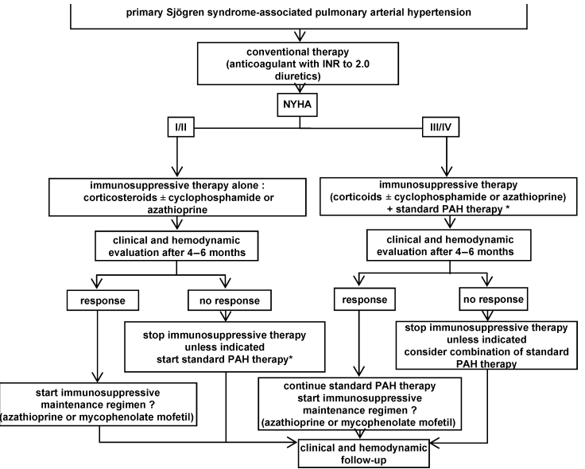
Medicine 2007;86:299–315)

Slide 38
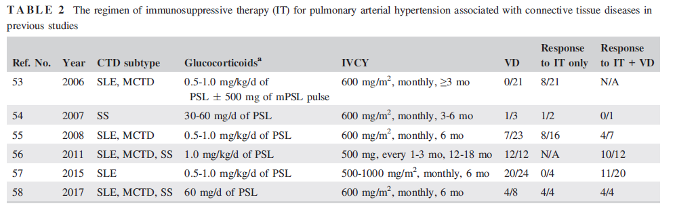
Tratamiento inmunosupresor
Kato M, Atsumi T.
Pulmonary arterial hypertension associated with connective tissue diseases: A review focusing on distinctive clinical aspects. Eur J Clin Invest 2018;48:e12876. https://doi.org/10.1111/eci.12876

Slide 39
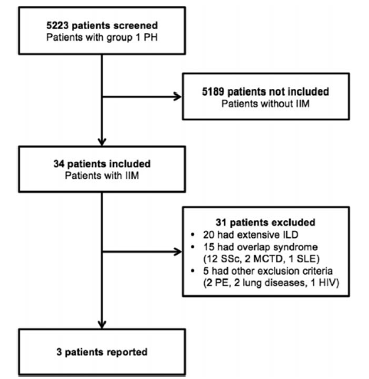
HAP en MIOPATIAS INFLAMATORIAS
Sanges et al. Medicine (2016) 95:39
Notes:
The explanation for this higher frequency of interstitial
lung disease is unclear. The first hypothesis is that interstitial
lung disease could play a role in the development of pulmonary
hypertension, as previously discussed. Indeed, pulmonary
hypertension can be a direct consequence of interstitial
lung disease because of associated hypoxemia in case of
extensive tissue destruction20. However, patients with pSSassociated
PAH often had a very high mPAP compared to the
degree of pulmonary lung function impairment, indicating
that pulmonary hypertension was out of proportion and that a
specific vasculopathy presumably played a major role in these
cases. Indeed, mPAP in hypoxic pulmonary hypertension is
usually moderately elevated with a normal or increased
cardiac output, resulting in a modest elevation of pulmonary
vascular resistance. For example, it is recognized that 1 of the
main characteristics of pulmonary hypertension in chronic
obstructive pulmonary disease patients is its mild-to-moderate
degree, with a resting mPAP in a stable state of the disease
usually ranging between 20 and 35 mm Hg79. However, some
patients with hypoxic pulmonary hypertension develop a more
severe pulmonary hypertension (mPAP > 40 mm Hg), which
is ‘‘out of proportion’’ to the degree of lung function
impairment13. These patients are probably important to
identify because specific, antiproliferative, pulmonary hypertension
treatment could represent a therapeutic option to
improve their clinical status. The second hypothesis to explain
a higher frequency of interstitial lung disease in patients with
pSS-associated PAH is that both conditions share similar
pathophysiologic pathways.

Slide 40
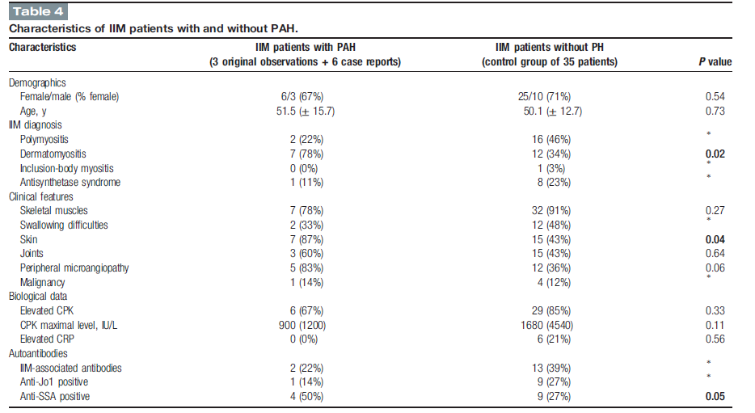
Sanges et al. Medicine (2016) 95:39

Slide 41
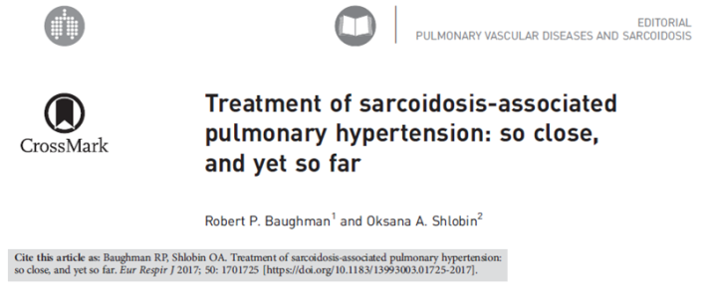
HAP EN SARCOIDOSIS
Más frecuente con fibrosis pulmonar
Peor supervivencia que sarcoidosis sin HAP
Registro francés de HAP:
  126 casos con seguimiento
  11 pacientes con tratamiento IS (PET)
  75% con vasodilatadores: Mejoría hemodinámica pero sin cambios en el test de la marcha, mediatizado por la CV
Notes:
The explanation for this higher frequency of interstitial
lung disease is unclear. The first hypothesis is that interstitial
lung disease could play a role in the development of pulmonary
hypertension, as previously discussed. Indeed, pulmonary
hypertension can be a direct consequence of interstitial
lung disease because of associated hypoxemia in case of
extensive tissue destruction20. However, patients with pSSassociated
PAH often had a very high mPAP compared to the
degree of pulmonary lung function impairment, indicating
that pulmonary hypertension was out of proportion and that a
specific vasculopathy presumably played a major role in these
cases. Indeed, mPAP in hypoxic pulmonary hypertension is
usually moderately elevated with a normal or increased
cardiac output, resulting in a modest elevation of pulmonary
vascular resistance. For example, it is recognized that 1 of the
main characteristics of pulmonary hypertension in chronic
obstructive pulmonary disease patients is its mild-to-moderate
degree, with a resting mPAP in a stable state of the disease
usually ranging between 20 and 35 mm Hg79. However, some
patients with hypoxic pulmonary hypertension develop a more
severe pulmonary hypertension (mPAP > 40 mm Hg), which
is ‘‘out of proportion’’ to the degree of lung function
impairment13. These patients are probably important to
identify because specific, antiproliferative, pulmonary hypertension
treatment could represent a therapeutic option to
improve their clinical status. The second hypothesis to explain
a higher frequency of interstitial lung disease in patients with
pSS-associated PAH is that both conditions share similar
pathophysiologic pathways.

Slide 42

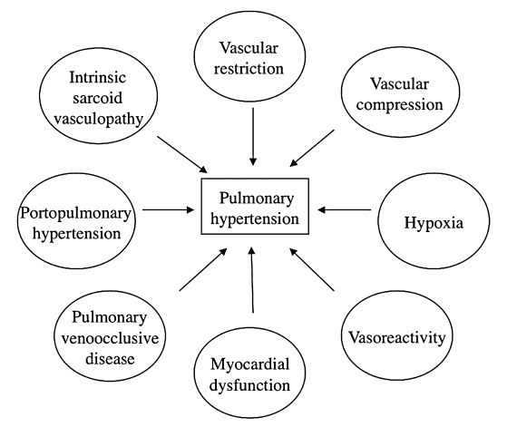
Respirology (2011) 16, 69–77
doi: 10.1111/j.1440-1843.2010.01872.x

Slide 43
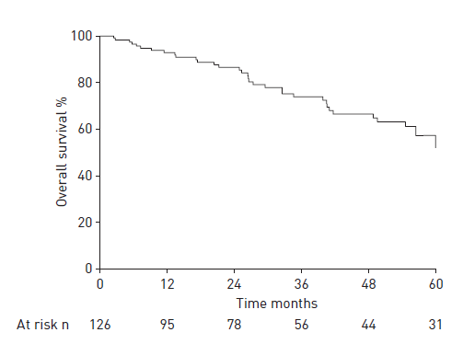
Survival at
1, 3 and 5 years was 93%, 74% and
55%, respectively.
Boucly A, Cottin V, Nunes H, et al. Management and long-term outcomes of sarcoidosis-associated pulmonary hypertension. Eur Respir J 2017; 50: 1700465 [https://doi.org/10.1183/13993003.00465-2017].

Slide 44
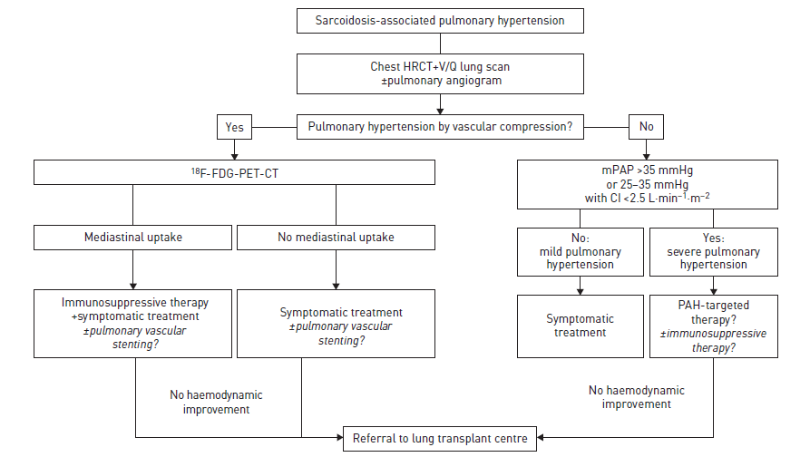
Boucly A, Cottin V, Nunes H, et al. Management and long-term outcomes of sarcoidosis-associated pulmonary hypertension. Eur Respir J 2017; 50: 1700465 [https://doi.org/10.1183/13993003.00465-2017].

Slide 45


