Slide 1
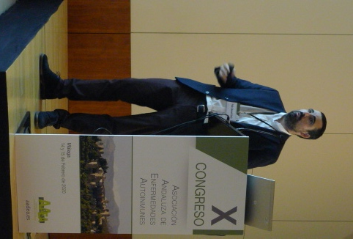
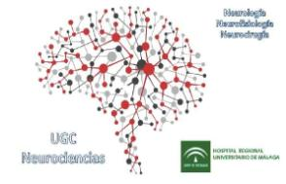
ENCEFALITIS AUTOINMUNE: EVOLUCIÓN CLÍNICA Y CLAVES PARA EL DIAGNÓSTICO
Dr. Pablo Cabezudo García
Servicio de Neurología, Unidad de Epilepsia, UGC de Neurociencias, HRU Málaga.
Instituto de Investigación Biomédica de Málaga‐IBIMA, Neuroinmunología y Neuroinflamación.

Slide 2
TERMINOLOGÍA
ENCEFALITIS AUTOINMUNE
ENCEFALITIS PARENOPLÁSICA
(anticuerpos antígenos intracelulares-onconeuronales)
ENCEFALITIS asociada a anticuerpos contra proteínas de superficie neuronal
CÁNCER
Notes:
Encephalitis is an inflammatory condition of the brain with many etiologies. There are several types of encephalitis that are immune mediated, including the classic paraneoplastic encephalitis syndromes, often associated with antibodies against intracellular neuronal proteins (onconeuronal proteins), and the encephalitis syndromes associated with antibodies against neuronal cell surface/synaptic proteins. The latter are often referred to as "autoimmune encephalitis."
While the paraneoplastic encephalitis syndromes are invariably cancer related, the autoimmune encephalitis syndromes may occur in the presence or absence of cancer. Thus, nomenclature can be confusing, as the paraneoplastic encephalitis syndromes are autoimmune, and autoimmune encephalitis may be paraneoplastic. In this topic, the term "autoimmune encephalitis" refers specifically to those syndromes that are associated with antibodies to neuronal cell surface/synaptic proteins.

Slide 3
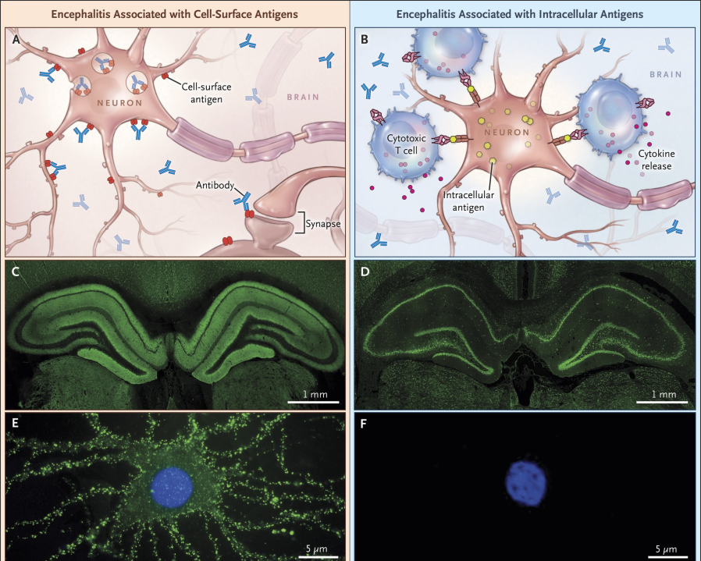
Dalmau J, Graus F. Antibody-Mediated Encephalitis. N Engl J Med. 2018
Notes:
Figure 1. Antibody Reactivity and Pathological Features of Encephalitis Associated with Antibodies against Neuronal Cell-Surface Antigens as Compared with Encephalitis Associated with Antibodies against Intracellular Antigens.In encephalitis associated with antibodies against cell-surface antigens, the antibodies have access to the epitopes and can potentially alter the structure and function of the cognate antigen (Panel A), whereas in encephalitis associated with antibodies against intracellular antigens, the antibodies cannot reach the intracellular epitopes, and cytotoxic T-cell mechanisms are predominantly involved (Panel B). N-methyl-d-aspartate receptor (NMDAR) antibodies (Panels C and E) are examples of the group of antibodies against cell-surface antigens, and Hu antibodies (Panels D and F) are examples of the group of antibodies against intracellular antigens. In immunofluorescence studies of rodent brain with tissue permeabilized to allow entry of antibodies, NMDAR antibodies are characterized by a pattern of neuropil-like immunolabeling (Panel C, green staining), whereas Hu antibodies have a discrete pattern of cellular immunolabeling (Panel D, green staining). In contrast, with live cultured neurons, NMDAR antibodies have access to the target antigen (Panel E, intensive immunolabeling), whereas Hu antibodies cannot reach the intracellular antigen (Panel F, no immunolabeling). Autopsy studies have shown that patients with anti-NMDAR encephalitis have moderate brain inflammatory infiltrates along with plasma cells (Panel G, cells stained brown with a CD138 antibody), deposits of IgG (Panel H, diffuse brown staining with an antihuman IgG antibody), and microglial proliferation (Panel H inset, microglial cells stained red with a CD68 antibody), without evidence of T-cell–mediated neuronal loss (not shown). In contrast, patients with anti-Hu paraneoplastic encephalitis have extensive neuronal loss and inflammatory infiltrates (not shown); the T cells are in direct contact with neurons (Panel I, arrows; hematoxylin and eosin), probably contributing to neuronal degeneration through perforin and granzyme mechanisms (Panel J, arrow; granzyme B staining). All human tissue sections (Panels G through J) were obtained from the hippocampus.

Slide 4
ENCEFALITIS AUTOINMUNE
ENCEFALITIS PARENOPLÁSICA
(anticuerpos antígenos intracelulares-onconeuronales)
ENCEFALITIS LÍMBICA
ENCEFALITIS asociada a anticuerpos contra proteínas de superficie neuronal
CÁNCER
Encefalitis anti-NMDA
Otros: Morvan, IgLON5…
Notes:
Encephalitis is an inflammatory condition of the brain with many etiologies. There are several types of encephalitis that are immune mediated, including the classic paraneoplastic encephalitis syndromes, often associated with antibodies against intracellular neuronal proteins (onconeuronal proteins), and the encephalitis syndromes associated with antibodies against neuronal cell surface/synaptic proteins. The latter are often referred to as "autoimmune encephalitis."
While the paraneoplastic encephalitis syndromes are invariably cancer related, the autoimmune encephalitis syndromes may occur in the presence or absence of cancer. Thus, nomenclature can be confusing, as the paraneoplastic encephalitis syndromes are autoimmune, and autoimmune encephalitis may be paraneoplastic. In this topic, the term "autoimmune encephalitis" refers specifically to those syndromes that are associated with antibodies to neuronal cell surface/synaptic proteins.

Slide 5
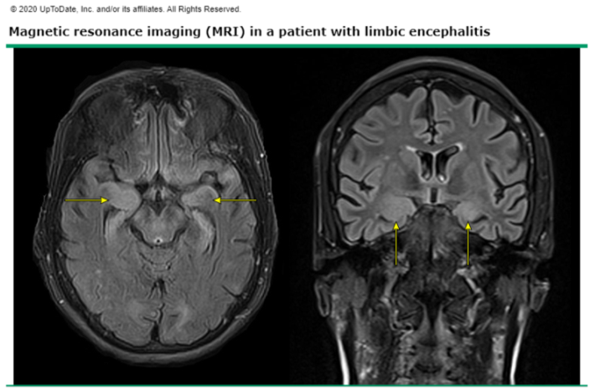
ENCEFALITIS LÍMBICA
Curso subagudo (días/semanas)
Alteraciones comportamiento/ánimo
Afectación memoria a corto plazo
Crisis epilépticas
Disfunción hipotalámica (hipertermia, somonlencia y alteraciones endocrinas

Slide 6
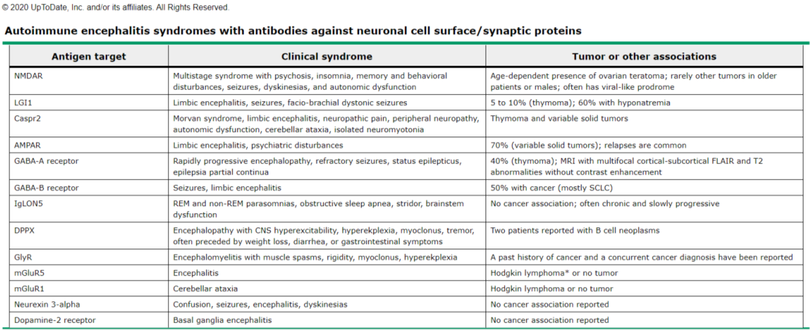
ENCEFALITIS AUTOINMUNE/ENCEFALITIS asociada a anticuerpos contra proteínas de superficie neuronal

Slide 8
Notes:
We report four young women who developed acute psychiatric symptoms, seizures, memory deficits, decreased level of consciousness, and central hypoventilation associated with ovarian teratoma (OT) and cerebrospinal fluid (CSF) inflammatory abnormalities. Three patients recovered with treatment of the tumor or immunosuppression and one died of the disorder. Five other OT patients with a similar syndrome and response to treatment have been reported. Our patients' serum or CSF showed immunolabeling of antigens that were expressed at the cytoplasmic membrane of hippocampal neurons and processes and readily accessed by antibodies in live neurons. Immunoprobing of a hippocampal-expression library resulted in the isolation of EFA6A, a protein that interacts with a member of the two-pore-domain potassium channel family and is involved in the regulation of the dendritic development of hippocampal neurons. EFA6A-purified antibodies reproduced the hippocampal immunolabeling of all patients' antibodies and colocalized with them at the plasma membrane. These findings indicate that in a young woman with acute psychiatric symptoms, seizures, and central hypoventilation, a paraneoplastic immune-mediated syndrome should be considered. Recognition of this disorder is important because despite the severity of the symptoms, patients usually recover. The location and function of the isolated antigen suggest that the disorder is directly mediated by antibodies.
Objective: To report the autoantigens of a new category of treatment-responsive paraneoplastic encephalitis.
Methods: Analysis of clinical features, neuropathological findings, tumors, and serum/cerebrospinal fluid antibodies using rat
tissue, neuronal cultures, and HEK293 cells expressing subunits of the N-methyl-D-aspartate receptor (NMDAR).
Results: Twelve women (14 – 44 years) developed prominent psychiatric symptoms, amnesia, seizures, frequent dyskinesias,
autonomic dysfunction, and decreased level of consciousness often requiring ventilatory support. All had serum/cerebrospinal
fluid antibodies that predominantly immunolabeled the neuropil of hippocampus/forebrain, in particular the cell surface of
hippocampal neurons, and reacted with NR2B (and to a lesser extent NR2A) subunits of the NMDAR. NR2B binds glutamate
and forms heteromers (NR1/NR2B or NR1/NR2A/NR2B) that are preferentially expressed in the adult hippocampus/forebrain.
Expression of functional heteromers (not single subunits) was required for antibody binding. Eleven patients had teratoma of the
ovary (six mature) and one a mature teratoma in the mediastinum; five of five tumors examined contained nervous tissue that
strongly expressed NR2 subunits and reacted with patients’ antibodies. Tumor resection and immunotherapy resulted in im-
provement or full recovery of eight of nine patients (paralleled by decreased antibody titers); two of three patients without tumor
resection died of neurological deterioration. Autopsies showed extensive microgliosis, rare T-cell infiltrates, and neuronal degen-
eration predominantly involving, but not restricted to, the hippocampus.
Interpretation: Antibodies to NR2B- and NR2A-containing heteromers of the NMDAR associate with a severe but treatment-
responsive encephalitis. Our findings provide a diagnostic test and suggest a model of autoimmune NMDAR-related encephalitis
with broad implications for other immune-mediated disorders of memory, behavior, and cognition.

Slide 9
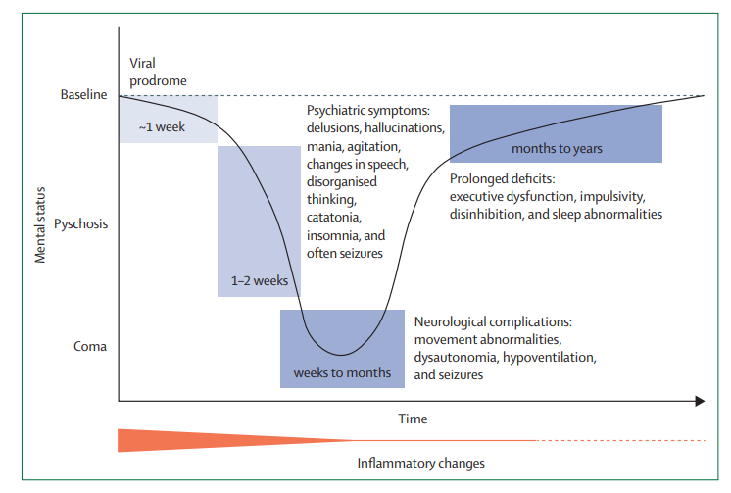
Dalmau J, Armangué T, Planagumà J, et al. An update on anti-NMDA receptor encephalitis for neurologists and psychiatrists: mechanisms and models. Lancet Neurol. 2019
Notes:
This graphic representation of the full-blown syndrome of anti-NMDAR encephalitis in teenagers and young adults shows the predominance of psychiatric symptoms at the initial phase of the disease. These symptoms are usually accompanied or followed by neurological alterations (abnormal movements, seizures, dysautonomia, or coma) that eventually improve or resolve, and lead to a prolonged phase of recovery with prominent involvement of executive functions. The intensity of inflammatory changes (which is usually reflected by the presence of pleocytosis in the CSF or suggested by the brain MRI findings), is shown by the thickness of the red line, which decreases over time until becoming a thin line and then a dotted line (minimal or undetectable inflammatory changes). Adapted from Kayser and Dalmau4 by permission of Bentham Science. NMDAR=NMDA receptor
Young children typically present with insomnia, seizures, abnormal movements, or a change in behavior such as irritability, temper tantrums, agitation, and reduction of verbal output. Teenagers and adults more often present with psychiatric symptoms, including agitation, hallucinations, delusions, and catatonia, which may lead to hospital admission
for psychosis. The disease progresses in a period of days or weeks to include reduction of speech, memory deficit, orofacial and limb dyskinesias, seizures, decreased level of consciousness,
and autonomic instability manifested as excess salivation, hyperthermia, fluctuations of blood pressure, tachycardia, or central hypoventilation.26 Bradycardia and cardiac pauses are
infrequent but require a temporary pacemaker in some patients. One month after disease onset, regardless of the symptoms at presentation,most children and adults have a syndrome that
combines several of the above-mentioned symptoms;in approximately 5% of patients, the disease may remain monosymptomatic (e.g., psychiatric symptoms)
Treatment options include immunosuppression and tumor resection when indicated [51,66,73,92]. Progressive neurologic deterioration and death can occur without treatment. However, spontaneous recovery has also been described in a few patients after several months of severe symptoms [93].
In the absence of prospective and randomized data, treatment decisions should be individualized and take into consideration patient age, the presence or absence of a tumor, and symptom severity. Based on observational studies reviewed below and clinical experience, we suggest initial treatment with intravenous methylprednisolone (eg, 1 gram daily for five days in an adult) and either intravenous immunoglobulin G (IVIG; eg, 400 mg/kg per day for five days) or plasma exchange in most patients, in addition to tumor removal when appropriate. It is unknown whether IVIG and plasma exchange have similar efficacy; some clinicians may find IVIG easier to administer in patients with anti-NMDA receptor encephalitis, who may be very young and have severe dyskinesias, agitation, and autonomic instability.
If there is no evidence of clinical improvement with initial therapies, we proceed with second-line therapies including rituximab (either 375 mg/m² weekly for four weeks, or 1 g twice two weeks apart), cyclophosphamide (750 mg/m² monthly for four to six months depending on results), or both. A similar escalation approach is being used in children by many experts; however, in children the dose of medications is less clear and often has been adapted from the use of the same medications in other autoimmune conditions (eg, cyclophosphamide in pediatric systemic lupus erythematosus). (See "Systemic lupus erythematosus (SLE) in children: Treatment, complications, and prognosis", section on 'Severe SLE'.)
An alternative approach to stepwise escalation of immunotherapy is to use rituximab in combination with steroids and IVIG or plasma exchange as initial therapy. We increasingly favor this approach in severely affected patients, based on personal experience and accumulating data supporting the effectiveness of rituximab in reducing relapses when used in the second-line setting.
The largest published experience on treatment and outcomes in anti-NMDA receptor encephalitis is a retrospective study of 577 patients that included 501 patients for whom treatment effects and outcome were assessable [51]. Nearly all patients (94 percent) were treated with tumor removal and first-line immunotherapy, including steroids, IVIG, and/or plasma exchange.
●Half of patients improved within the first four weeks of first-line therapy. Of these, 97 percent had a good outcome at 24-month follow-up.
●Of the 221 patients who did not improve within the first four weeks of first-line therapy, 125 (57 percent) received rituximab, cyclophosphamide, or both. Patients who received second-line therapy had a higher likelihood of a good outcome (modified Rankin Scale [mRS] 0 to 2) than those who did not (odds ratio [OR] 2.7, 95% CI 1.2-5.8). Response rates were similar in adults and children.
●By 24 months, approximately 80 percent of patients achieved a good outcome (mRS 0 to 2) and 30 patients had died. Outcomes continued to improve for up to 18 months after symptom onset.
●Twelve percent of patients relapsed within the first two years of the initial episode. Patients without a tumor and those who did not receive second-line immunotherapy were at increased risk for relapse.
The utility and safety of rituximab was examined in another retrospective study of 144 children with inflammatory or autoimmune encephalitis, including 39 with anti-NMDA receptor encephalitis [94]. All children in the series received rituximab at a median of six months from diagnosis. Early use of rituximab was associated with greater likelihood of good outcome. Infectious adverse events occurred in 8 percent of patients, including serious or fatal infection in four patients.
These and other smaller series support a treatment approach based on escalation of immunotherapy that results in substantial improvement in 75 to 80 percent of patients by 24 months [51,94-96]. Most studies show that predictors of good outcome are early treatment and low severity of disease (eg, no need for admission to an intensive care unit) [51,96].
Patients may require intensive care support for several weeks or months, and afterwards a multidisciplinary team including physical rehabilitation and psychiatric management of protracted behavioral symptoms [48,93]. Symptoms of frontal lobe dysfunction (poor attention and planning, impulsivity, behavioral disinhibition, memory deficits) typically improve gradually over months but can persist long term in some patients [97]. Substantive persistent cognitive impairments are more common and more severe when there is a delay to diagnosis and treatment [98]. The strongest risk factors for poor one-year functional outcomes are lack of clinical improvement within the first four weeks of treatment and requirement for intensive care unit admission [99]. Most patients have resolution of seizures with a combination of antiseizure drugs and immunotherapy, and the risk of long-term epilepsy in the absence of encephalitis relapse appears to be low [100].
As noted above, patients with anti-NMDA receptor encephalitis are at risk for relapse. Relapse occurs in 15 to 24 percent of patients, sometimes after several years [48,66,101]. Relapse may occur in the absence of a tumor or in association with an occult or recurrent teratoma. In several series, relapses were more common among those who did not receive immunotherapy with the initial presentation [51,101]. Relapses are typically treated similarly to the approach in newly diagnosed patients, with a lower threshold to initiate second-line therapies early in the course of the relapse.

Slide 10
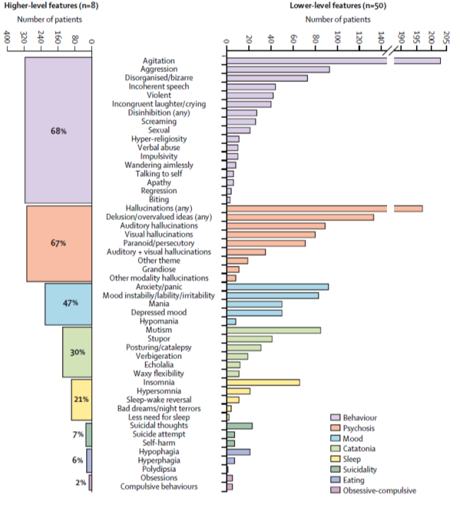
Al-Diwani A, Handel A, Townsend L, et al. The psychopathology of NMDAR-antibody encephalitis in adults: a systematic review and phenotypic analysis of individual patient data. Lancet Psychiatry. 2019;6
Notes:
The distinctive aspect of NMDAR-antibody encephalitis psychopathology is complexity; core aspects of
mood and psychotic disorders consistently coexist within individual patients. Alongside the predominant young
female demographic, these psychopathological features could help psychiatrists identify patients who would benefit
from cerebrospinal fluid testing and immunotherapies. Well-controlled prospective studies with bespoke inventories
are needed to advance this clinically grounded approach.

Slide 11
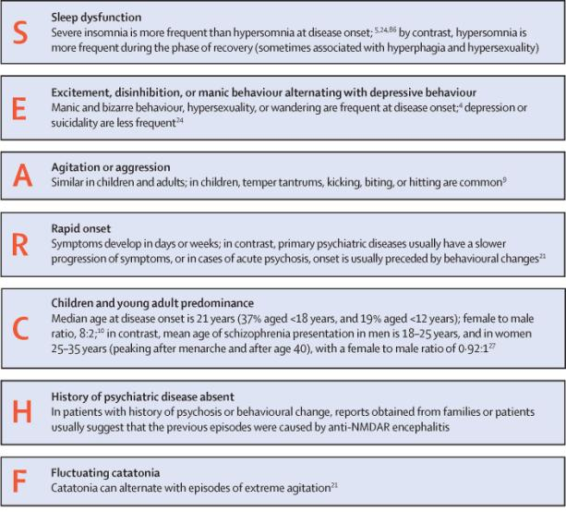
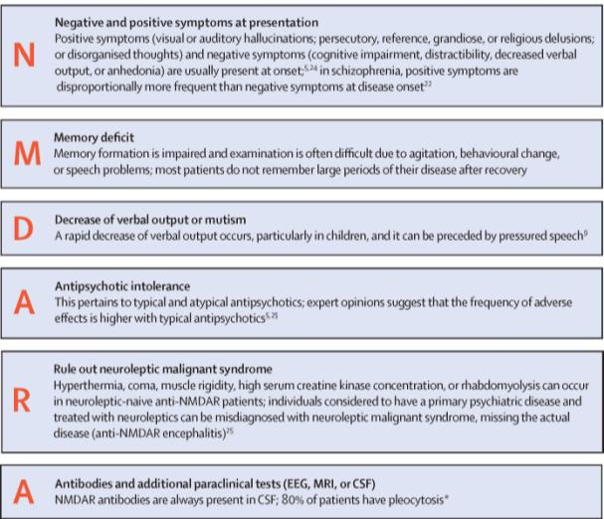
Dalmau J, Armangué T, Planagumà J, et al. An update on anti-NMDA receptor encephalitis for neurologists and psychiatrists: mechanisms and models. Lancet Neurol. 2019
Notes:
Figure 2: Diagnostic clues of anti-NMDAR encephalitis in patients with new-onset psychiatric symptoms
(SEARCH For NMDAR-A)
NMDAR=NMDA receptor. *Further information and other tests are shown in the table.

Slide 12
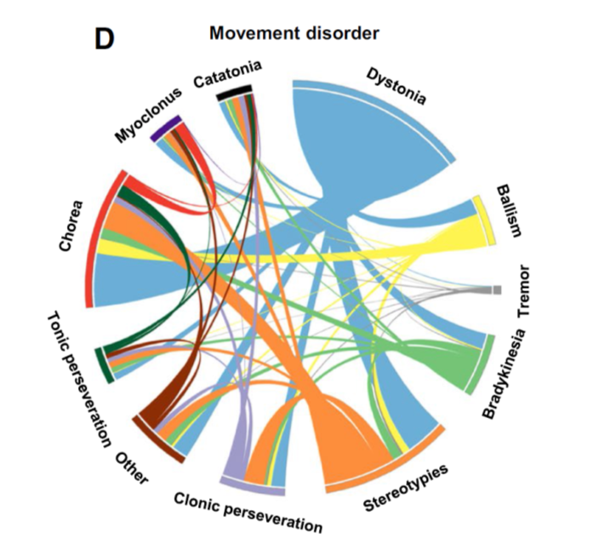
Ramanathan S, Al-Diwani A, Waters P, Irani SR. The autoantibody-mediated encephalitides: from clinical observations to molecular pathogenesis J Neurol. 2019

Slide 13
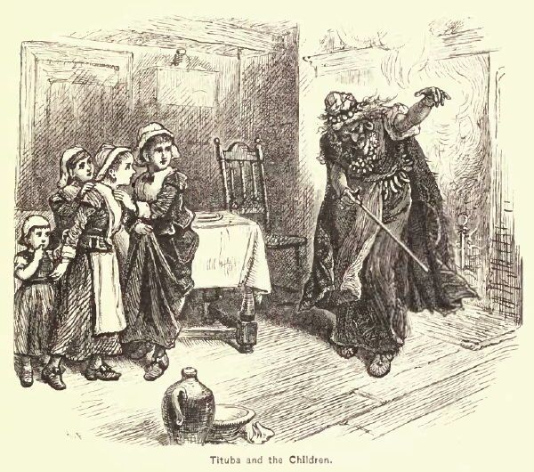

Slide 14
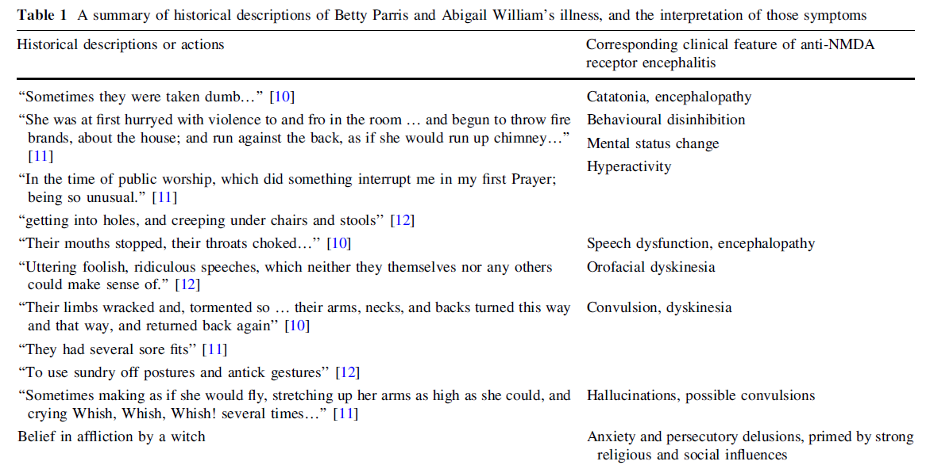
Tam J, Zandi MS. The witchcraft of encephalitis in Salem. J Neurol. 2017

Slide 15
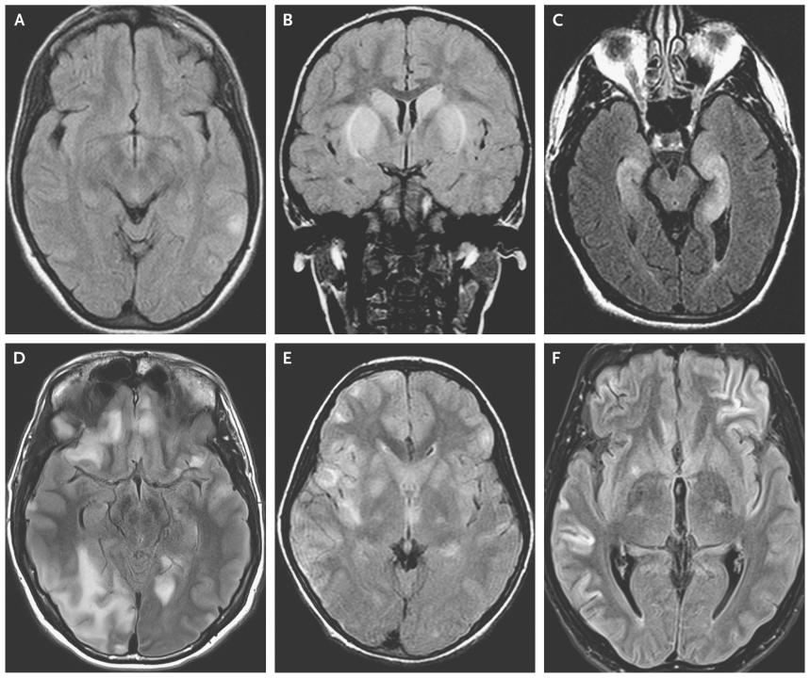
Anti-NMDA
Anti-DP2
Dalmau J, Graus F. Antibody-Mediated Encephalitis. N Engl J Med. 2018
GABAaR
ADEM
AMPA
Notes:
Figure 2. MRI Findings in Antibody-Mediated Encephalitis.Shown are representative MRI scans from patients with several types of autoimmune encephalitides. Anti-NMDAR encephalitis often is present despite normal MRI findings or mild signal abnormalities on fluid-attenuated inversion recovery (FLAIR) images (Panel A). Basal ganglia encephalitis associated with dopamine 2 receptor antibodies typically affects the striatum (Panel B). Limbic encephalitis may result from several different immune responses and is typically indicated by FLAIR signal increases in the medial temporal lobes (Panel C). In contrast, encephalitis with antibodies against γ-aminobutyric acid (GABA) type A receptor (GABA_{A}R ) is usually associated with multiple cortical and subcortical FLAIR signal changes (Panel D). Patients with various acute inflammatory demyelinating diseases may have clinical and MRI findings that are indistinguishable from the findings in patients with autoimmune encephalitis. For example, an MRI scan showing extensive, bilateral FLAIR signal abnormalities was obtained from a patient in whom sudden-onset confusion and encephalopathy developed that were caused by acute disseminated encephalomyelitis associated with antibodies against myelin oligodendrocyte glycoprotein (Panel E). The clinical and radiologic features of autoimmune encephalitides can occasionally be misleading. For example, a young man was admitted for severe encephalitis and refractory seizures that required pharmacologically induced coma. Studies showed a large thymoma, α-amino-3-hydroxy-5-methyl-4-isoxazolepropionic acid receptor (AMPAR) antibodies, and MRI findings (Panel F) that suggested widespread cortical damage and a poor prognosis. However, removal of the tumor and immunotherapy resulted in complete clinical recovery.
As the older term limbic encephalitis implies, the most common location of involvement is the mesial temporal lobes and limbic systems, typically manifested by cortical thickening and increased T2/FLAIR signal intensity of these regions. Bilateral involvement is most common (60%), although often asymmetric ⁸. The lateral temporal lobe and insula are less commonly involved, whereas the basal ganglia, in contrast, are frequently involved, helpful in distinguishing it from HSV encephalitis which characteristically spares the basal ganglia ⁸. Although far less common, essentially any part of the central nervous system can be involved.
Magnetic resonance imaging (MRI) may show areas of T2/fluid-attenuated inversion recovery (FLAIR) hyperintensity in the medial temporal lobes (image 1); contrast enhancement in these regions is very infrequent. Positron emission tomography (PET) may demonstrate hypermetabolism in the medial temporal lobes; later in the course of disease, hypometabolism may be present [3].
MRI findings in the medial temporal lobes are reasonably sensitive but not specific for limbic encephalitis. Approximately 80 percent of patients with symptoms of limbic encephalitis, in whom the diagnosis is eventually confirmed during the course of disease, will have uni- or bilateral increased FLAIR signal in the medial temporal lobes on MRI. The other patients may show late changes or no changes on MRI.

Slide 16
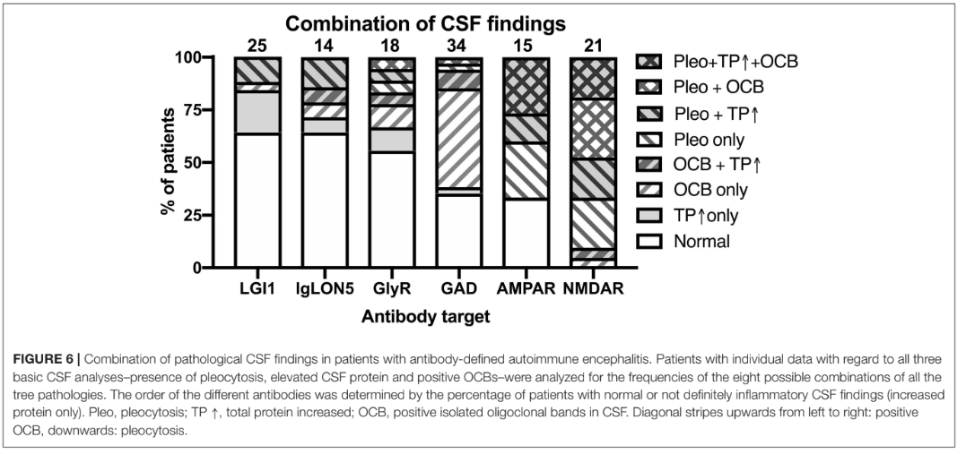
Blinder T, Lewerenz J. Cerebrospinal Fluid Findings in Patients With Autoimmune Encephalitis-A Systematic Analysis. Front Neurol. 2019

Slide 17
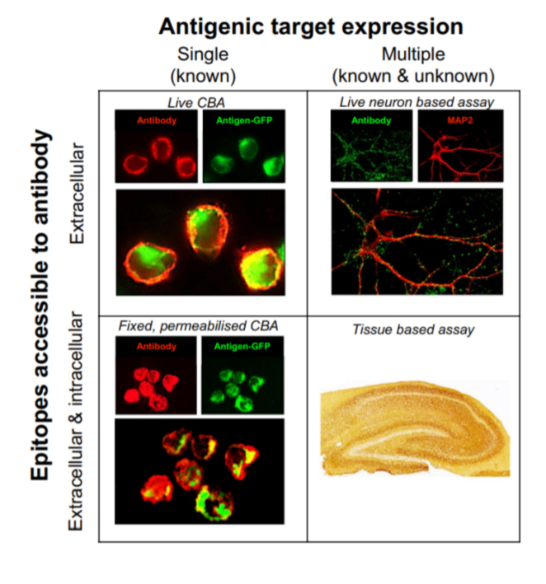
Ramanathan S, Al-Diwani A, Waters P, Irani SR. The autoantibody-mediated encephalitides: from clinical observations to molecular pathogenesis . J Neurol. 2019
Notes:
Neuronal surface antibody detection methods. Prevailing methods used in research and diagnostic practice expose neuronal antigens to the test sample but difer in the properties of the antigen(s). Cell-based assays (CBA) aim to largely expose a single known antigen, by cell transfection. Conversely, neuron-based assays and tissue-based assays expose multiple natively expressed antigens which include those known to be targets of pathogenic antibodies, in addition to as-yet unknown antigens. Additionally, the assays vary on whether the antigen is fxed prior to incubation with the sample, and whether the cell membrane is intact. Live CBAs and live neuron-based assays neither fx the surface antigen nor permeabilise the membrane prior to exposure to the patient’s sample. In contrast, in fxed permeabilised CBAs and tissue-based assays, target antigens are fxed and cell membrane integrity is lost. CBA cell-based assay

Slide 18
15% pacientes anti-NMDA negativos en sangre
Notes:
15% of the patients with anti-NMDAR encephalitis did not have antibodies in the serum, only had antibodies in the CSF, and that these patients were less likely to be women, have an underlying tumor, and develop seizures, movement disorders, central hypoventilation, or admission to ICU.
In a routine clinical diagnosis, the frequency of seronegative cases may even increase because samples are usually tested by a single technique without the expertise of a reference laboratory. There are 2 possible explanations for the apparent absence of NMDAR antibodies in the serum. The first is that the titer of NMDAR-abs is below the threshold of detection using the indicated techniques.
Alternatively, seronegative patients, or a subset of them, may have NMDAR antibodies only in the CSF after systemically activated T and B cells cross the blood-brain barrier and orchestrate the synthesis of NMDAR antibodies in the brain, reflected by an almost constant presence of intrathecal NMDAR antibody synthesis and plasma cells in perivascular, interstitial, and Virchow-Robin spaces. These patients could potentially have transient low levels of antibodies in the serum, which become rapidly negative or below the threshold of detection. Against the later possibility is the presence, although with a lower frequency compared with seropositive patients, of a systemic NMDAR-expressing tumor, such as a teratoma (usually infiltrated by lymphocytes that can synthesize NMDAR antibodies) in 6% of the seronegative patients, and the observation in previous studies that the presence of a teratoma associates with higher titers of serum NMDAR antibodies

Slide 19
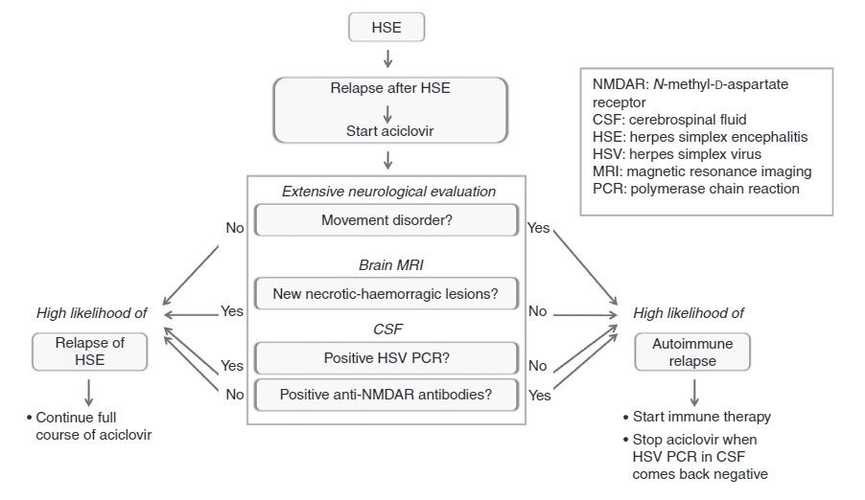

Slide 20
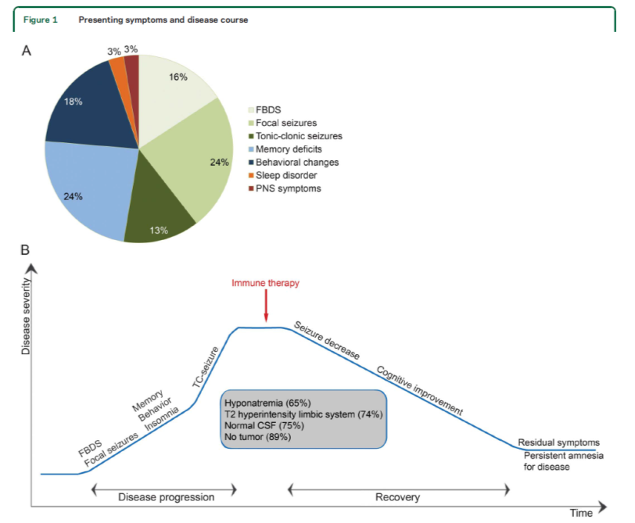
Anti-LGI1 encephalitis
22 semanas
van Sonderen A, Thijs RD, Coenders EC, et al. Anti-LGI1 encephalitis: Clinical syndrome and long-term follow-up. Neurology. 2016
Notes:
(A) First symptom in 38 patients with anti–leucine-rich glioma-inactivated 1 (LGI1) encephalitis. (B) Disease course in anti-LGI1 encephalitis. Timeline: median
disease progression 22 weeks, median treatment delay 25 weeks, median start of improvement 2 weeks after treatment, median time of recovery 33
weeks. FBDS 5 faciobrachial dystonic seizures; PNS 5 peripheral nervous system; TC seizure 5 tonic-clonic seizure.

Slide 21
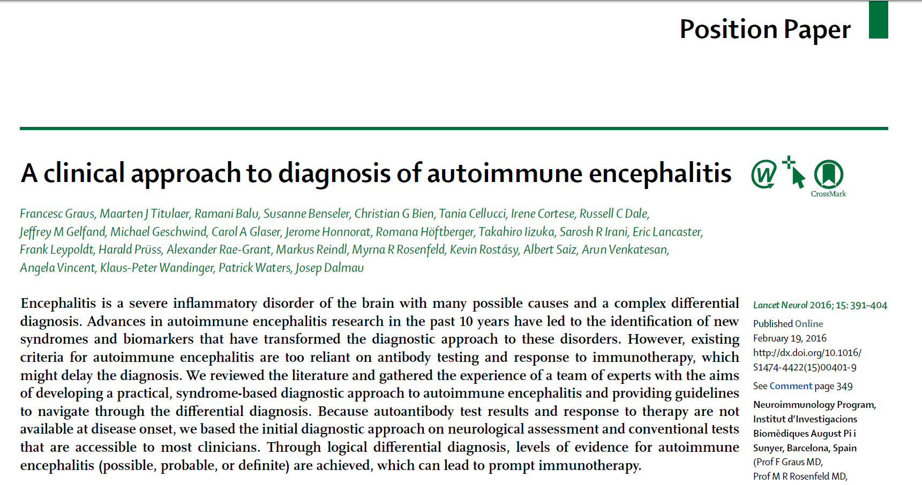

Slide 22
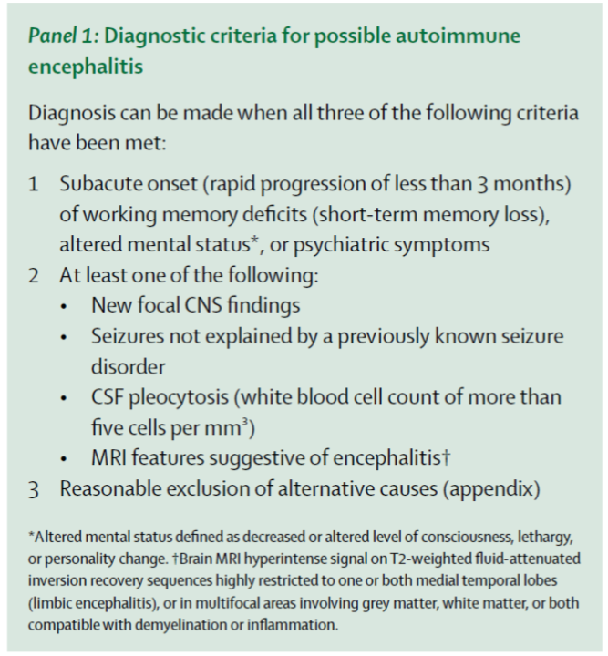

Slide 23
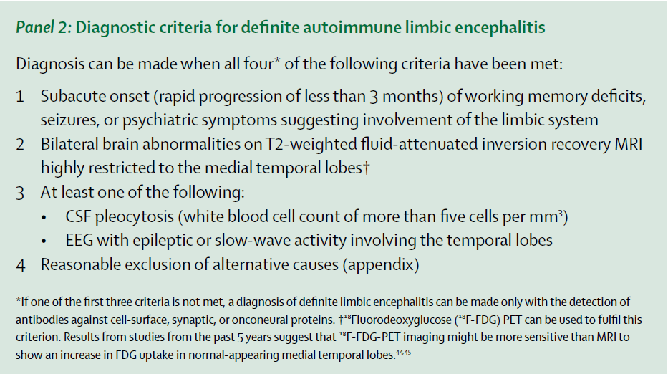

Slide 24
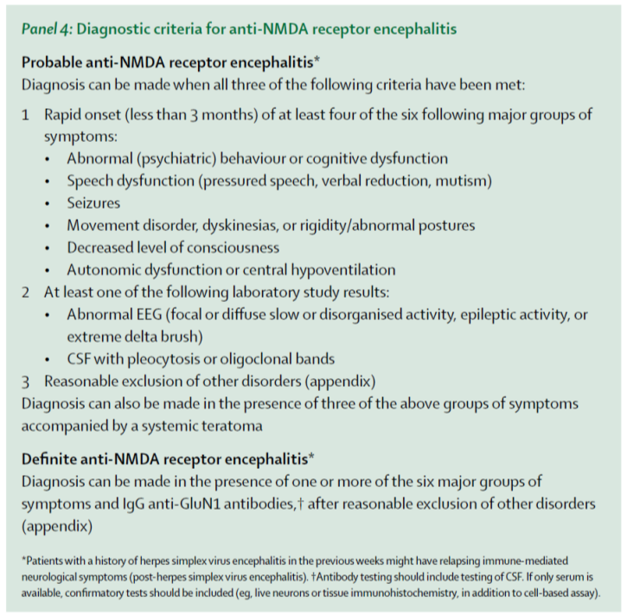

Slide 25
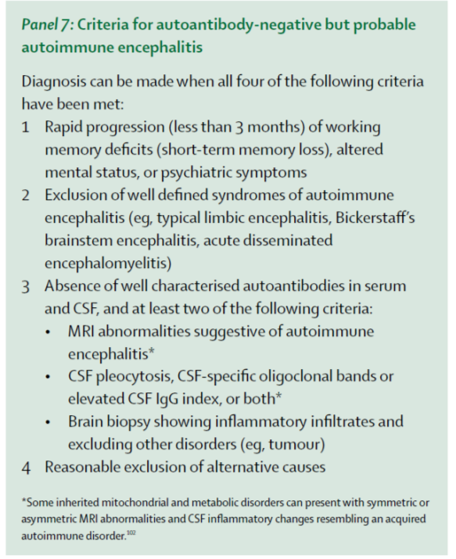

Slide 26
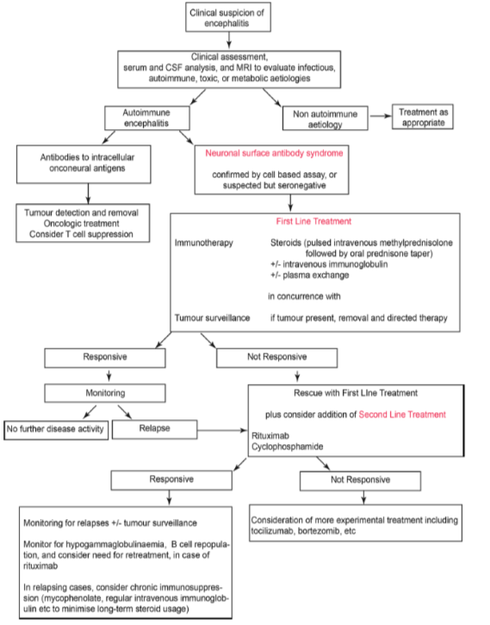
Ramanathan S, Al-Diwani A, Waters P, Irani SR. The autoantibody-mediated encephalitides: from clinical observations to molecular pathogenesis J Neurol. 2019

Slide 27
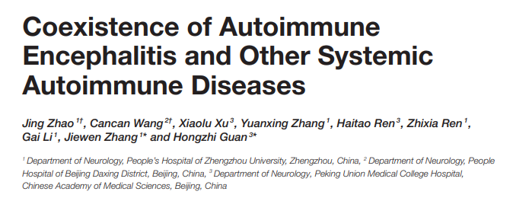

Slide 28
