Slide 1
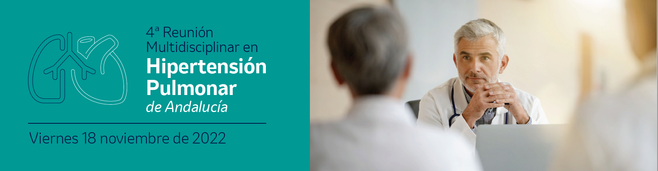
Estratificación y Pronóstico: ¿Que echamos en falta?
Dr. Alejandro Recio Mayoral
Coordinador Unidad Multidisciplinar de HP.
Cardiología
H.U. Virgen Macarena, Sevilla
@areciomayoral

Slide 2
Conflict of interest
Dr. Recio Mayoral
  Advisory board, drug safety monitoring (DSMB) and speakers honoraria over the past five years for many of the companies involved in PH including including Actelion, MSD and Janssen
I receive fee for this presentation
Disclosure
Este Evento está organizado y financiado por MSD
Los puntos de vista u opiniones expresados en las presentación son exclusivamente del ponente y no necesariamente coinciden con los puntos de vista de MSD

Slide 3
2022 ESC/ERS PH guidelines: what is new?
Humbert M et al. Eur Heart J. 2022 Oct 11;43(38):3618-3731.
doi: 10.1093/eurheartj/ehac237.

Slide 4
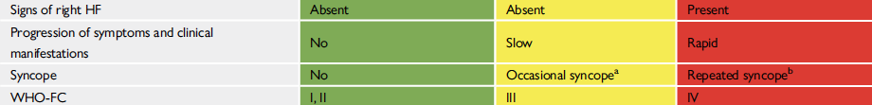
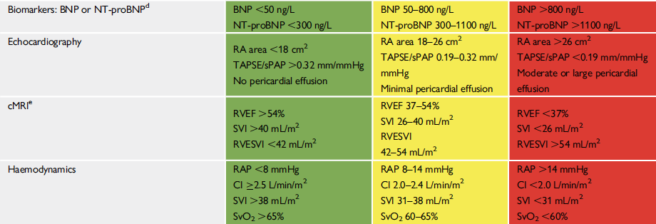
Comprehensive risk assessment in PAH
Clinical evaluation
Physical capacity
Risk assessment for patient with PAPm>25 and PAWP<15
RV function
Humbert M et al. Eur Heart J. 2022 Oct 11;43(38):3618-3731.
doi: 10.1093/eurheartj/ehac237.

Slide 5
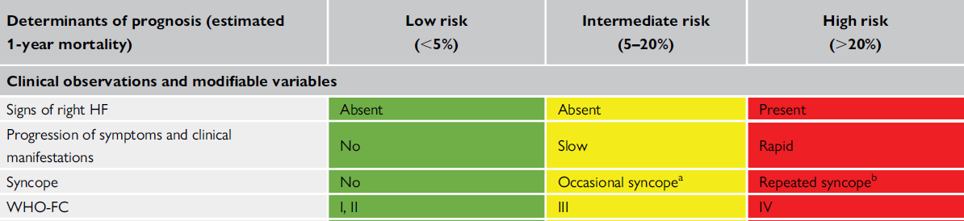
Diuretics should be considered?
Heavy exercise or occasional orthostatic syncope??
Most of the proposed variables and cut-off values are based on expert opinion.
Humbert M et al. Eur Heart J. 2022 Oct 11;43(38):3618-3731.
doi: 10.1093/eurheartj/ehac237.

Slide 6
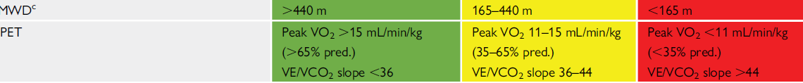
6MWD based on COMPERA study
Functional capacity III>>II
PAH idiopathic/CTD/CHD 55.4%/20.2%/14.1%...
  But prognosis can vary between diferent etiologies
Monotherapy/Double therapy 66.6%/27.1%
Improvement in 6MWT had considerably less predictive value on mortality and survival than deterioration
Adding SaO2 measured by pulse oximetry and heart rate responses may improve prognostic relevance
Humbert M et al. Eur Heart J. 2022 Oct 11;43(38):3618-3731.
Zelniker TA et al. Clin Res Cardiol. 2018 Jun;107(6):460-470
Notes:
findings still await confirmation in large multicentre studies.

Slide 7
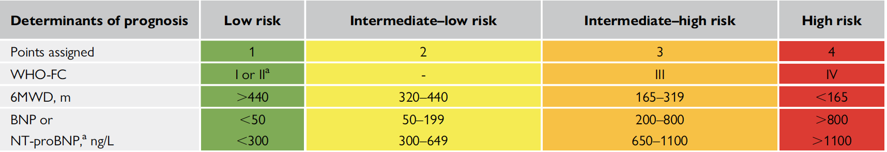



Simplified four-strata risk-assessment tool
Humbert M et al. Eur Heart J. 2022 Oct 11;43(38):3618-3731.
doi: 10.1093/eurheartj/ehac237.

Slide 8
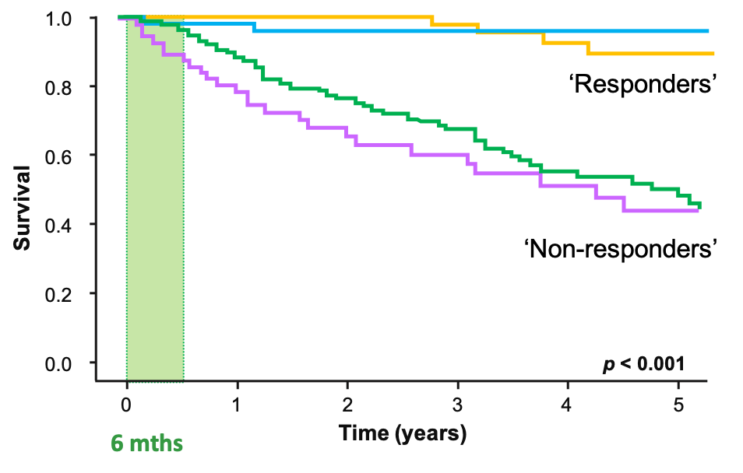
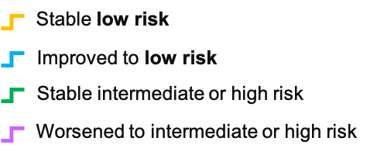
First follow up visit
  The first follow-up visit is the most important, because with that risk assessment we can determine if the patient is a responder and predict their likely long-term response to initial starting therapy and decide on the need for escalation.
Kylhammar D, et al. Eur Heart J 2018; 39:4175-81:
Notes:
How do you follow-up patients with PAH?
Which do you think is the most important visit?

Slide 9
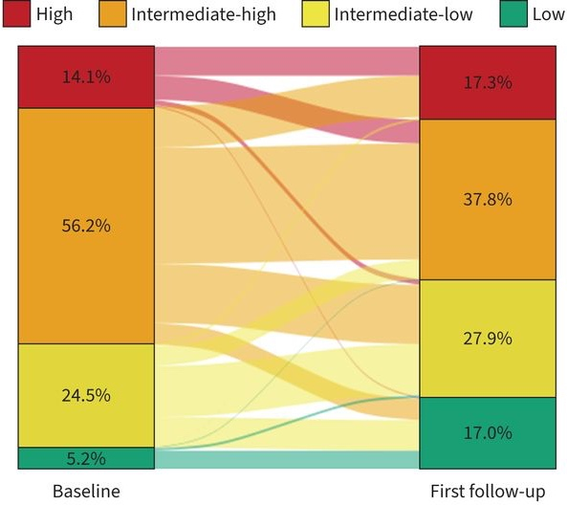

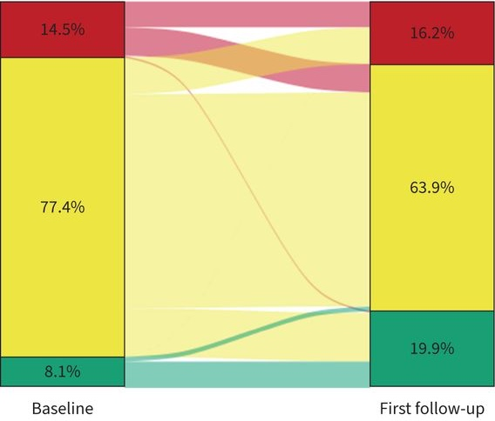

A 4-strata risk assessment model for PAH from COMPERA 2.0
Change in risk from baseline to first follow-up
High risk
Sequential triple combination, including
IV/SC PGI2
Initial triple combination, including
IV/SC PGI2
Intermediate risk
Add PO PGI2/switch from PDE5F to sGCs
Initial double oral combination
Low risk or
Hoeper MM, Pausch C, Olsson KM, et al. Eur Respir J 2021; in press https://doi.org/10.1183/13993003.02311-2021).
Notes:
Do we have enough evidence to “optimize” treatment or must we intensify to triple therapy using the 3 therapeutic pathways quick in time?

Slide 10
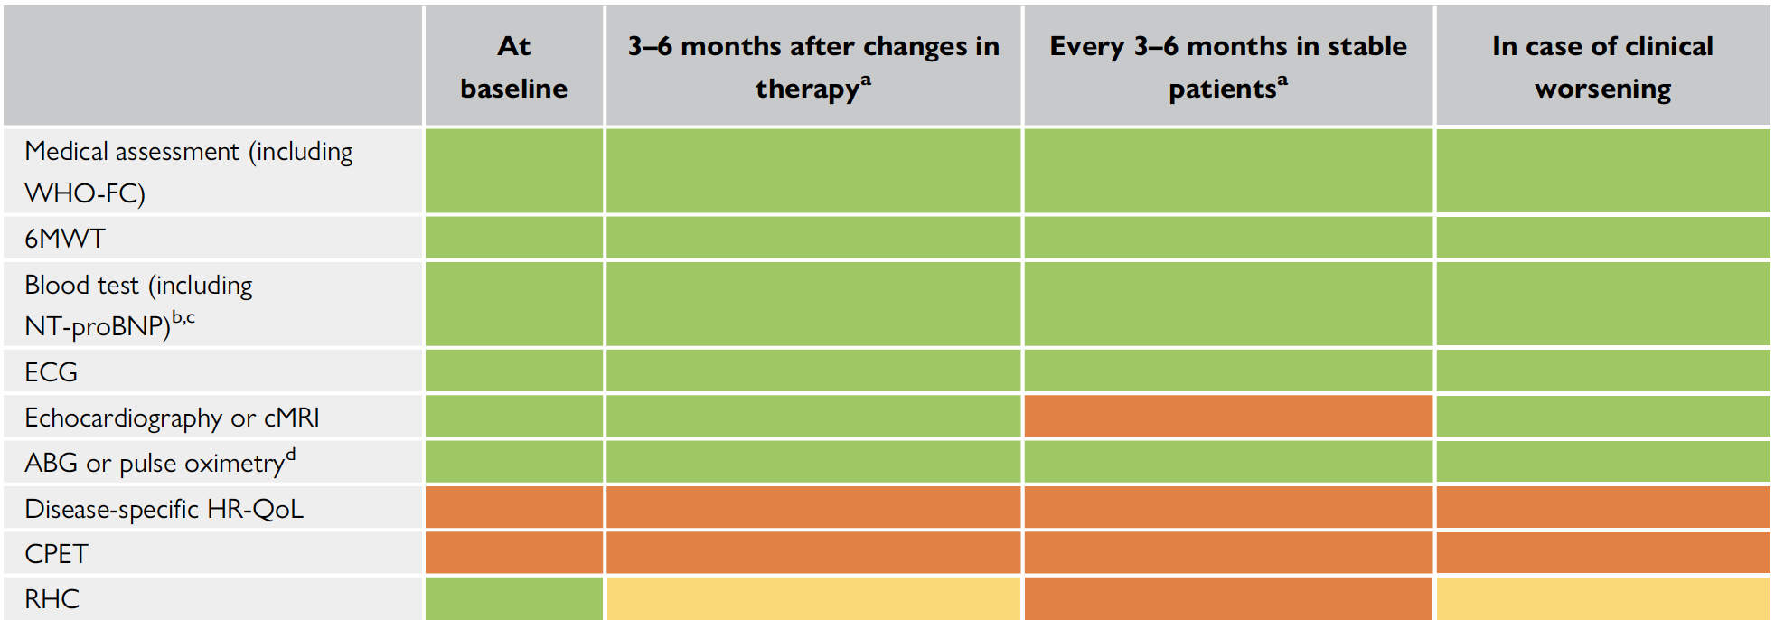
Assessment and timing for the follow-up of patients
Humbert M et al. Eur Heart J. 2022 Oct 11;43(38):3618-3731.
doi: 10.1093/eurheartj/ehac237.

Slide 11
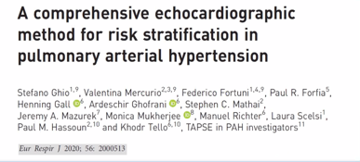

Slide 12

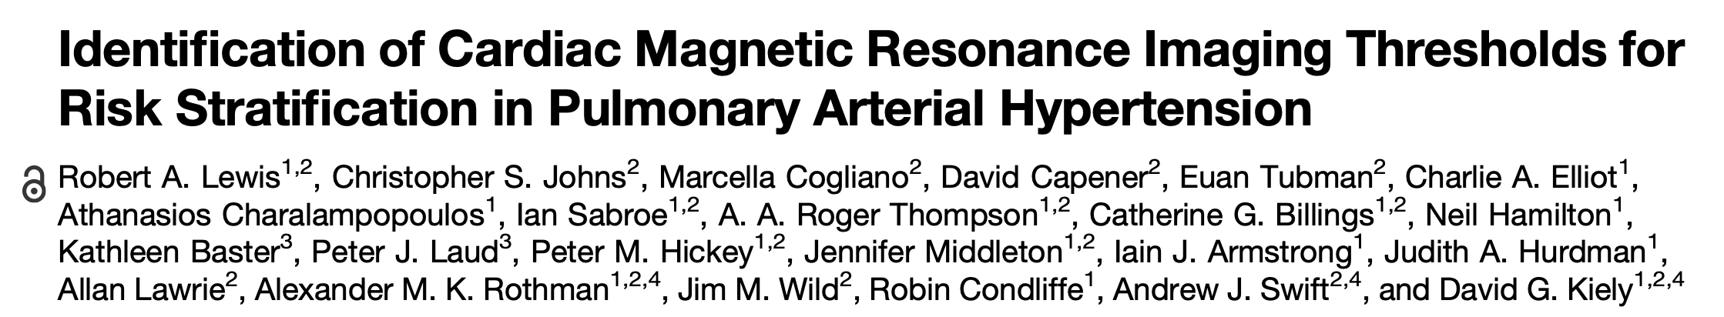
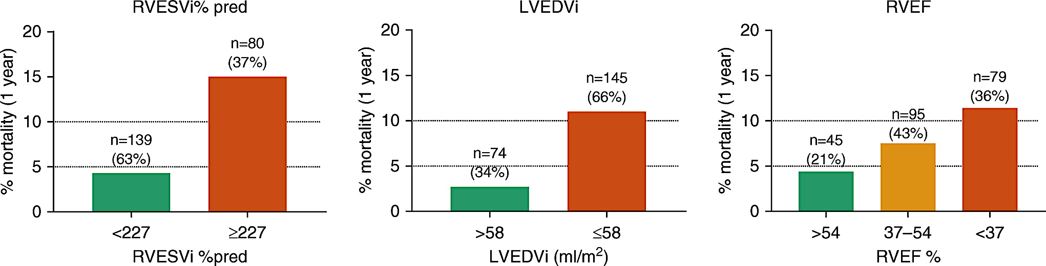
ASPIRE (Assessing the Spectrum of Pulmonary Hypertension Identified at a Referral Center)
% pred: percentage predicted for age and sex; LVEDVI: left ventricular end-diastolic volume index; RVEF: right ventricular ejection fraction; RVESVI: right ventricular end-systolic volume index.
Lewis RA, et al. Am J Resp Crit Care Med 2020; 201:458-68.

Slide 13
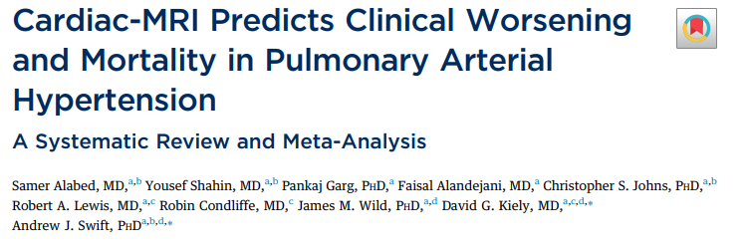
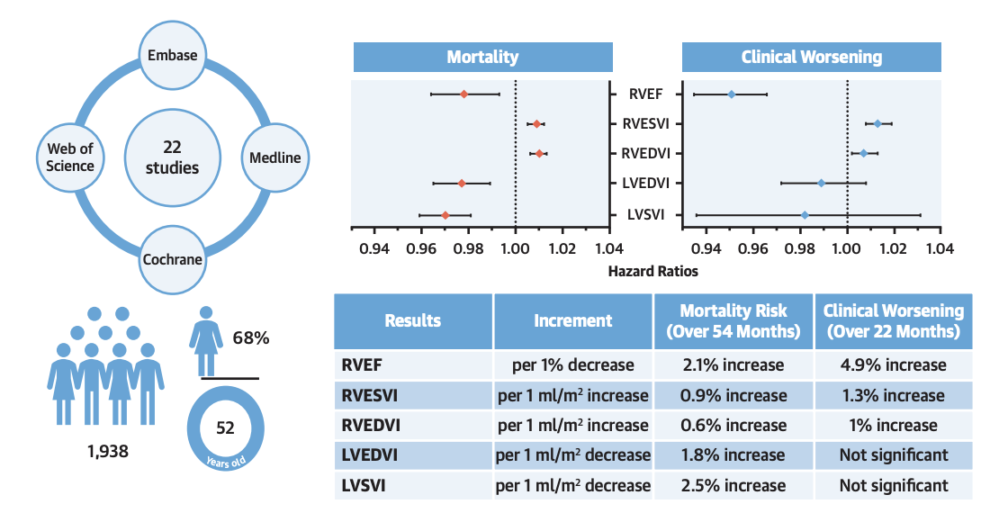
Alabed S, et al. J Am Coll Cardiol.Imag 2021; 2021 May;14(5):931-942.

Slide 14
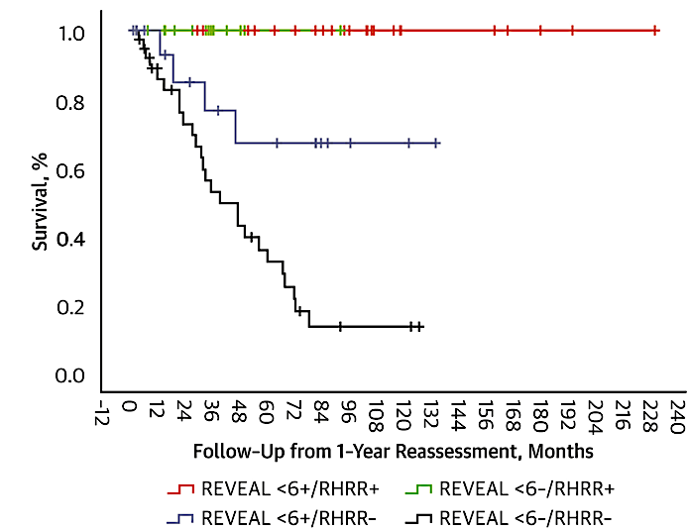
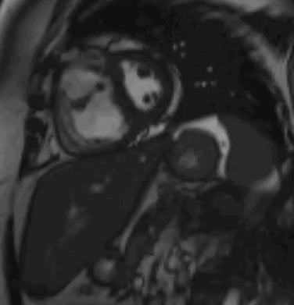

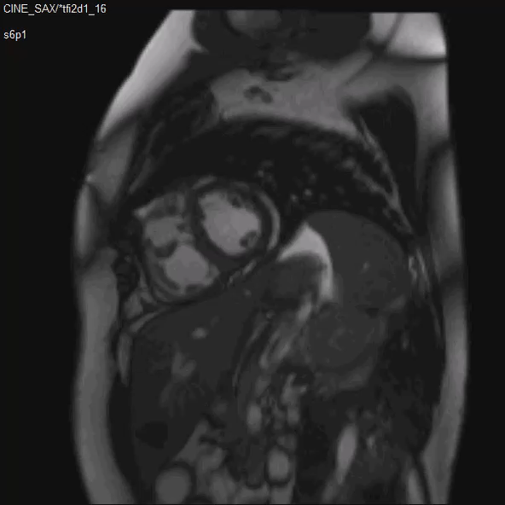
Right heart reverse remodeling, prognostic relevance
Badagliacca R, et al. JACC Cardiovasc Imaging. doi:10.1016/j.jcmg.2020.04.005

Slide 15
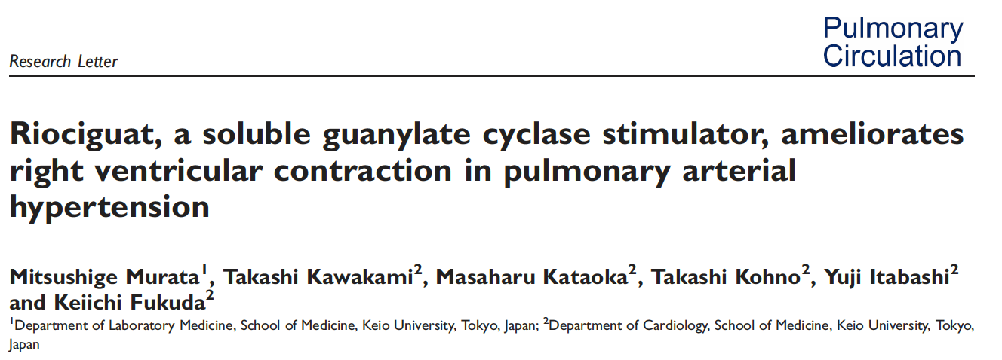
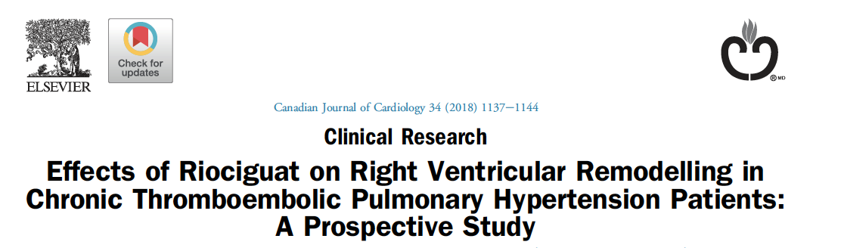
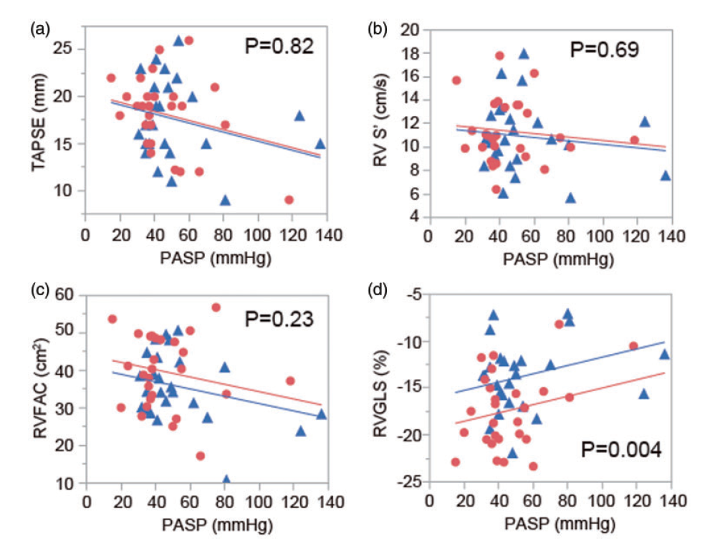
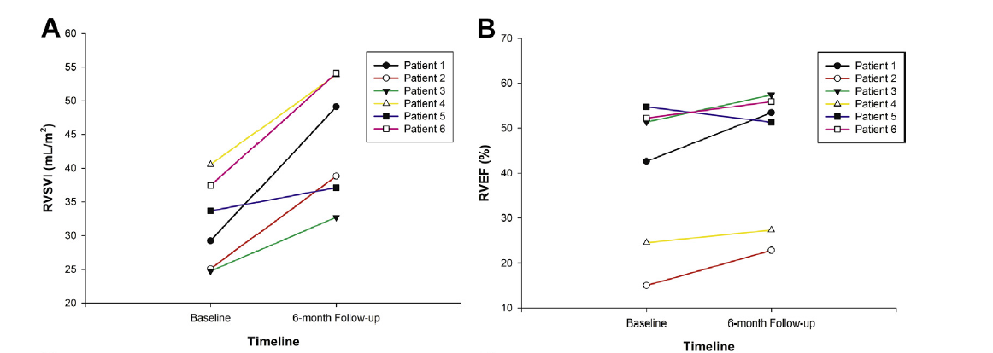
Ahmadi A et al. Canadian Journal of Cardiology 34 (2018) 1137e1144
Murata M et al. Pulmonary Circulation 2017; 8(1) 1–4

Slide 16
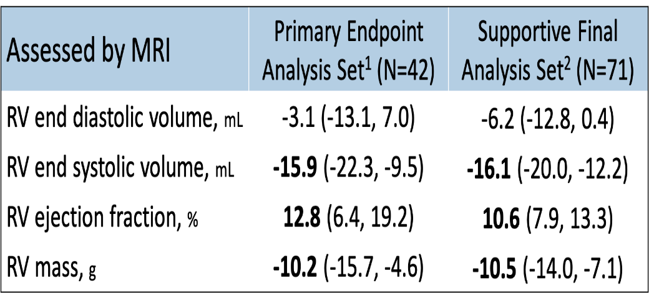
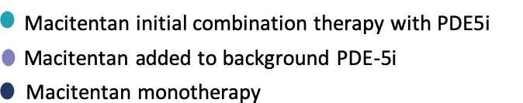
12 ml
RVSV
38%
PVR
RVSV change from baseline to Week 26, mL
+ 12.0 (8.4, 15.6)
p<0.0001
0.62 (0.56, 0.69)
p<0.0001
Vonk Noordegraaf A, et al, Oral Presentation at The International Society For Heart And Lung Transplantation Annual Meeting, April 22 – 25, 2020; Virtual Congress
Rosenkranz S, et al. Oral Presentation at American Congress Of Cardiology, March 16 – 18, 2019; New Orleans, United States

Slide 17
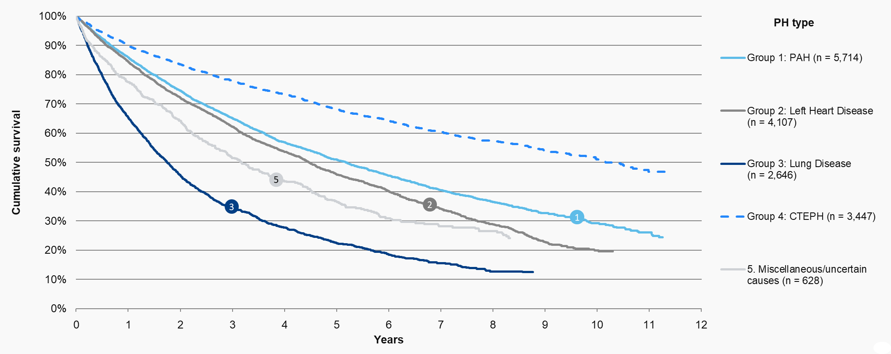

Survival analysis: PH type- Survival curves
National Pulmonary Hypertension Audit, 12th Annual Report - NHS Digital. 20 Jan 2022. https://digital.nhs.uk/data-and-information/publications/statistical/national-pulmonary-hypertension-audit/12th-annual-report#

Slide 18
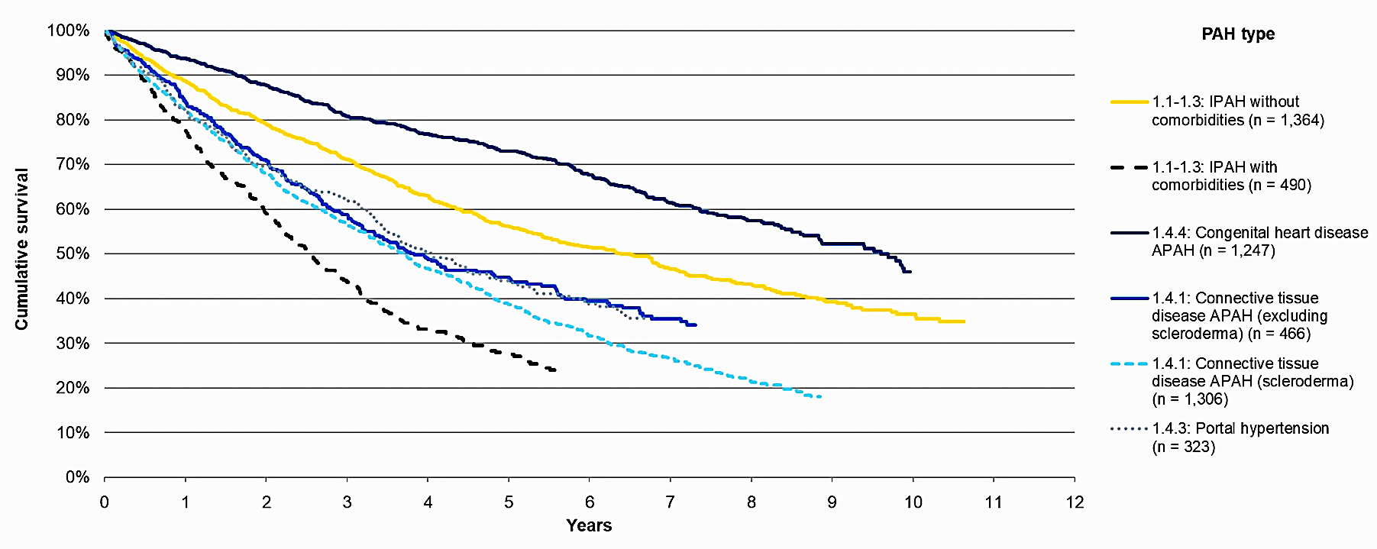
Survival analysis: PAH type – Mortality curves
National Pulmonary Hypertension Audit, 12th Annual Report - NHS Digital. 20 Jan 2022. https://digital.nhs.uk/data-and-information/publications/statistical/national-pulmonary-hypertension-audit/12th-annual-report#

Slide 19
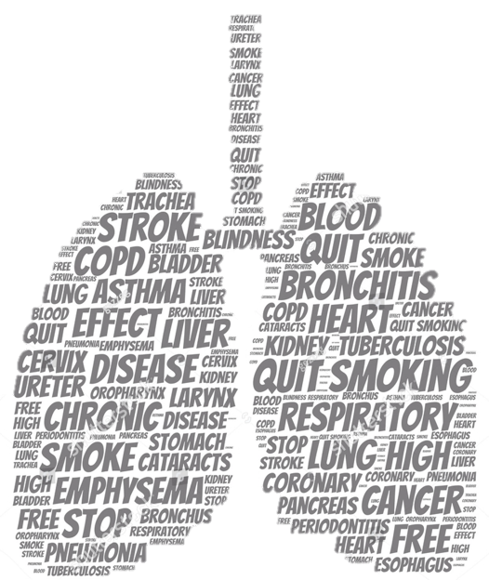

Patient with PH and cardiopulmonary comorbidities

Slide 20





Muchas gracias
Organiza:
Con el aval de:
Con la colaboración de:

