Slide 1




Reposicionamiento de Fármacos en Enfermedades Autoinmunes Sistémicas
---
XI Seminario de la Asociación Andaluza de Enfermedades Autoinmunes
Córdoba 17 de junio, 2023
Joaquín Dopazo
Computational Medicine Platform, Fundación Progreso y Salud,
Instituto de Biomedicina de Sevilla (IBIS)
FPS/ELIXIR-es; CIBERER
Hospital Virgen del Rocío, Sevilla, Spain
http://www.clinbioinfosspa.es
@xdopazo, @ClinicalBioinfo

Slide 2

Digital twins
Digital twins are virtual replicas of physical objects or systems that can be used to simulate and analyze real-world events.
In healthcare, digital twins have been proposed as a methodology to improve patient outcomes.
The use of this concept in medicine is questionable as it requires full knowledge of the simulated system, something we are far from in medicine.

Slide 3
Strategies towards the digital twin
We need a paradigm shift in the study of diseases.
We need to:
Focus on disease mechanisms instead on individual diseases
Focus on drug repurposing
Advantages:
Knowledge and treatments break the disease barrier
Known security profile
Known mechanism of action
Already registered
Problems:
Most of the detail of disease mechanisms are unknown yet
The relationships between targets of registered drugs and disease mechanisms are unknown yet
Solutions:
Mechanistic models combined with causal machine learning
Causal machine learning
Disease
Drug

Slide 4
Mechanistic models
Mechanistic models provide a quantitative representation of the functioning of cellular pathways.
Use pathways to define the way proteins and other molecules interact among them to trigger functional activity in the cell
Define functional endpoints in the pathways that are related to cell, organ or individual phenotypes
Use gene expression data (easy to measure but difficult to interpret) to estimate the level of activity in relevant cell functionalities (difficult to measure but easy to interpret)

Slide 5

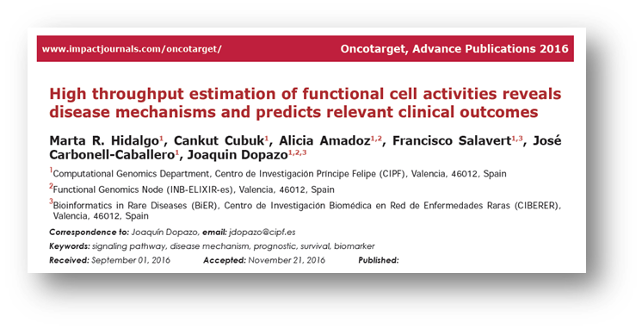


Mechanistic models
Pathway
Function triggered
A
E
The model is built using the wiring among proteins provided by the pathway.
The cell activity/functionality is inferred from the gene expression activity measured (RNA-seq)
C
D
G
B
F
Genes | A | B | C | D | E | F | G
Condition A
Condition B
A
E
A
E
C
D
G
C
D
G
B
F
B
F
Notes:
<número>

Slide 6
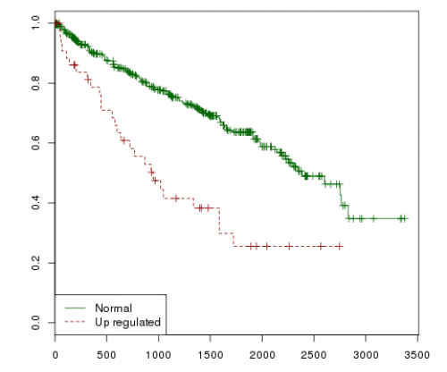
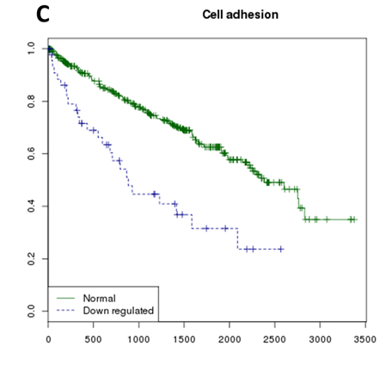
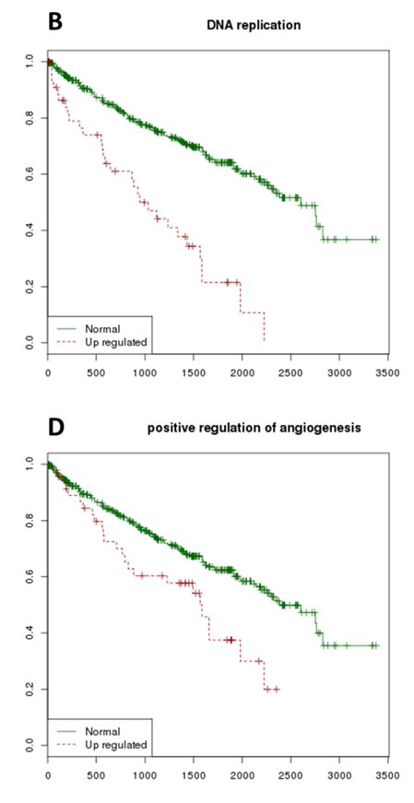
Mechanistic models explain cancer hallmarks
Anti-apoptosis
DNA replication= f(gene₁, gene₂, … gene_{n})
DNA replication function is a construct: the activity is inferred not measured
Hanahan, Weinberg, 2011 Hallmarks of cancer: the next generation. Cell 144, 646

Slide 7
Mechanistic models for causal predictions
A specific condition can be used to generate simulated KOs (or overexpression) and studying their functional consequences on the cell / phenotype
A
E
C
D
G
B
F
Genes | A | B | C | D | E | F | G
Condition
Simulated KO gene E |  |  |  |  | X
Simulated KO gene D |  |  |  | X
A
E
C
D
G
B
F
Simulated KOs are obtained from the original condition, changing the expression of one or several genes
A
E
C
D
G
B
F

Slide 8
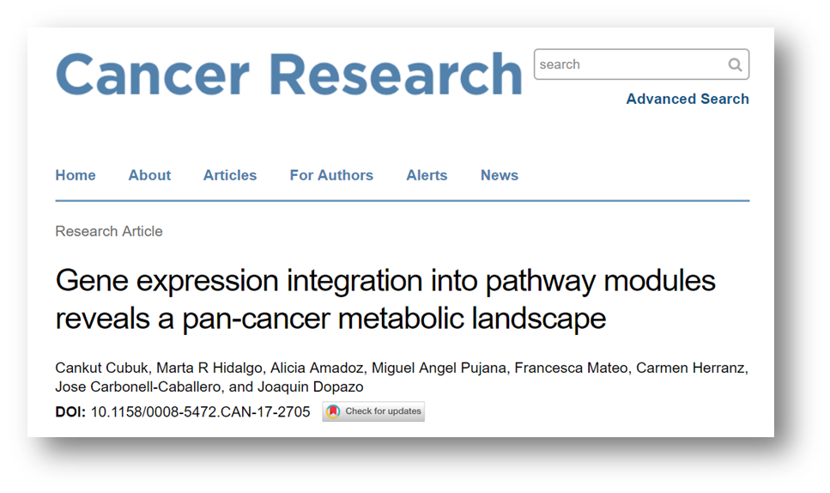
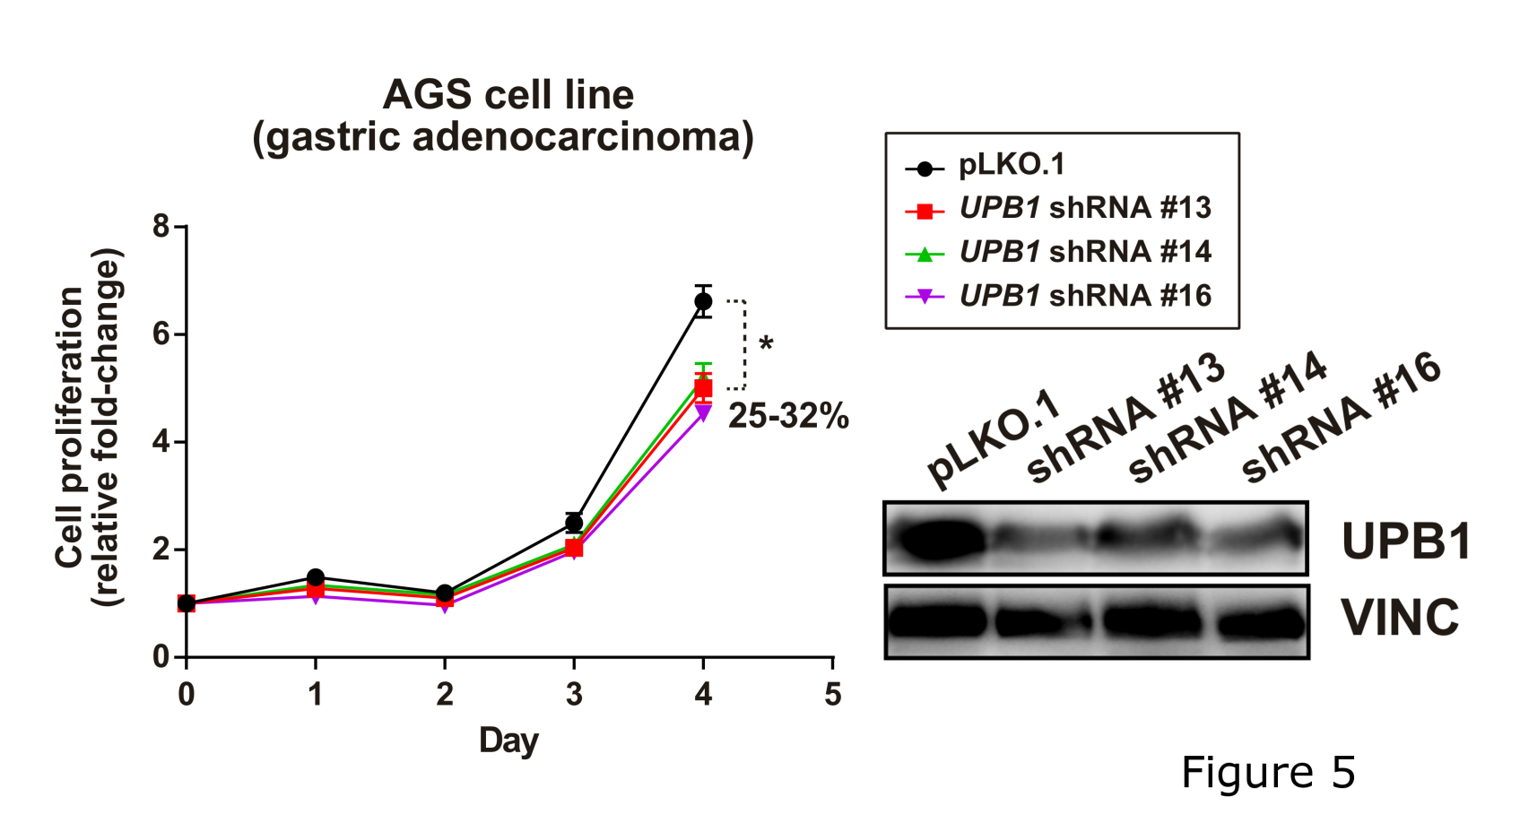
Model prediction with experimental validation
Pyrimidine degradation pathway was predicted to be an onco-module in gastric cancer cell lines. Predicted genes that switch the pathway off are DPYD, DPYS (confirmed in Achilles) and UPB1
The prediction was validated in vitro, confirming the accuracy of the model

Slide 9
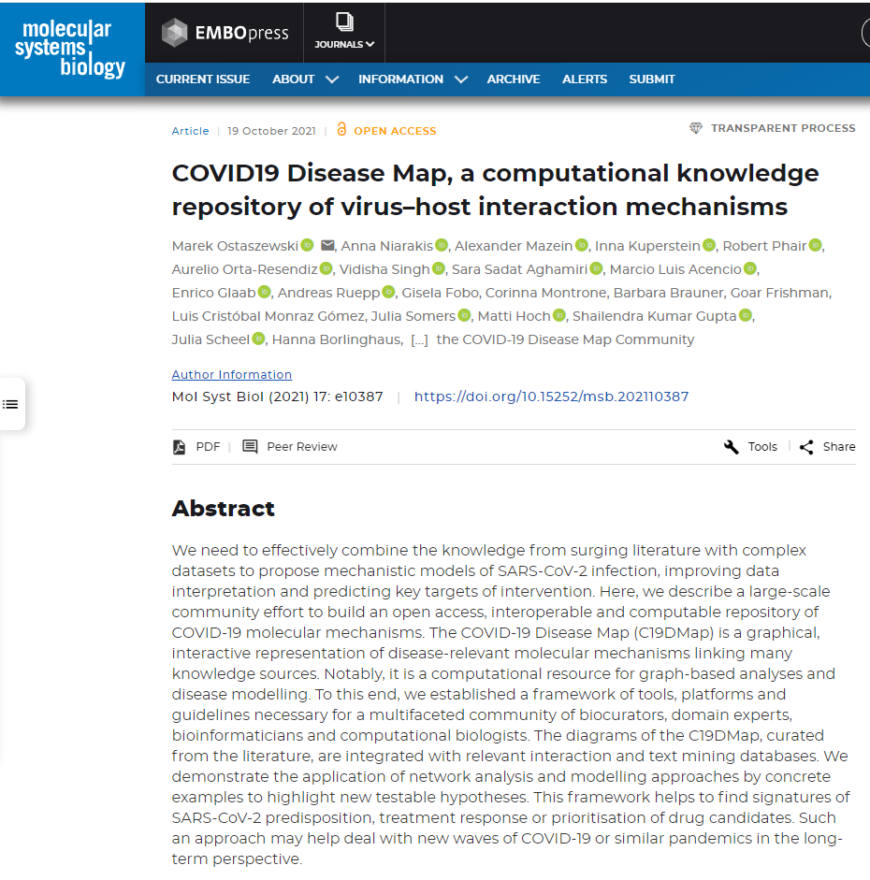
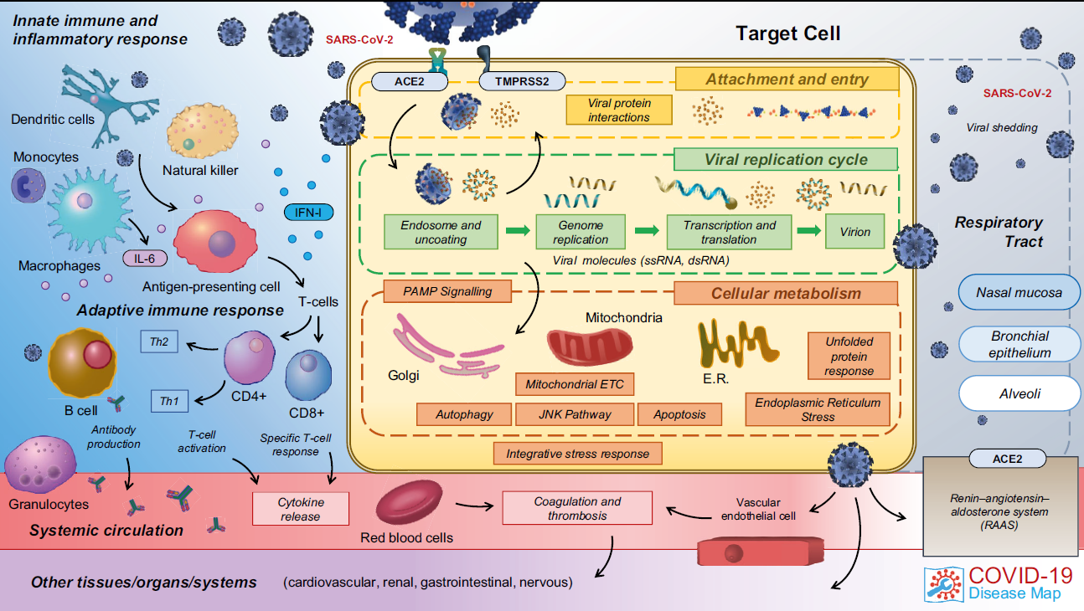
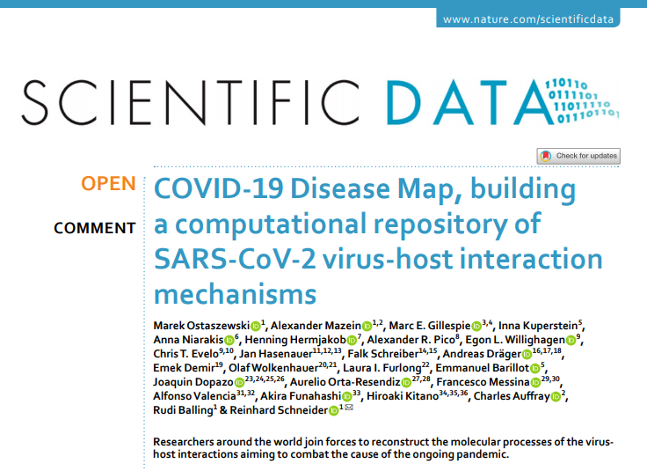
Taking advantage of the COVID-19 disease map
The C19DMap is a constantly evolving resource, refined and updated by ongoing biocuration, sharing and analysis efforts. Currently, it is a collection of 42 diagrams containing 1,836 interactions between 5,499 elements, supported by 617 publications and preprints.
Is a collaborative effort involving over 230 biocurators, domain experts, modelers and data analysts from 120 institutions in 30 countries

Slide 10
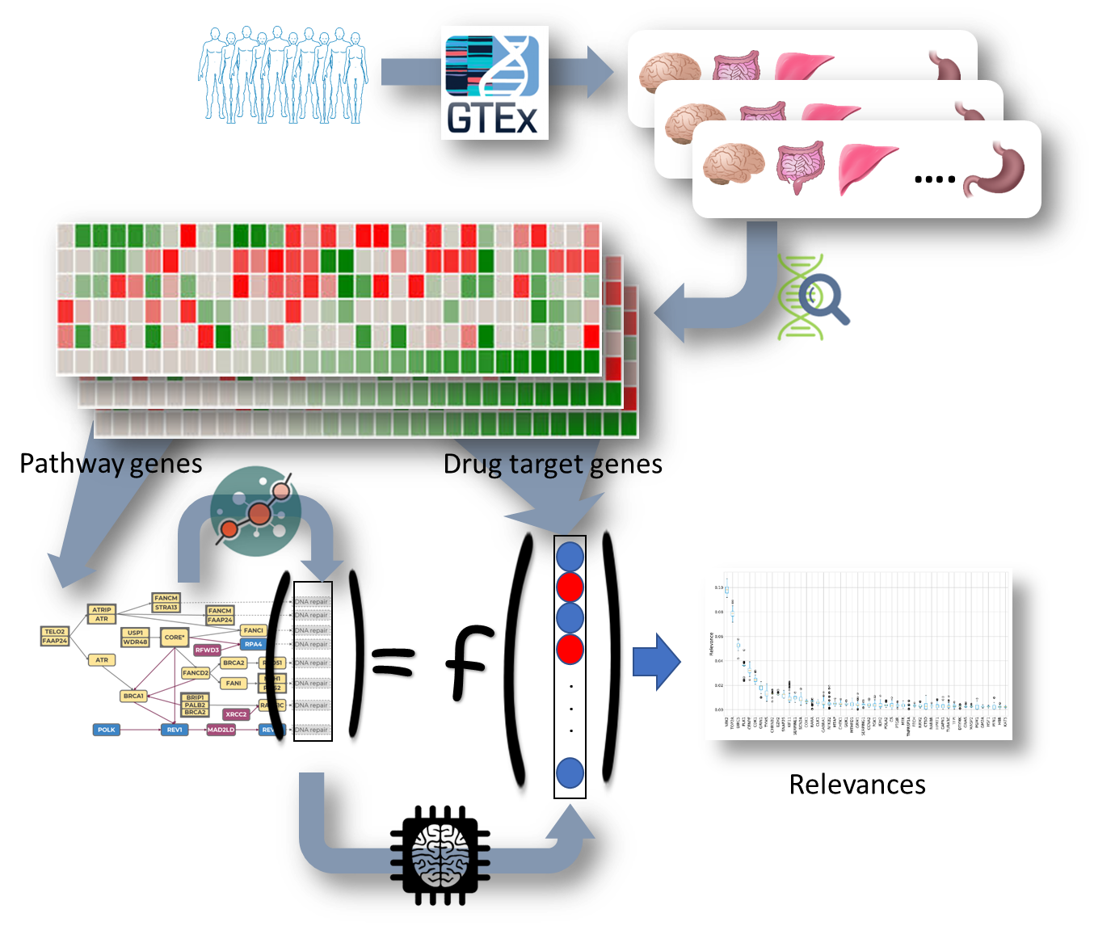
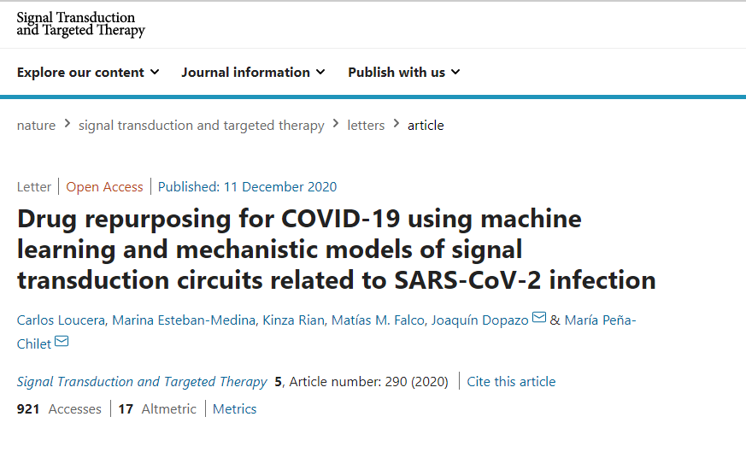

Machine learning to find potential causal relationships
Machine learning (Multi-Output Random Forest regressor combined with SHapley Additive exPlanations) are used to detect potential causal relationships between known drug targets and the activity of COVID-19 hallmarks

Slide 11
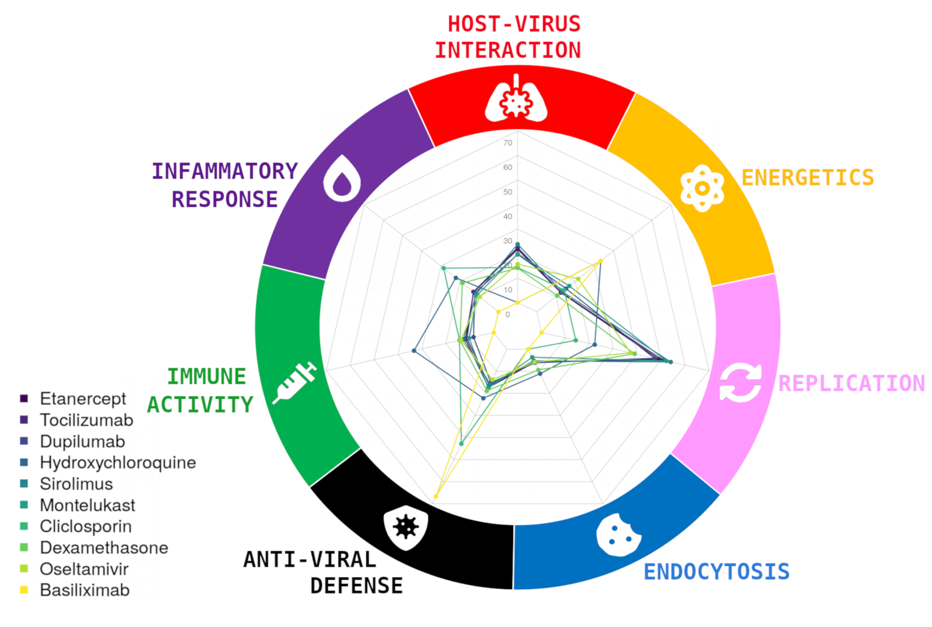
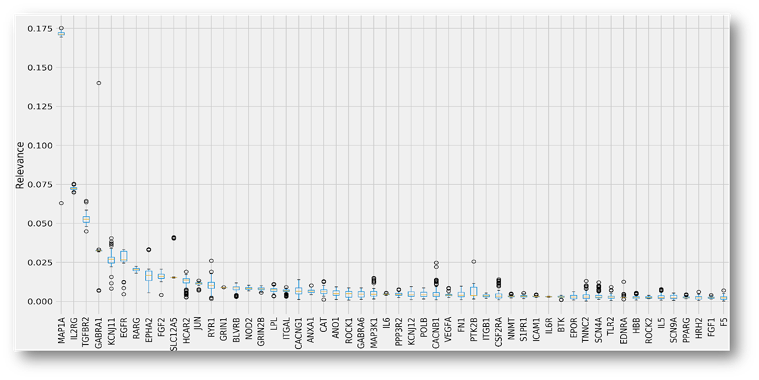
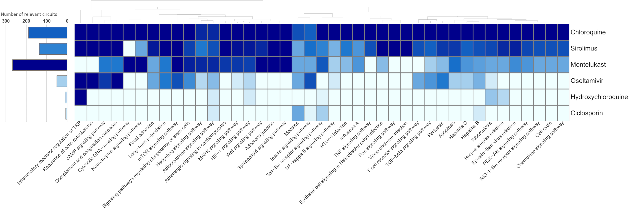
Relevance: impact of potential therapeutic targets over the COVID-19 disease map
Best therapeutic target for each signaling circuit
Specific hallmarks of the Disease can be targeted.
Some drugs affect to many signaling circuits (and consequently many hallmarks) and other ones ara highly specific of hallmark and even of circuit

Slide 12
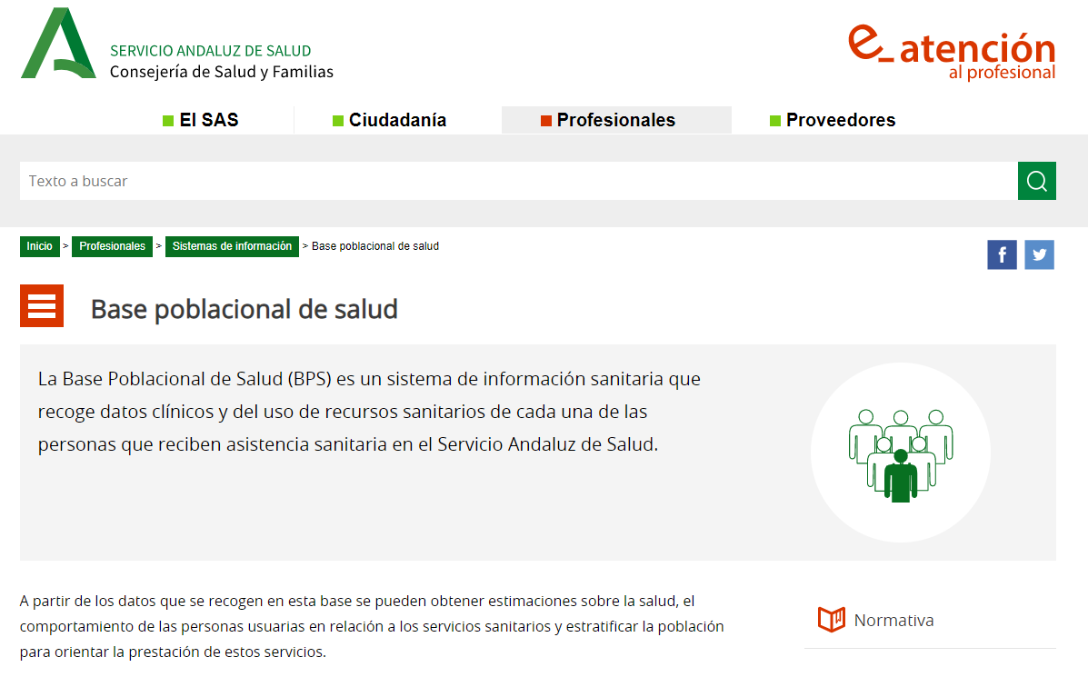

Real World Data validation (Real World Evidence):
The Population Health Database:
A comprehensive repository with all the clinical information (EHRs) of more tan 15 million patients of the Andalusian Public Health System.
BPS is used for secondary data analysis

Slide 13
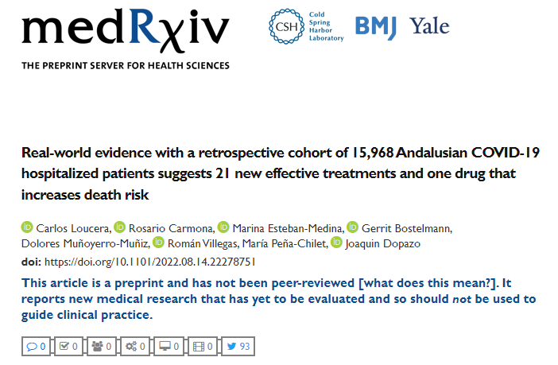
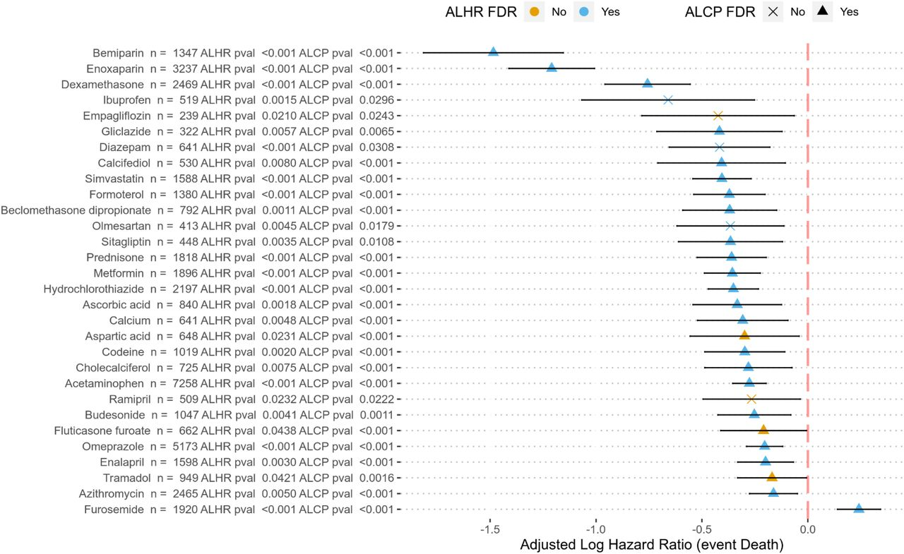

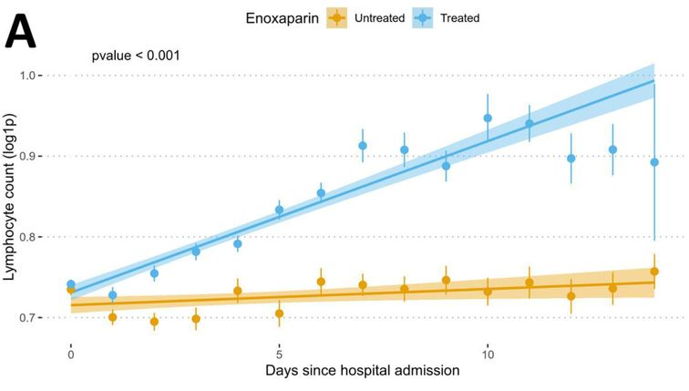
Real World Evidence of the accuracy of the predictions from the ML+model strategy
A retrospective cohort of 16.401 patients was used to demonstrate the protective effect of 21 drugs in COVID-19 hospitalized patients.
There is a significant enrichment of drugs predicted as repurposable by the machine learning model among those with a significant protective effect (X2 = 6.674, p-value = 0.0098)

Slide 14
Data used
All diseases vs Controls
TYPE
Controls
Mixed connective tissue disease (MCTD)
Pulmonary alveolar proteinosis (PAPs)
Rheumatoid arthritis (RA)
Stevens-Johnson Syndrom (SjS)
Systemic lupus erythematosus (SLE)
Systemic sclerosis (SSc)
Undifferentiated connective tissue disease (UCTD)
Nº Samples
497
75
81
273
281
340
280
111
Limma model
Covariates → type + age + gender + center + pool + RIN
Results (Adj.p-value < 0.05)
340 differentially activated circuits
61 differentially activated pathways

Slide 15


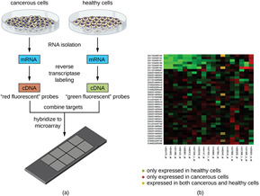
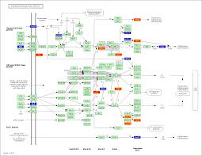
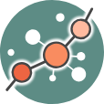

Estudio en lupus
Control
Lupus
Actividad diferencial
Expresión génica
Modelo mecanistico del mapa de lupus: 288 circuitos de señalización

Slide 16
Fármacos con dianas en los circuitos de señalización
Etanercept: TNF, FCGR1A, FCGR2A, FCGR2B, FCGR2C, FCGR3A, FCGR3B, LTA, C1QA
Anakinra: IL1R1
Adalimumab: TNF
Infliximab: TNF
Azathioprine: RAC1
Leflunomide: PTK2B
Abatacept: CD80, CD86
Hydroxychloroquine: TLR7, TLR9
Ustekinumab: IL12B
Tocilizumab: IL6R
Belimumab: TNFS13B
Sifalimumab: IFNA2

Slide 17
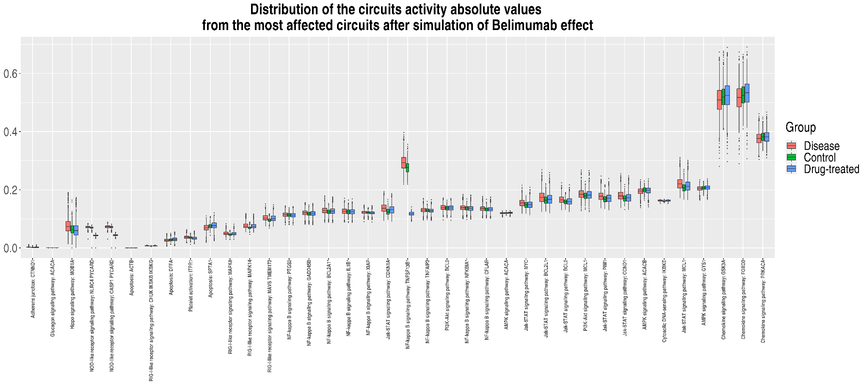
Aplicaciones de la estrategia a Lupus
Entendiendo como funciona un fármaco: ej. belimumab, usado en tratamiento de lupus.

Slide 18
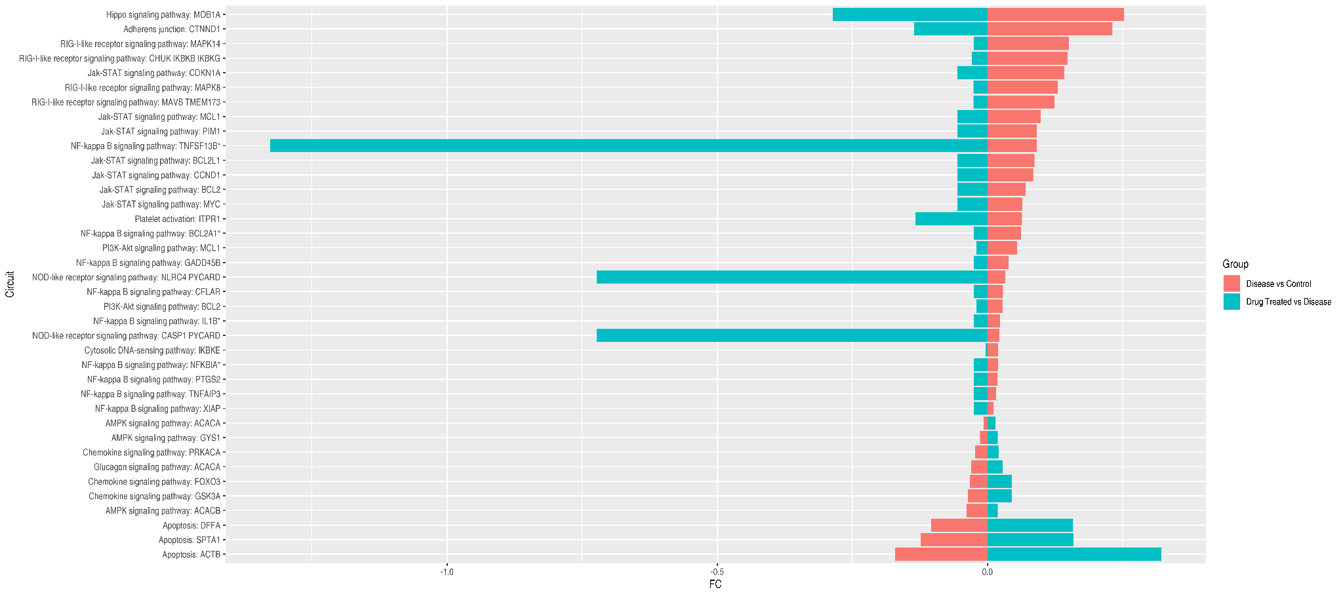
Simulación del efecto de un fármaco
Efecto simulado de belimumab sobre la actividad de los diferentes circuitos de señalización.
Circuitos en los que la actividad compensa el cambio de actividad de sano a enfermo

Slide 19
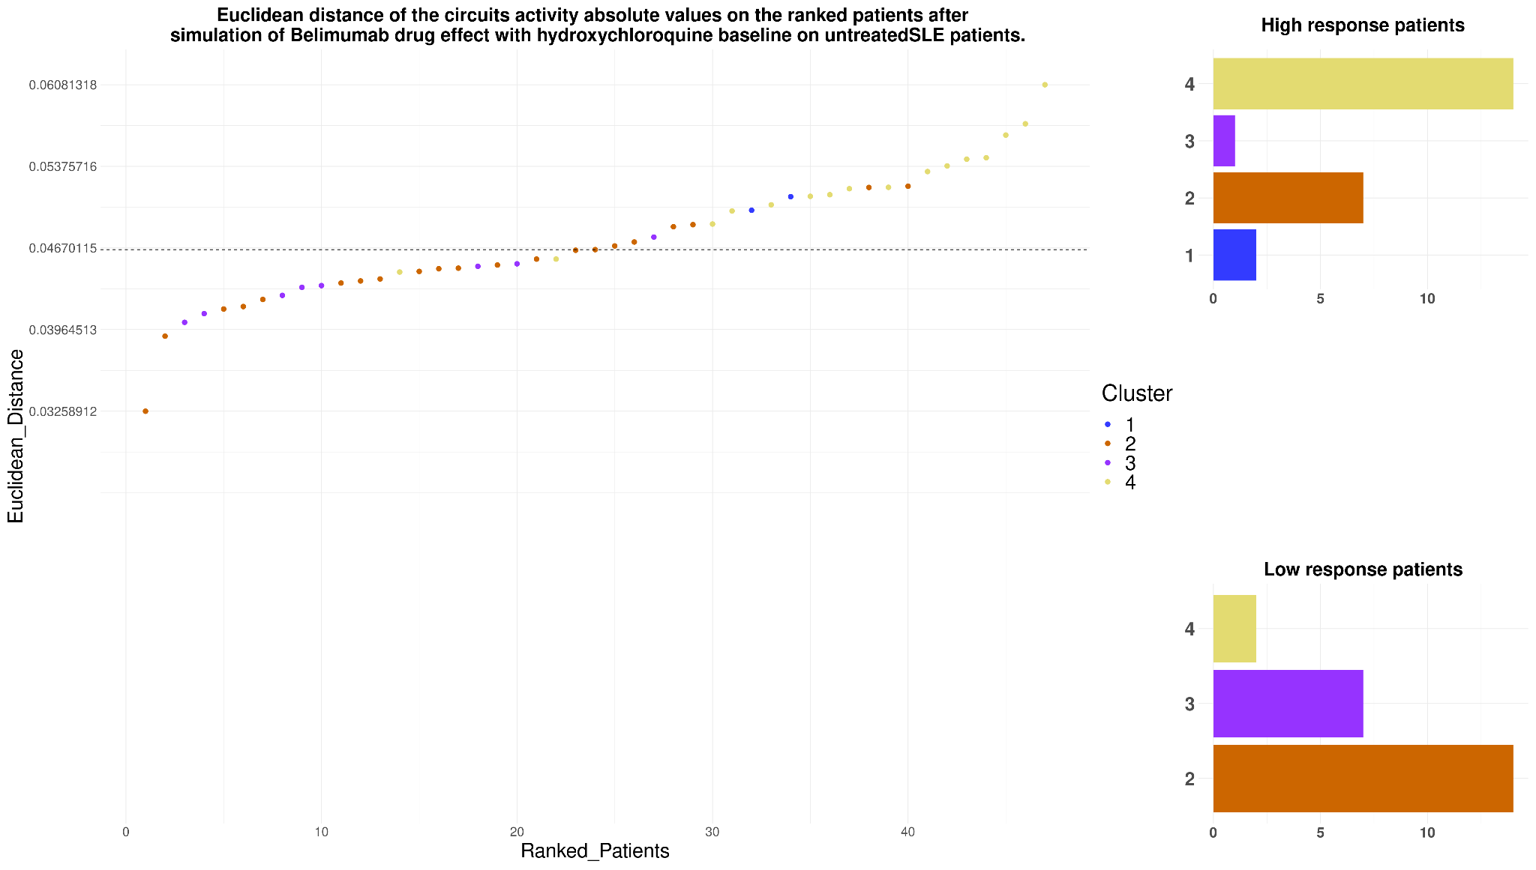
El efecto depende del paciente
Cada punto representa un paciente. En el eje Y se representa la intensidad del efecto del belimumab sobre cada paciente.
Los clusters han sido definidos en base a datos moleculares por el grupo de la Dra. Marta Alarcón (Genyo) y claramente tienen una relación con la respuesta al tratamiento

Slide 20

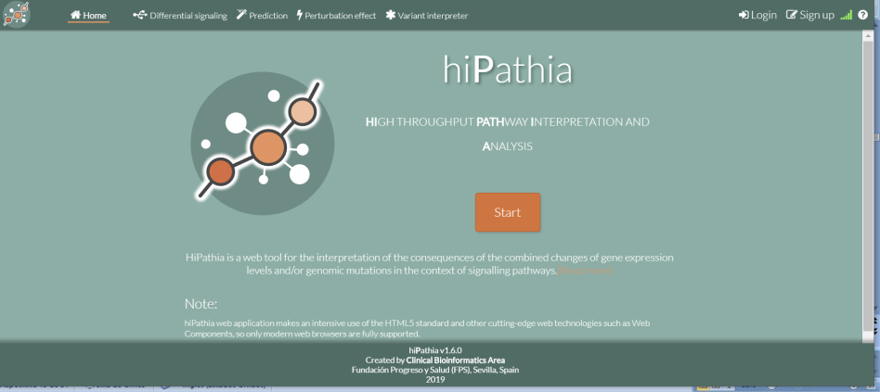
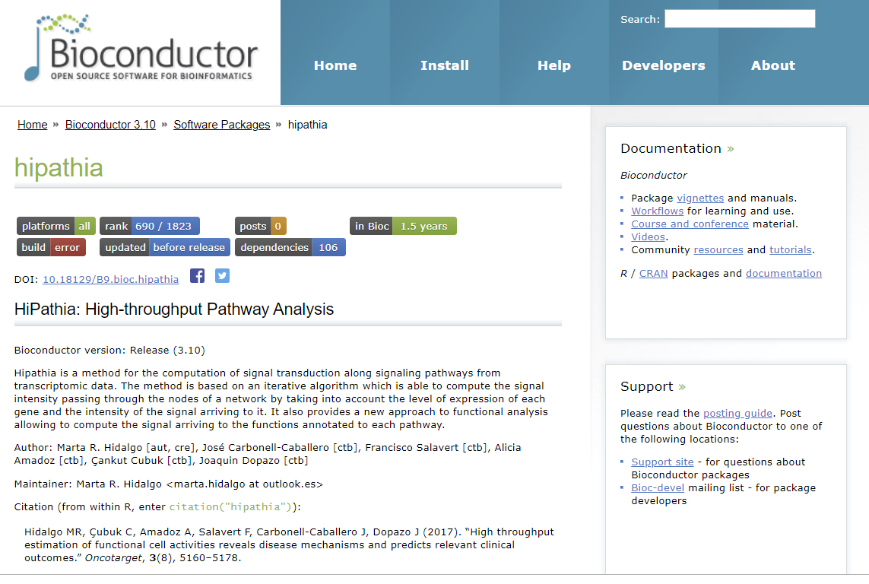

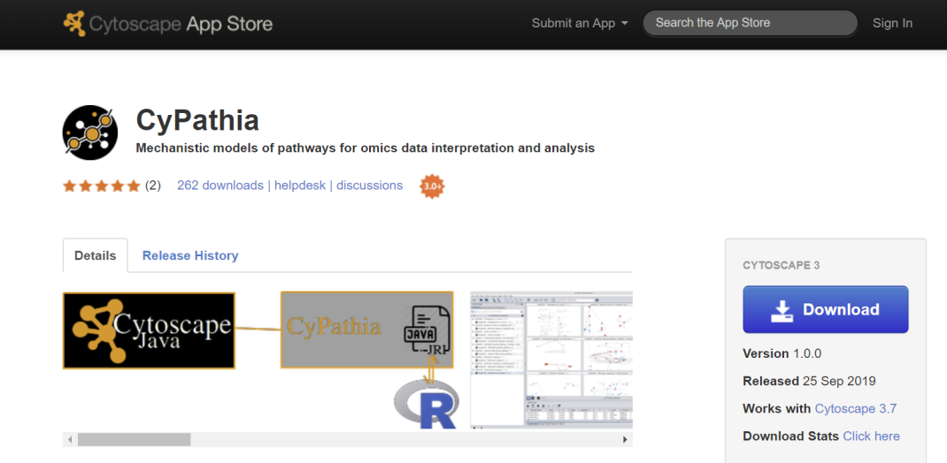

Open software implementing mechanistic models are available
http://hipathia.babelomics.org/
https://bioconductor.org/packages/release/bioc/html/hipathia.html
http://apps.cytoscape.org/apps/cypathia

Slide 21

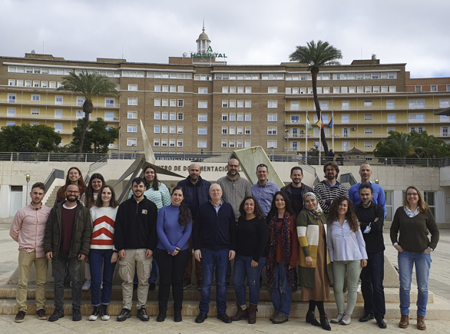






















Computational Medicine Platform, Fundación Progreso y Salud,
Hospital Virgen del Rocío, Sevilla, Spain;
Computational Systems Medicine, IBIS, Sevilla, Spain
and ...the FPS/ELIXIR-ES and CIBERER
Follow us on twitter
@xdopazo
@ClinicalBioinfo

